Slide 1


The Science of Reading
in Ohio Schools
The basics for families
go.osu.edu/literacyvideoseries
Notes:
30 secs
Welcome and thanks for coming today. We’ re so glad you are here!
We are here for you.
We are here today because we wanted to share with you some information about how kids learn to read and write, the Science of Reading, and what is called Structured Literacy
We are also here to give you some good resources to help you communicate more easily with your child’s teacher about their reading and writing.
AND we wanted to give you a chance to ask questions and connect with other families in the community.
A recording of some of the information you’ll hear today is available using the link on the screen.
Virtual Tip: Share the link in the chat or question/answer box.
go.osu.edu/literacyvideoseries

Slide 2
Introductions
Organization Name
Description
Mission Statement
(Organization Logo)
Facilitator Name
Title
Role
Facilitator Name
Title
Role
Notes:
40 secs
Introduce your organization….
Name and describe your organization.
You can include its logo and mission statement.
Introduce facilitators: Add pictures of facilitators, their title and role with regards to literacy.

Slide 3

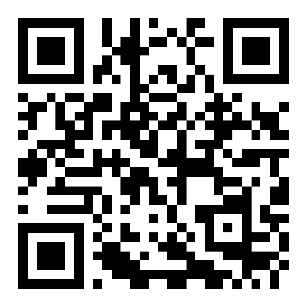
Visit the Family Engagement Center’s Website!
OhioFamiliesEngage.osu.edu
Notes:
30 secs
The Ohio Statewide Family Engagement Center at The Ohio State University developed this workshop for community partners in literacy.
We have taken the workshop and adapted it for [our school/organization] but have kept the core information the same.
We are glad to have The Ohio State and the Statewide Family Engagement Center as partners in supporting children’s success in school and life! They have lots of free resources for parents, so definitely check out the site sometime.
Virtual Tip: Share the link in the chat or question/answer box.

Slide 4
Learning Objectives
I can make connections with other families, my school, and community partners.
I can explain how science says reading and writing should be taught.
I can identify information, language, and resources needed to support and advocate for my child.
Notes:
30 secs
By the end of today’s presentation, we hope you can
make connections with other families, my school, and community partners.
explain how science says reading and writing should be taught.
identify information, language, and resources needed to support and advocate for my child.

Slide 5

Why we are here?
Work together
Ask good questions
Support your child
Notes:
1:10 min
Let’s start out today, with why this presentation was made for your family.
Well, we know that when we all work together*—schools, families, and community organizations like libraries—
When we all work together, it benefits everyone.
Everyone's job and life improves with support AND we can support each other better when we know more about what is going on in each other's world.
So, this session will help you as a family understand what’s being taught in school about reading and writing, and how it’s taught.
With this information, you can *talk to your child’s teacher more easily and ask good questions if you any have concerns.
Talking with their teacher, also helps the teacher to know and understand your child better.
You’ll also learn some little things you can do to support your child’s reading and writing at home.
Working together as partners and talking to each other often will give your child the *strong support they need to become a good reader and writer.

Slide 6

Overview
Learning to talk vs. Learning to read/write
The science of reading​
The structured literacy approach​
Questions to ask
Notes:
1 min
During this workshop today, We’ll talk about 4 main things.
Since reading and writing have to do with language, we'll start off by looking at:
How we *learn to talk versus how we learn to read and write
Then we'll learn about: What is this *Science of Reading and how the Science of Reading has helped to develop good reading and writing instruction called the
*Structured Literacy Approach; We'll talk about what we mean by "structure" and give you lots of examples of what Structured Literacy looks like in classrooms.
Finally, we'll give you some really good *questions to ask your child's teacher.
These questions will help you really get to know how your child is doing with their reading and writing at school- and will help you form that strong support network for them.
Let's get started by talking about how learning to read and learning to talk are related.

Slide 7

Greeting & Connect
Introduce yourself
Children’s names/ages
Favorite song, rhyme, or children’s story
Why you came
Notes:
3 minutes (Greeting Option #1)
We want to give you time to meet and get to know your neighbors!
Turn to your neighbor, introduce yourself, share your children’s names, ages, maybe your favorite rhyme, song, or children’s story and what motivated you to come today.
We’ll share for about 2 minutes and then come back together as a group.
(WAIT 2 minutes)
Thanks for sharing with each other! We have such a great group today.
Virtual Tip: Have participants share their greeting in the chat.

Slide 8
Greeting & Connect!
Family Engagement in Literacy Bingo
Say “Hello!”
  Find someone
  Introduce yourself
  Discuss something you each do from the bingo board
  Write that person’s name in the space
  Find someone new!
Who can be the first person to get a BINGO!
Notes:
5 minutes (Greeting Option #2)
For our literacy bingo game, we are going to get up and move! Find the bingo board on your table. When the time starts, you will
Find someone
Introduce yourself
Discuss something you each do from the bingo board
Write that person’s name in the space
Then find someone new!
Let’s see who can be the first person to get a BINGO!
[Optional: Provide a prize to the BINGO winner, like your school’s swag (pencil, pen, water bottle, etc.) or something from the community]
Go here to download and print copies of the BINGO game: https://ohiofamiliesengage.osu.edu/wp-content/uploads/2026/08/BINGO-FE-in-Literacy.docx
Virtual Tip: This activity cannot be done virtually.

Slide 9

Learning to Talk: It's natural!
ohiofamiliesengage.osu.edu
Notes:
1:10 min
Now let’s dig into how learning to talk is different than learning to read.
How do we learn to talk? Do we go to school for it? Or does it happen naturally?
Let’s look at babies-How do most babies learn to talk? We anxiously await their first word or babble of mama or dada.
Just by hearing words and interacting with us they typically learn to understand and babble words by the time they are 4-6 months old!
We don't have to teach children to talk or what mama and dada mean, they learn those words naturally.
In fact, our brains are wired at birth to learn to talk automatically- this happens naturally for up to 95% of kids.
Babies learn spoken language without instruction. They learn by hearing it around the house and they learn a lot when we play and interact with them-
And for a long, long time, talking to each other was the only way people communicated, so nothing else was needed.

Slide 10
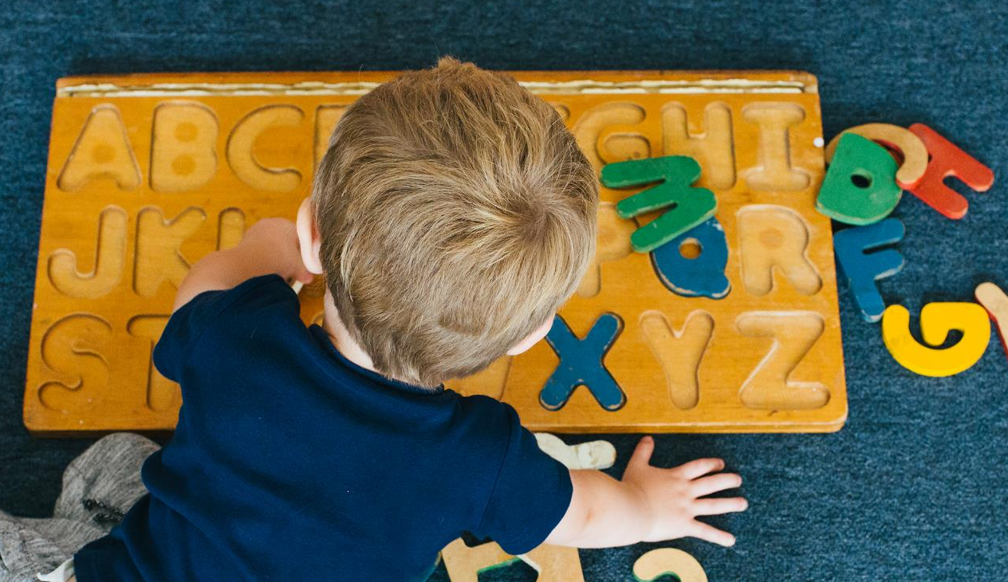
Learning to Read: The code
alphabet
a =
apple
By Excavations and Israel Antiquities - [1], Public Domain, https://commons.wikimedia.org/w/index.php?curid=3746228
Notes:
1:10 min
At some point, though, someone thought, "Wouldn't it be great if we could write down what we say, so we could communicate with others even when we're not with them?’
So, for the English language, they took the sounds that we hear in words and made symbols for those sounds.
Other languages used symbols to represent entire words, syllables, or used pictures to represent things or ideas—BUT
For the English language, they used symbols to represent individual sounds.
Those symbols are the letters we use today—*the alphabet.
Like the letter *<a> represents the sound **/a/
AND different letters used together could make entire words that we speak like *a-pple.
Remember, our brain is born ready to pick up on and learn spoken words,
It is NOT born to figure out this written code of letter symbols and how they relate to spoken words.
This has to be taught.
How to read and write HAS to be taught.

Slide 11

Try It!
How would you say this word:
  flimbloaded
  prevoudle
How are you working to figure these words out?
  commisterable
Notes:
1:40 min
OPTIONAL INTERACTIVE ACTIVITY: Hide this slide if you are not doing it.
Now that we see how sounds from speech were used to make printed words or words in print,
I want you to take a minute to
Imagine you are your child, and you’re seeing a word that you’ve never seen before, for the first time.
How will you figure out what the word is, what it says?
I am going to show you you a made-up word and I want you to pretend you are a child, seeing this word for the first time. Try to figure out what it says….
Ready?
*CLICK*
[Allow for WAIT time]
How about this one? *CLICK*
[Allow for WAIT time]
1:40 min
How are you working to figure these words out. What are you doing in your mind?
Are you trying to sound out the words? Are you looking for larger parts inside the words?
Try this last one? *CLICK*
[Allow for WAIT time]
Good readers often don’t have to think about how to read words very often and they just read them automatically.
However, when learning to read or when trying to read unfamiliar words, we have to think of this basic code of letters representing sounds, for larger words like these, we also look for syllables or larger chunks of words that look familiar.
The skills we use to figure out how to read new words, sounding out the letters, looking for larger parts like syllables and prefixes and suffixes,
Those skills, if taught to children, will help them grow to be good readers and spellers.

Slide 12

Teaching Reading
Letters & sounds
vs.
Whole word
ohiofamiliesengage.osu.edu
Notes:
1:10 min
So, if how to read and spell written language has to be taught, and its not learned naturally,
Teachers should be trained to teach children about *letters and sounds--how the letters as symbols relate to spoken words.
And some teachers were trained to teach reading and writing by teaching this "code" of letters to sounds.
But for a long time, people have argued about how reading should be taught.
Even way back in the 1800s there were people who believed that it wasn't necessary or that it was silly to teach letters and sounds. They believed that teachers should be taught to teach *reading in a different way.
So, instead of teaching this code and how to sound out words, teachers were supposed to have children memorize the picture of the* "whole word".
In this "whole word" method, kids would have to use pictures and guessing to figure out a word they didn't know, and they were taught new words by seeing the whole word and saying it over and over again.

Slide 13
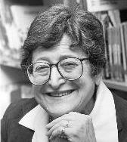

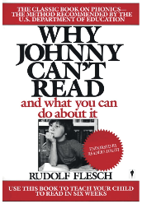
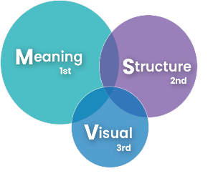
Teaching Reading
Whole Word
1800s
1955
1967
Learning to Read: The Great Debate
1990s
Balanced Literacy
2000
Three-Cueing System
Whole Word
ohiofamiliesengage.osu.edu
Notes:
1:10 min
This other method of teaching reading, the *whole word method, has been used for a long time and is still used some today. Let’s look at this timeline.....
By the 1950s and 1960s, some people realized that teaching kids to read by having them try to memorize "whole words" wasn’t working well.
A lot of kids were having trouble learning to read and write.
SO....
A really popular book was published, *"Why Johnny Can't Read", and this book drew attention to the weaknesses of the whole word method.
AND then later, a Harvard researcher,* Jeanne Chall (Jeen) did a big research project and she found:
that science was showing over and over again that teaching the alphabet code was really important for beginning readers and spellers!
BUT the "whole word" method and *other methods were so popular,
That colleges kept training teachers to use them even though they weren't working well.
Finally, a *big research report was written in 2000 and it helped remind people what really works.
AND here is what they found.....

Slide 14


Five Things
Listen and hear
Letter-sound
Practice
New words
Understanding
ohiofamiliesengage.osu.edu
Notes:
1:50 min
This research was under the name the National Reading Panel
This panel or group of researchers found that indeed-
The sounds and letters in words are important to beginning readers!
They found five things in the research that really help kids learn to read:
First, was to teach kids to *listen carefully* and hear the parts of spoken words
for example, being able to pull three sounds out of the word "cat" c-a-t, or
pull apart syllables like ro-bot, or
hear and say rhymes like "bead" and "read"
It was also important to teach kids the *letters that go with each sound they hear, this helps them to be able to sound out when reading or write the letters as they try to spell a word.
They also found that it was important to give students a lot of *practice* sounding out different spelling patterns so they could get comfortable reading and spelling different kinds of words quickly and smoothly.
Vocabulary was another important thing. *New words* that kids don't hear in everyday conversation should be taught directly so they build a strong vocabulary.
Finally, if kids have to read something really long, the researchers found that teaching them simple ways to *understand* these long texts helps them make sense of what they read.
Now this research summary was written in 2000, BUT the research didn't stop! We have tons of new research every year. We call ALL of this research “the science of reading"…....

Slide 15
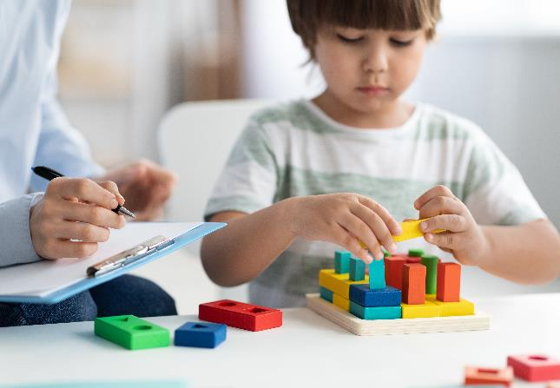


What is the science of reading?
Notes:
50 sec
So, what is the science of reading?
It is ALL the research to this day, that looks at how kids’ bodies and brains learn to read and spell and write.
It's research from lots of different scientists—from psychologists to speech therapists, brain researchers, linguists and educators.
All of their work combined is called the science of reading
AND it never stops growing! With every research study done, we learn a little more about how to teach reading more effectively.
So yes! Reading and writing have to be taught, and we look to science to know the best way to teach it!
There is a handout from the Ohio Statewide Family Engagement Center that summarizes the basics of the science of reading for you. There is also an audio version if you’d rather listen to the content online.
https://ohiofamiliesengage.osu.edu/resources/what-is-the-science-of-reading-the-basics-for-families/
Virtual Tip: Share the link in the chat or question/answer box.

Slide 16

The Science of Reading
is not a book you can read
is not just letters and sounds
shows us the best way to teach
Notes:
30 sec
Keep in mind, "The Science of Reading" --
is NOT *a book you can read or a particular program you can buy
AND it's NOT just knowing *letters and their sounds
Remember it's the results from research- and research tells us a lot!
What the science of reading DOES do, what all that research does do...
is show us the *best way to teach reading and writing....
We call it the Structured Literacy Approach
When teachers use the science of reading to guide their teaching, it is often called taking a “structured literacy approach” because there is a lot of structure to how they go about teaching all of the letters, sounds, and skills to read and write.

Slide 17

Structured Literacy
Like a recipe
Everyone
Dyslexia
ohiofamiliesengage.osu.edu
Notes:
1:10 min
[SAY SLOWLY]
The Structured Literacy Approach is a way of teaching reading and writing that’s based on what science says works best. [REPEAT SLOWLY]
It’s *like following a recipe where teachers know what the ingredients are how to combine them—they know what to teach AND how to teach it
You can use this approach—Structured Literacy—in big classrooms, small groups, or even one-on-one sessions.
This approach works for *everyone!* --all kinds of learners—
whether you're just starting to read, or
you're a more advanced reader, or
if you’re learning English.
AND It’s especially helpful for students who have trouble with reading, like those with dyslexia.
Teaching reading and writing in this way, with the Structured Literacy Approach, gives students the best chance to become great readers and writers.

Slide 18

The "Structure": What is taught
Lists
Order
Build up
Together
ohiofamiliesengage.osu.edu
Notes:
1:10 min
So why do is it called Structured Literacy?
Well, because it is structured!
The word structure means that the teaching is done in a clear, organized way.
To do this, teachers follow *lists that tell them what to teach and in what *order.
There are lists for things like what letters and sounds to teach and in what order, lists for spelling rules, syllables types, hard-to spell words (or uncommon spellings or pronunciations), prefixes, suffixes, root words, grammar, sentence structures, and how to write paragraphs and essays.
There are lots of lists! They help with both reading and writing.
The lists start with the easy stuff and *build up* to more complex material over time.
When all the lists from different areas of literacy are *used together, they help students improve in all areas of reading and writing.

Slide 19




The "Structure": How we teach it
Direct instruction
Many senses
Teach everything
Reading = Spelling
New stuff
Notes:
3 min
Besides these lists that say what to teach, how those things are taught is really important too.
AND how things are taught is part of the structured literacy approach.
Good teaching uses direct instruction*.
Good direct instruction means that things are explained clearly, teachers use examples, modeling, lots of practice with support, and they reteach or re-explain things if needed.
It also means teachers don’t expect students to figure things out on their own.
They teach everything* step by step, starting with the simple things and building up to harder stuff.
Teachers also don’t teach too much at once.
It's better to teach only a little bit of new material* at a time. Keeping the rest of the work review and practice.
Another interesting thing about how reading and writing is taught when using structured literacy- is that teachers try to have the kids use as *many of their senses* as possible!
Why do all the senses matter? Well, for many reasons but let's think:
I am going to say a word and pay attention to what happens in your mind when you hear it.
"cat" (pause)
When we hear the word cat, our brain lights up with activity!
It doesn't just light up in the area of our brain that hears sound....
It lights up all over the place!
Scientists have taken pictures of the brain that show that when we hear, see, or write a word—these pictures of the brain show that our brain lights up with activity, not just in one place, but all over the place!
They found that when we see a word, our brain also thinks about how it sounds, what it means, and how to write AND how to say it, it even conjures up an image or picture in our mind.
Good teaching helps connect all these areas in the brain by giving lots of practice seeing, saying, writing, and hearing words.
In good lessons, kids are DOING things, not just listening. They use their eyes, ears, voices, and hands to learn how to read and write.
"Reading" is what we hear about most, but good literacy lessons should also *equally include spelling and writing*, because
Research shows that teaching spelling and writing helps students become better readers.

Slide 20

Ohio Laws Support Structured Literacy!
Science-based materials
Approved list
Teacher training
Notes:
1:50 min
Ohio is working really hard to make sure all kids get good reading and writing instruction in school.
To do that, Ohio actually has LAWS about using the Structured Literacy Approach.
These laws make sure that anything the school uses to teach reading and writing follows *science* and is a made for a structured literacy approach.
You see, schools and teachers will often *buy materials like entire reading programs*, books, workbooks, and worksheets from different companies to help teachers teach.
Now, some of these companies make their stuff using the science of reading,
But other companies don't.
So, these laws in Ohio have really helped because...
Now, when Ohio schools go to buy stuff for the classrooms, they have a *list of good stuff* to pick from. And we as families can even see this list!
In fact, we can ask our child's teacher what stuff they are using to teach reading and writing, and we
Should be able to find it on the Ohio list of Approved materials.
The law made it so that schools and teachers don't have to search for good science-based teaching materials- they have a trusted list of things to choose from.
Oh! And this is really important!
Ohio laws also are making sure that teachers who didn't get *structured literacy training, *they get it now—that way teachers have both the materials and the knowledge to teach reading and writing using the Structured Literacy Approach!
There is a handout from the Ohio Statewide Family Engagement Center that summarizes the basics of structured literacy for you. There is also an audio version if you’d rather listen to the content online. https://ohiofamiliesengage.osu.edu/resources/what-is-structured-literacy/

Slide 21

Our Local Literacy Materials
ohiofamiliesengage.osu.edu
Notes:
3-5 min
Let’s take a look at some of these lists!
We have some of these here for you—ones from local school(s) [add school(s) name]
Teachers sometimes call these lists a scope and sequences.
Different skills are taught in different grades, and the lists will be a little different based on what program or curriculum your school has chosen to use.
Feel free to stand up and stretch here.
(This is a great place for you to take a break in the presentation.
Have a co-facilitator hand out official lists from the local schools showing what is being taught and in what order.
OR you can have people get up from there seats to come over to a display table, giving them a chance to mingle)
Try to include a list for targeted ages and include reading, spelling and writing/grammar, and morphology if possible.
This is just a placeholder image, feel free to make it more specific.)
Virtual Tip: Provide links in the chat box to local literacy materials for participants to view.

Slide 22
Parent Experience
Notes:
2-5 min
Parent Experience
Use this slide for a parent cofacilitator to share about their experience supporting their child’s literacy in partnership with the school. You may also choose to make copies of this slide and add it a few times throughout the presentation to signal that your co-facilitator will share in those moments.
Hide slide if you do not have a cofacilitator or your cofacilitator will present other content.

Slide 23
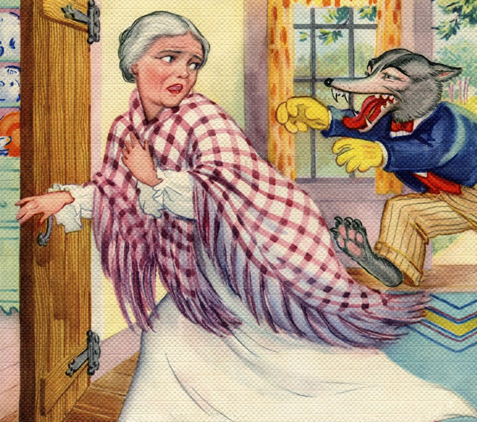
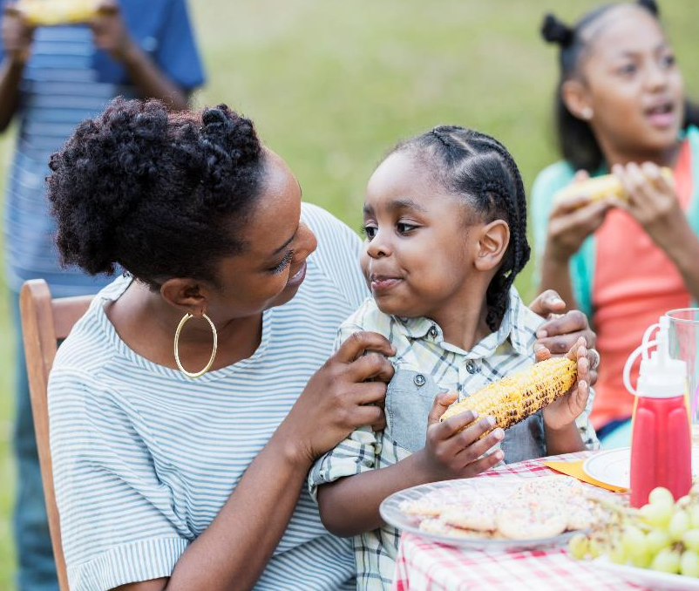
Try it!
ohiofamiliesengage.osu.edu
Notes:
2 min
OPTIONAL INTERACTIVE ACTIVITY: Hide this slide if you are not going to do it.
So why is teaching writing and the structure of writing such an important part of the structured literacy approach? Well let’s try it!
I'm going to say a sentence,
As you hear the sentence, try to figure out what you think it means! Ready?
Let's eat Grandma...(wait)…..
What did it mean?....(wait) did you think of this? *(animate)*
Okay, a little scary, right?
Now I'm going to say the same thing, I'm going to say it again, listen.....and figure out what you think it means....
Let's eat, Grandma!
Did you think of something different that time? Even though I said the same words?
Maybe something like this?*(animate)*
Both sentences use the same words but mean different things.
You can probably tell that I mean something different in each sentence by listening to the tone of my voice and the tiny pauses between the words as I speak.
But what if I need to write these sentences? Then how would you know the difference? How will you know what I mean if the words are the same?

Slide 24


Talking vs. Writing
Jumbled sentences
Facial expressions
Tone & gestures
Writing structure
Helps understanding
"See" the structure
Notes:
1:50 min
Well, remember earlier, we saw how babies learn to talk, and writing is kind of like the written form of talking.
BUT! There is BIG difference in how we talk and how we write.
When we talk or tell a story, it's often in *jumbled sentences*—stopping and starting our train of thought, running our sentences together, AND we use *facial expressions*, tone of voice, and gestures to help us communicate what we mean.
When someone reads our writing, we don't have *facial expressions, tone and gestures to help tell our story, and so the words and the structure of our sentences are all we have to communicate what we mean.
In the sentences you just heard, I said the same words, but I would have to use a punctuation mark, a comma, after the word eat, in order for grandma to make it out alive!
And *punctuation, like commas, are just one way that we structure writing so that we are sure to get our meaning across.
The structured literacy approach teaches kids the *written structure, not just of words with the order of letters and sounds, but the structure of sentences, paragraphs, and essays.
Writing instruction also helps kids *understand what they read better.
Research has shown that teaching kids how to use words to write well helps improve their reading. It helps them to *"see the code"* or structure inside what they read and helps them understand what they read better.
Let’s take a closer look at how writing is structured…..

Slide 25


Early Skills
Book words
Rhyming
Syllables
Coloring & writing
Letter names & sounds
ohiofamiliesengage.osu.edu
Notes:
2 min
I'm going to show you some videos in a minute to give you an idea of what Structured Literacy looks like in action!
But let me give you a sense of what activities you might see in school at different ages.
Let's start with what early skills instruction looks like:
Lessons focus mainly on spoken language and pre-literacy skills.
For example, teachers will read lots of books to kids, getting them familiar with *words that describe books* like: the cover of the book, the title, illustrations, who wrote the book—the author, and showing that we read from left to right by tracing the words as they read the stories aloud. They show kids how books work, how we use them.
Students will also learn lots of nursery rhymes.
Those rhyming stories help children to hear words that are similar like “wall” and “fall”,
Which gives them clues about how letters and sounds work together to build words.
The beat or rhythm in these nursery rhymes also helps children to hear that larger words are broken into *syllables* when we speak, like the word
to-ge-ther. Listen to this:
Hump-ty Dump-ty sat on a wall,
Hump-ty Dump-ty had a great fall.
All the king's horses and all the king's men
Couldn't put Hump-ty to-ge-ther a-gain."
Also kids begin to learn to hold and use a pencil, crayon, or marker and practice *coloring and drawing*.
They will also begin to learn the names and sounds of *letters* and they practice tracing or writing letters and even work on writing their name.

Slide 26

Intermediate Skills
Hearing sounds
Handwriting
Letter names & sounds
Read & spell
Sentence structure
ohiofamiliesengage.osu.edu
Notes:
1:30
Intermediate skills
Students will work even more on learning to *hear and repeat sounds in words like syllables and rhyming
*Letter writing, or handwriting becomes really important in these grades
Practicing good letter writing can help students to learn their letters and sounds better AND
When they can write a letter easily—without thinking—they can then focus on spelling and getting their ideas on the paper.
These students need to learn to what *letters go with what sounds*, such as, the letter <b> says /b/ and <r> says /r/.
They need this because they will start learning to blend sounds together to *read* small words and pull apart the sounds in words to figure out how to *spell* them.
They will start to learn new spelling and sound patterns like when we use the letters: ch, dge, and the silent or sneaky <e>.
AND they will learn the exceptions to those patterns.
Hard-to spell words (sometimes called sight, red, or heart words) will also be taught early in school.
Kids will also start to learn how to read and write simple sentences—learning *sentence structure*

Slide 27

Advanced Skills
Longer words
Vocabulary
Understanding
Writing skills
ohiofamiliesengage.osu.edu
Notes:
50 sec
Advanced Skills
Students will learn to read and spell *longer words* using syllables and prefixes, roots, and suffixes.
Teachers will continue to teach new words that kids don't hear a lot in conversation to help them build a big *vocabulary*.
And they will teach students ways or skills to help them*understand* what they read- since they will be reading longer books and reading passages.
In older grades students will keep working on those *writing skills* so they can write sentences, paragraphs and essays with good structure.

Slide 28
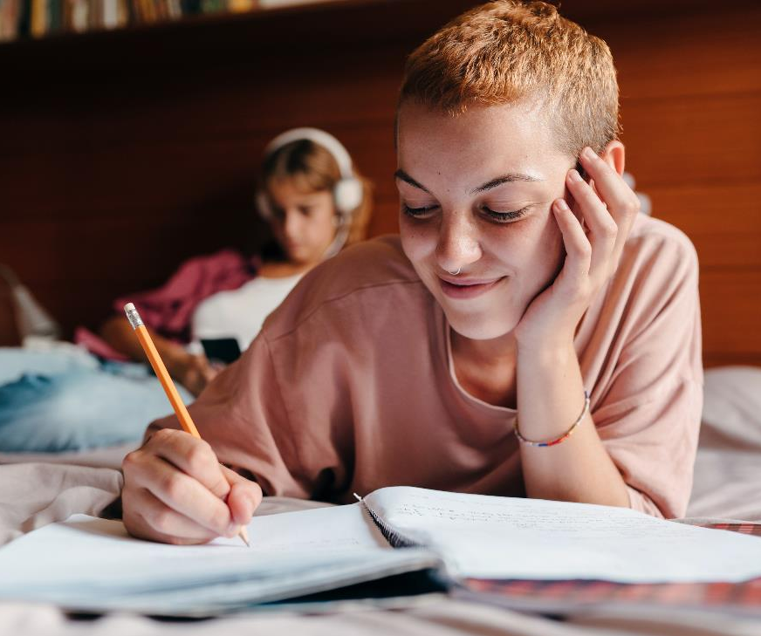
At Home
Talking & Reading
Play with letters
Writing stuff
Audiobooks
Decodables
Notes:
2:30 min
At home, our families can be a great help to our kids as they learn to read and write.
It is really fun and special to share moments of new learning with our kids! Here are some little ways that might be able to support their reading and writing. Some ideas might be:
As simple as *talking with your child, having good conversations. Remember, listening and speaking are the foundation skills for reading and writing. Encourage them to ask questions. Conversations will help them learn new words, new sentence structures, and knowledge about the world that will help them to understand things that they read.
If you can, read to your child, you could read them just stuff that's around, like the back of the cereal box, signs, the menu at a restaurant, or books; OR If reading is difficult for you, there are lots videos online of people reading children's books . You could ask your child's teacher if they have a favorite YouTube channel or storyteller they would recommend for your child's story time.
Another idea might be to make some kind of letter cards or Post-its like we mentioned earlier so you can just *play* around with letter sounds, building words, and you can even make up your own matching or any other kind of letter games!
Also, having *writing materials* like markers, crayons, pens or pencils, and any kind of paper just around the house encourages writing and spelling. Our kids can help us make a list, or we can write notes to each other, or they keep a journal of ideas, or a diary! AND Writing tools make great gifts for children too.
AND this one is great! *Audiobooks*! Audiobooks are just the sound recording of someone reading a book. The library has lots of these we can get for free. We can play them from our phone—in the car or around the house. Audiobooks make it so kids can hear lots of new words, build a strong vocabulary, and learn about the world!
Lastly, as they are learning to read, try and find what are called *"decodable books"* for early readers or readers that need more practice reading specific kinds of words. We have a great resource about decodable books we will share at the end of the presentation.

Slide 29

Early and Intermediate Skills in Action!
Notes:
30 secs
Now, let's take a look at some videos that show some of the early and intermediate literacy skills in action!
[NOTE: Be sure to choose 2 or 3 videos and discussion questions for this section.)
Virtual Tip: Make sure you are sharing your computer sound for the videos.

Slide 30
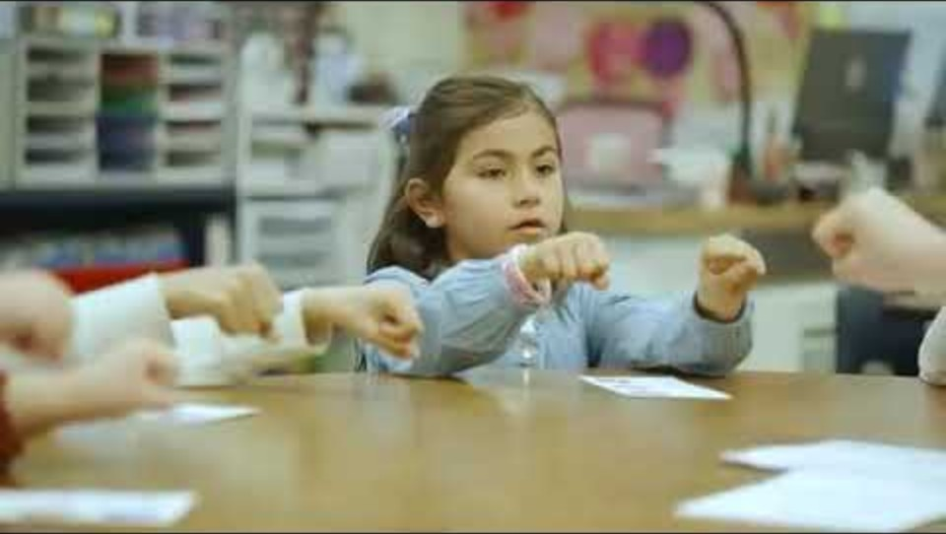
Video Example: Hearing syllables
As you watch:
How are students using all of their senses?
How could you practice this skill at home with your child?
How have you seen your child practicing this skill at home?
https://www.youtube.com/watch?v=C2I0tS-Z8iI&t=3s
Notes:
1:00 min
Hearing Syllables Video (0:43)
In this video you'll see how a teacher helps students to listen for the "big chunks of sound" in words OR syllables.
As you watch, how are students using all of their senses? Could you see yourself practicing this at home? Have you seen your child practicing these at home?
YouTube link: https://www.youtube.com/watch?v=C2I0tS-Z8iI&t=3s

Slide 31

Hearing syllables: Parent Perspective
How are students using all of their senses?
How could you see yourself practicing this skill at home with your child?
How have you seen your child practicing this skill at home?
Notes:
6 mins
Now, turn and talk to the people next to you and share what your thoughts to the questions.
How are students using all of their senses?
How could you see yourself practicing this skill at home with your child?
How have you seen your child practicing this skill at home?
[After a few minutes, ask for any parent to share to the whole group].
[Participants should note: The teacher helps students to listen for the "big chunks of sound" in words OR syllables.
The kids are using all of their senses: listening, speaking, watching, and using their hands to really engage with the words.]
Virtual Tip: Have families share in the chat or unmute to share their answers to the questions.

Slide 32
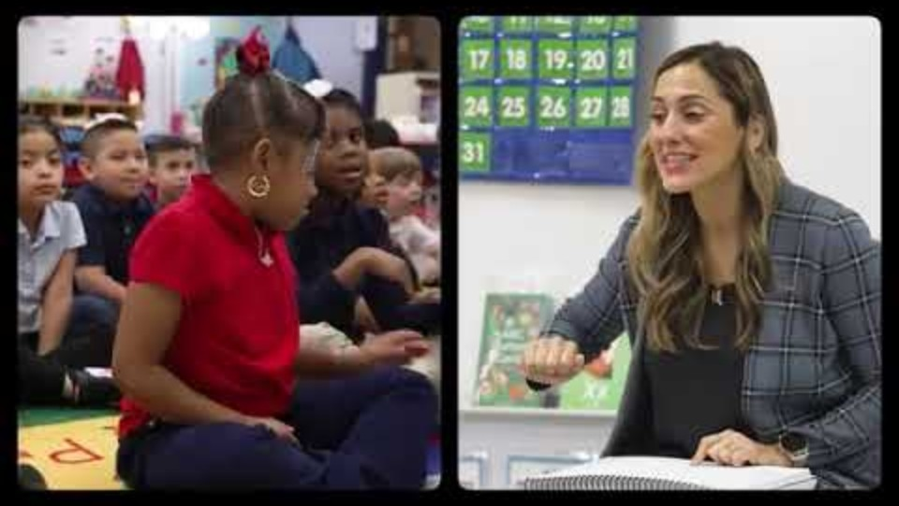
Video Example: Listening for sounds
As you watch:
What do you notice the teacher does to help the students?
How could you practice this skill at home with your child?
How have you seen your child practicing this skill at home?
https://www.youtube.com/watch?v=rhZMjpcvpGA&t=1s
Notes:
1:30 min
This video is of a whole class and shows lots of ways to help kids hear the sounds in words. (beginning to 1:03)
YouTube link: https://www.youtube.com/watch?v=rhZMjpcvpGA&t=1s
As you watch:
What do you notice the teacher does to help the students?
How could you practice this skill at home with your child?
How have you seen your child practicing this skill at home?
Virtual Tip: Have families share in the chat or unmute to share their answers to the questions.

Slide 33
Listening for sounds: Parent Perspective
What do you notice the teacher does to help the kids?
How could you practice this skill at home with your child?
How have you seen your child practicing this skill at home?
Notes:
6 min
Now, turn and talk to the people next to you and share what your thoughts to the questions.
[After a few minutes, ask for any parent to share to the whole group].
[Participants should note:
This teachers helps kids to listen for:
The first sound in a word
The middle sound in a word
How to blend sounds together to make a word (for sounding out when reading)
How to break a word apart into sounds (like you would need to do for spelling)]
Virtual Tip: Have families share in the chat or unmute to share their answers to the questions.

Slide 34
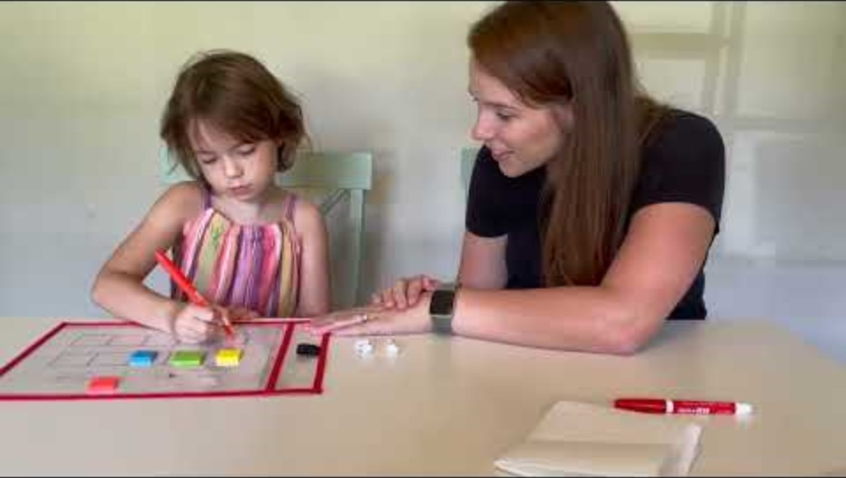
Video Example: Sounds to spelling
As you watch:
How did the teacher help this student spell words?
How could you practice this skill at home with your child?
How have you seen your child practicing this skill at home?
https://www.youtube.com/watch?v=HYEHJiffwoM
ohiofamiliesengage.osu.edu
Notes:
1:30 min
This video will show you a teacher or parent working one-on-one with a student.
As you watch:
How did the teacher help this student spell words?
How could you practice this skill at home with your child?
How have you seen your child practicing this skill at home?
YouTube link: https://www.youtube.com/watch?v=HYEHJiffwoM

Slide 35
Sounds to spelling: Parent Perspective
How did the teacher help the student spell words?
How could you practice this skill at home with your child?
How have you seen your child practicing this skill at home?
Notes:
6 mins
Now, turn and talk to the people next to you and share what your thoughts to the questions.
[After a few minutes, ask for any parent to share to the whole group].
[Particpants should note: The student listens for the sounds in the word "got" and writes the letter for each sound to spell the word. Families can do this activity at home with cheerios or any small objects. Notice that children are taught to use their fingers to "tap out the sounds“]
Virtual Tip: Have families share in the chat or unmute to share their answers to the questions.

Slide 36
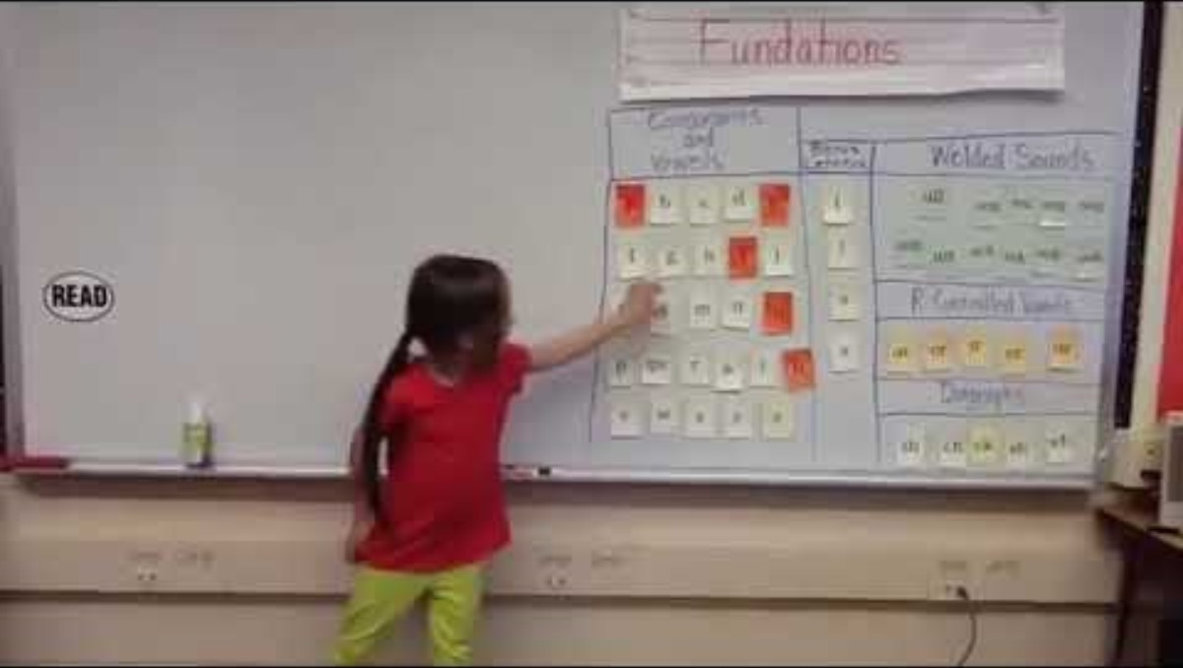
Video Example: Spelling and syllable type
As you watch:
What do you notice the students doing?
How could you see yourself practicing this skill at home with your child?
How have you seen your child practicing this skill at home?
https://www.youtube.com/watch?v=nHNKNxNDuCU
Notes:
1:30 min
This video shows a big classroom lesson with first grade students. In this, the kids are running the show!
As you watch:
What do you notice the students doing?
How could you see yourself practicing this skill at home with your child?
How have you seen your child practicing this skill at home?
YouTube link: https://www.youtube.com/watch?v=nHNKNxNDuCU

Slide 37
Spelling and syllable type: Parent Perspective
What do you notice the students doing?
How could you see yourself practicing this skill at home with your child?
How have you seen your child practicing this skill at home?
Notes:
6 mins
Now, turn and talk to the people next to you and share what your thoughts to the questions.
[After a few minutes, ask for any parent to share to the whole group].
[Participants should note: The students
Do a letter-sound warm-up
Practice building a word together
Then figure out the syllable type (which helps them figure out what the vowel sound will be)
You can play with building words just like this at home using:
post its or index cards with letters drawn on them
you can use them to do what you see in the video OR play matching or go fish type games!]
Virtual Tip: Have families share in the chat or unmute to share their answers to the questions.

Slide 38
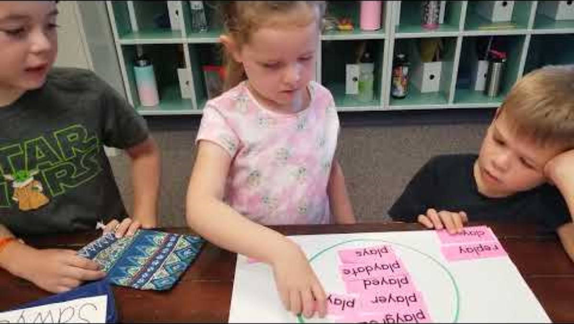
Video Example: Roots, prefixes, suffixes
As you watch:
What do you notice the teacher and students doing?
How could you see yourself practicing this skill at home with your child?
How have you seen your child practicing this skill at home?
https://www.youtube.com/watch?v=7oSp4OXe1qA&t=1s
Notes:
1:30 min
This last video shows three kids sorting words that have some of the same letters.
As you watch:
What do you notice the teacher and students doing?
How could you see yourself practicing this skill at home with your child?
How have you seen your child practicing this skill at home?
YouTube link: https://www.youtube.com/watch?v=7oSp4OXe1qA&t=1s

Slide 39
Roots, prefixes, suffixes: Parent Perspective
What do you notice the teacher and students doing?
How could you see yourself practicing this skill at home with your child?
How have you seen your child practicing this skill at home?
Notes:
6 mins
Now, turn and talk to the people next to you and share your thoughts to the questions.
[After a few minutes, ask for any parent to share to the whole group].
[Participants should note: Here, the teacher is helping the kids to learn to see the larger parts of words that hold meaning—in this case the base or root word.
They are trying to find words with the same root word or base <play>, p-l-a-y.
The little boy on the right will figure out that <play> can be a root word even if there are some letters in front of it...as in "re-play"
The teacher reminds them that what matters here is the meaning of the root word.....]
Being able to "see" or hear the roots, prefixes, and suffixes inside words helps kids to figure out what a word means—increasing their reading, writing, and speaking vocabulary.
Virtual Tip: Have families share in the chat or unmute to share their answers to the questions.

Slide 40

Questions to Ask
Approach
Programs
Direct instruction time
Small groups
Ask the teacher
Notes:
1:40
Before Ohio and many other states began passing new laws, most teachers weren’t using the Science of Reading, and instead, they were still relying on other methods to teach reading and writing.
Even now, according to the latest reports, only about one-third of students are reading and writing at grade level.
The good news is, many states, including Ohio, have laws and programs to teach reading more effectively with the Structured Literacy approach!
There is still a long way to go, so it's really important that families speak up and take part in making sure that kids get good reading and writing instruction.
SO, to help you partner with the school and your child's teacher even more,
Here are some ideas for questions to ask to get the conversation started.
You might ask things like:
What *approach do you use to teach reading and writing (it should be a structured literacy approach)?
You could ask: What *curriculums or programs are you using (there might be more than one – are they on the approved list)?
AND How much time do you get to spend giving direct instruction using those materials?
Lastly, Is my child in or a part of any small groups for reading or writing? AND what types of things are they working on in those groups?
It's good to ask specific questions about where your child is in their learning and if they are on track to meet grade level goals.

Slide 41

Questions: Early readers
Handwriting
Letter-Sound
Sound-out & Spell
Hard-to-spell
Notes:
1:10 min
Specific questions for early readers and spellers might be:
How is their *handwriting or letter formation (is it automatic and smooth yet?),
How are they doing with hearing sounds and syllables in words....with rhyming?
What *letter-sounds do they know so far?
Also, are they able to *read small words by sounding them out?
And are they able to spell those same small words?
Also ask: What *hard-to-spell words do they know so far? (these also called red words, high frequency, or sight words)
For each of these questions. Ask if they are having trouble with any specific letters or types of words.
A good idea might be to ask the teacher for a copy of the lists they are using, so you can keep track of exactly where your child is doing well or needs more practice.
Finally, we can ask the teacher for ways we can help at home.
They'll really appreciate the team effort!

Slide 42

Questions: More advanced readers
Larger words
Syllables
Roots, prefixes, suffixes
Writing
Understanding
Notes:
1:40 min
Specific questions for families with older readers and writers might be:
How is my child doing with reading and spelling *larger words OR are they still struggling to read and spell some smaller words?
What *syllable types have they mastered—and are they having trouble with any?
Again, considering older students are being asked to read and write bigger words, maybe ask: What *roots prefixes and suffixes they've learned, AND How are they doing reading and spelling those larger word parts?
And the writing assignments get harder as they get older too, so ask:
What *writing skills are they working on?
Are they remembering to capitalize and punctuate their sentences?
Are they having trouble with sentence structures or trouble writing longer papers?
Lastly, older students are asked to read longer and harder books and reading passages. SO, it would be good to ask:
Are they *understanding what they read when they are given grade-level stuff?
Teachers in the older grades still have lists to follow for teaching using the Structured Literacy Approach so
Again, a good idea might be to ask the teacher for a copy of the lists they are using, so you can keep track of exactly where your child is doing well or where they might need more practice.
Teachers enjoy working with families, and when parents and teachers talk about how kids are learning, research shows that students do much better in school.

Slide 43
Curious for more?!
Watch: Dotting the ‘i’ in Literacy https://www.youtube.com/watch?v=qR-ctPFixzY
View: Ohio Department of Education and Workforce Approved Literacy Materials Website
https://go.osu.edu/odewhighqualitymaterials
Read: What are decodable books?
https://ohiofamiliesengage.osu.edu/resources/what-are-decodable-books/
Explore: The Family Literacy Toolkit
https://ohiofamiliesengage.osu.edu/family-literacy-toolkit/
Go.osu.edu/scienceofreadingvideo
Notes:
1 min
If you are curious to learn more and dive deep, we have some additional resources for the science of reading.
Watch: Dotting the ‘i’ in Literacy- Ohio has put together a beautifully done video, Dotting the ‘I’, that shows how they have committed to using the Science of Reading in their schools. In it, you’ll hear from the Kareem Weaver—the film star, community activist, and literacy expert; you’ll hear from the governor, teachers, administrators, and national literacy parent advocate Brett Tingley. Brett reminds families of their critical role in advocating for the Science of Reading in their child’s classroom. It is well worth the watch!
View: Ohio Department of Education and Workforce Approved Literacy Materials Website
https://go.osu.edu/odewhighqualitymaterials
Read: What are decodable books?
https://ohiofamiliesengage.osu.edu/resources/what-are-decodable-books/
Explore: The Family Literacy Toolkit
https://ohiofamiliesengage.osu.edu/family-literacy-toolkit/
Virtual Tip: Share the links in the chat or question/answer box.

Slide 44





Families and Schools
Notes:
30 sec
You are an important part of your child's reading and writing success.
We want you to know:
what is being taught at school,
how your child is doing, and
how you can support your child at home.
There is great evidence that shows that the more families and teachers talk and work together, the better the kids do!
We invite and encourage you to talk with your child's teacher regularly.
You have the power to make a huge difference in your child's education.

Slide 45
More questions about how we teach kids literacy skills, or about the science of reading?
Staff Member
Title
Role
Contact Information
Notes:
30 secs
[Insert picture and contact information of the person at your school that families can contact with more questions]
If you have more questions about how we teach kids literacy skills, or about the science of reading, you may reach out to __________________________________.

Slide 46

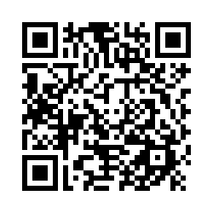
We’re so glad you came!
What did you think?
go.osu.edu/SFECfamilysurvey
Notes:
1 min
It was lovely to see everyone today. Thanks for coming out! We would love to hear what you thought of the workshop! The Statewide Family Engagement Center loves feedback! It is important to all of us that we offer resources and events that help families like yours. So please take a minute to fill out this short survey. Your comments are very important to us. And when you’re done filling out the survey, please feel free to stay after for a while to talk and connect more with other families and staff.
Virtual Tip: Share the link in the chat or question/answer box.
go.osu.edu/SFECfamilysurvey

