Slide 1
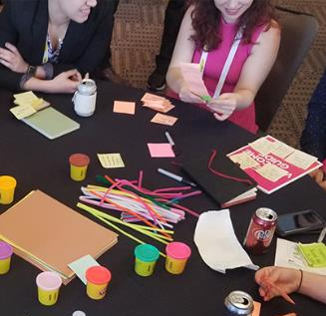

What is the Science of Reading?
A Workshop for Parents/Caregivers
[Date] at [Time]
[Address or Virtual Link]
Replace this box with your school or organization logo
[School/Town Name] parents, please join us! At this interactive workshop, you’ll learn about how our local schools are teaching reading and writing, and you will receive ideas for supporting your child’s learning.
What will we do together?
Meet & Greet
Receive Handouts and Information
Watch our teaching demonstrations
Share your ideas and questions
Language interpretation services are available. Please contact [Name] at [Contact information to arrange].
[List other accommodations such as childcare, meals, etc. that may be provided].
Workshop materials were originally developed by the Ohio Statewide Family Engagement Center at The Ohio State University’s Center on Education and Training for Employment.

