Slide 1

The Science of Reading
in Ohio Schools
The basics for families
go.osu.edu/literacyvideoseries
Notes:
Welcome and thanks for coming today. We’ re so glad you are here!
We are here for you.
We are here today because we wanted to share with you some information about how kids learn to read and write, the Science of Reading, and what is called Structured Literacy
We are also here to give you some good resources to help you communicate more easily with your child’s teacher about their reading and writing.
AND we wanted to give you a chance to ask questions and connect with other families in the community.

Slide 2


Introductions
Organization Name
Description
Mission Statement
(Organization Logo)
Facilitator Name
Title
Role
Facilitator Name
Title
Role
Notes:
Introduce your organization….
Name and describe your organization.
You can include its logo and mission statement.
Introduce facilitators: Add pictures of facilitators, their title and role with regards to literacy.

Slide 3
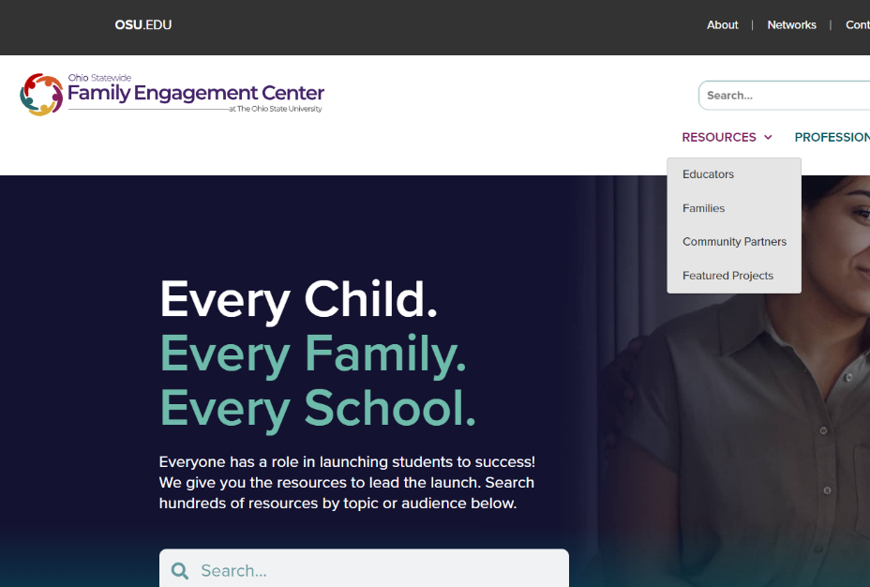
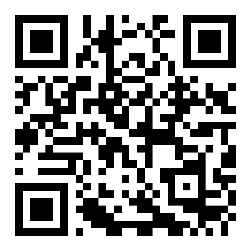
Visit the Family Engagement Center’s Website!
OhioFamiliesEngage.osu.edu
Notes:
The Ohio Statewide Family Engagement Center at The Ohio State University developed this workshop for community partners in literacy.
We have taken the workshop and adapted it for [our school/organization] but have kept the core information the same.
We are glad to have The Ohio State and The Statewide Family Engagement Center as partners in supporting children’s success in school and life!

Slide 4

Connect
Introduce yourself
Children’s names/ages
Favorite song, rhyme, or children’s story
Why you came
Notes:
We want to give you time to meet and get to know your neighbors!
Turn to your neighbor, introduce yourself, share your children’s names, ages, maybe your favorite rhyme, song, or children’s story and what motivated you to come today.
We’ll share for about 2 minutes and then come back together as a group.
(WAIT 2 minutes)
Thanks for sharing with each other! We have such a great group today.

Slide 5

How will this help me?
Work together
Ask good questions
Support your child
Notes:
Let’s start out today, with why this presentation was made for your family.
How will the information in this session help you and your child?
Well, we know that when we all work together*—schools, families, and community organizations like libraries—
When we all work together, it benefits everyone.
Everyone's job and life improves with support AND we can support each other better when we know more about what is going on in each other's world.
So, this session will help you as a family understand what’s being taught in school about reading and writing, and how it’s taught.
With this information, you can *talk to your child’s teacher more easily and ask good questions if you any have concerns.
Talking with their teacher, also helps the teacher to know and understand your child better.
You’ll also learn some little things you can do to support your child’s reading and writing at home.
Working together as partners and talking to each other often will give your child the *strong support they need to become a good reader and writer.

Slide 6

Overview
Learning to talk vs. Learning to read/write
The Science of Reading​
The Structured Literacy Approach​
Questions to ask
Notes:
During this workshop today, We’ll talk about 4 main things.
Since reading and writing have to do with language, we'll start off by looking at:
How we *learn to talk versus how we learn to read and write
Then we'll learn about: What is this *Science of Reading and how the Science of Reading has helped to develop good reading and writing instruction called the
*Structured Literacy Approach; We'll talk about what we mean by "structure" and give you lots of examples of what Structured Literacy looks like in classrooms.
Finally, we'll give you some really good *questions to ask your child's teacher.
These questions will help you really get to know how your child is doing with their reading and writing at school- and will help you form that strong support network for them.
Let's get started by talking about how learning to read and learning to talk are related.

Slide 7

Learning to Talk: It's natural!
ohiofamiliesengage.osu.edu
Notes:
How do we learn to talk? Do we go to school for it? Or does it happen naturally?
Let’s look at babies-How do most babies learn to talk? We anxiously await their first word or babble of mama or dada.
Just by hearing words and interacting with us they typically learn to understand and babble words by the time they are 4-6 months old!
We don't have to teach children to talk or what mama and dada mean, they learn those words naturally.
In fact, our brains are wired at birth to learn to talk automatically- this happens naturally for up to 95% of kids.
Babies learn spoken language without instruction. They learn by hearing it around the house and they learn a lot when we play and interact with them-
And for a long, long time, talking to each other was the only way people communicated, so nothing else was needed.

Slide 8
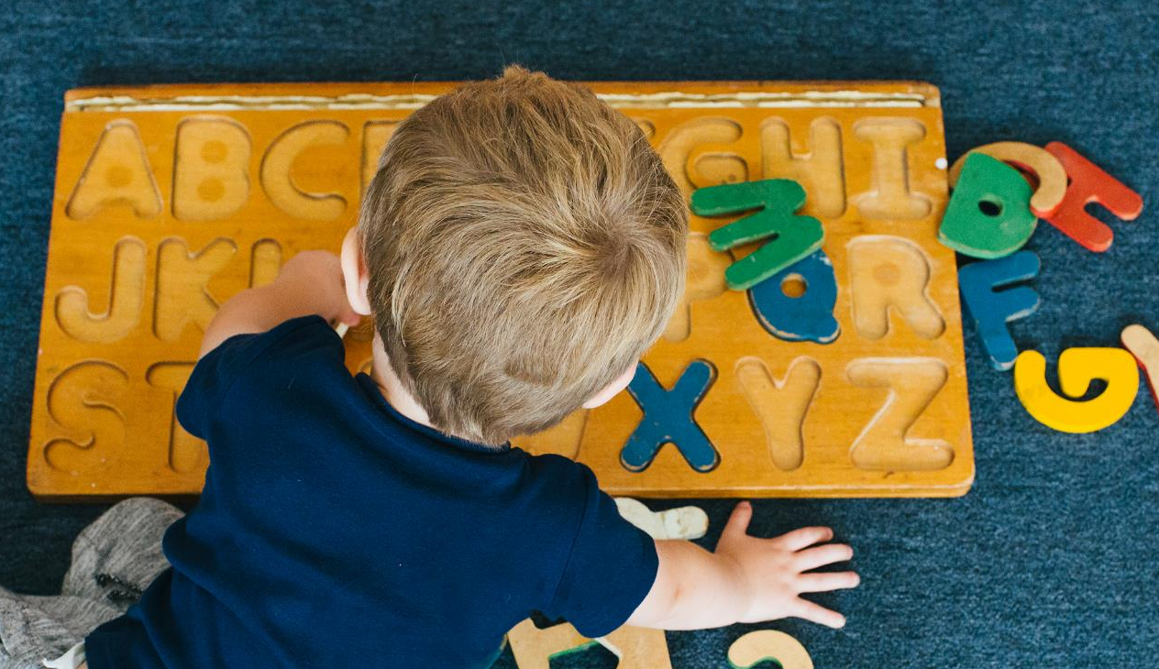

Learning to Read: The code
alphabet
a =
apple
By Excavations and Israel Antiquities - [1], Public Domain, https://commons.wikimedia.org/w/index.php?curid=3746228
Notes:
At some point, though, someone thought, "Wouldn't it be great if we could write down what we say, so we could communicate with others even when we're not with them?’
So, for the English language, they took the sounds that we hear in words and made symbols for those sounds.
Other languages used symbols to represent entire words, syllables, or used pictures to represent things or ideas—BUT
For the English language, they used symbols to represent individual sounds.
Those symbols are the letters we use today—*the alphabet.
Like the letter *<a> represents the sound **/a/
AND different letters used together could make entire words that we speak like *a-pple.
Remember, our brain is born ready to pick up on and learn spoken words,
It is NOT born to figure out this written code of letter symbols and how they relate to spoken words.
This has to be taught.
How to read and write HAS to be taught.

Slide 9

Activity
How would you say this word:
  flimbloaded
  prevoudle
How are you working to figure these words out?
  commisterable
Notes:
Now that we see how sounds from speech were used to make printed words or words in print,
I want you to take a minute to
Imagine you are your child, and you’re seeing a word that you’ve never seen before, for the first time.
How will you figure out what the word is, what it says?
I am going to show you you a made-up word and I want you to pretend you are a child, seeing this word for the first time. Try to figure out what it says….
Ready?
*CLICK*
[Allow for WAIT time]
How about this one? *CLICK*
[Allow for WAIT time]
How are you working to figure these words out. What are you doing in your mind?
Are you trying to sound out the words? Are you looking for larger parts inside the words?
Try this last one? *CLICK*
[Allow for WAIT time]
Good readers often don’t have to think about how to read words very often and they just read them automatically.
However, when learning to read or when trying to read unfamiliar words, we have to think of this basic code of letters representing sounds, for larger words like these, we also look for syllables or larger chunks of words that look familiar.
The skills we use to figure out how to read new words, sounding out the letters, looking for larger parts like syllables and prefixes and suffixes,
Those skills, if taught to children, will help them grow to be good readers and spellers.

Slide 10
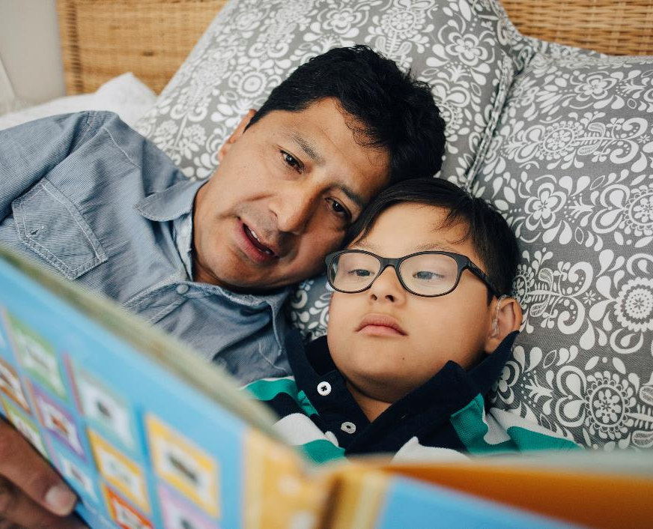
Teaching Reading
Letters & sounds
vs.
Whole word
ohiofamiliesengage.osu.edu
Notes:
So, if how to read and spell written language has to be taught, and its not learned naturally,
Teachers should be trained to teach children about *letters and sounds--how the letters as symbols relate to spoken words.
And some teachers were trained to teach reading and writing by teaching this "code" of letters to sounds.
But for a long time, people have argued about how reading should be taught.
Even way back in the 1800s there were people who believed that it wasn't necessary or that it was silly to teach letters and sounds. They believed that teachers should be taught to teach *reading in a different way.
So, instead of teaching this code and how to sound out words, teachers were supposed to have children memorize the picture of the* "whole word".
In this "whole word" method, kids would have to use pictures and guessing to figure out a word they didn't know, and they were taught new words by seeing the whole word and saying it over and over again.

Slide 11
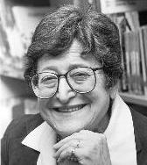

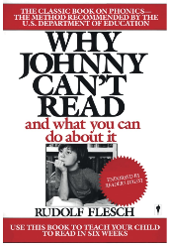
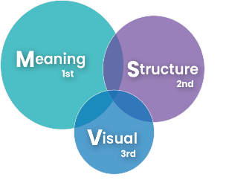
Teaching Reading
Whole Word
1800s
1955
1967
Learning to Read: The Great Debate
1990s
Balanced Literacy
2000
Three-Cueing System
Whole Word
ohiofamiliesengage.osu.edu
Notes:
This other method of teaching reading, the *whole word method, has been used for a long time and is still used some today. Let’s look at this timeline.....
By the 1950s and 1960s, some people realized that teaching kids to read by having them try to memorize "whole words" wasn’t working well.
A lot of kids were having trouble learning to read and write.
SO....
A really popular book was published, *"Why Johnny Can't Read", and this book drew attention to the weaknesses of the whole word method.
AND then later, a Harvard researcher,* Jeanne Chall (Jeen) did a big research project and she found:
that science was showing over and over again that teaching the alphabet code was really important for beginning readers and spellers!
BUT the "whole word" method and *other methods were so popular,
That colleges kept training teachers to use them even though they weren't working well.
Finally, a *big research report was written in 2000 and it helped remind people what really works.
AND here is what they found.....

Slide 12


Five Things
Listen and hear
Letter-sound
Practice
New words
Understanding
ohiofamiliesengage.osu.edu
Notes:
This research was under the name the National Reading Panel
This panel or group of researchers found that indeed-
The sounds and letters in words are important to beginning readers!
They found five things in the research that really help kids learn to read:
First, was to teach kids to *listen carefully* and hear the parts of spoken words
for example, being able to pull three sounds out of the word "cat" c-a-t, or
pull apart syllables like ro-bot, or
hear and say rhymes like "bead" and "read"
It was also important to teach kids the *letters that go with each sound they hear, this helps them to be able to sound out when reading or write the letters as they try to spell a word.
They also found that it was important to give students a lot of *practice* sounding out different spelling patterns so they could get comfortable reading and spelling different kinds of words quickly and smoothly.
Vocabulary was another important thing. *New words* that kids don't hear in everyday conversation should be taught directly so they build a strong vocabulary.
Finally, if kids have to read something really long, the researchers found that teaching them simple ways to *understand* these long texts helps them make sense of what they read.
Now this research summary was written in 2000, BUT the research didn't stop! We have tons of new research every year. We call ALL of this research "The Science of Reading"…....

Slide 13
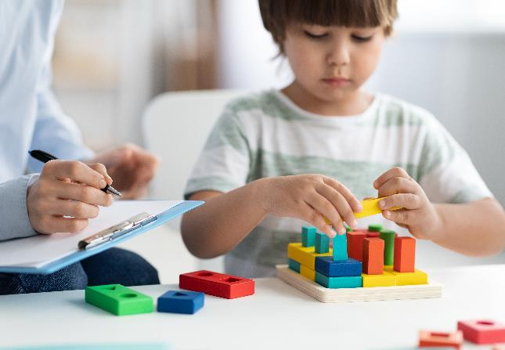


What is the Science of Reading?
Notes:
So, what is the science of reading?
It is ALL the research to this day, that looks at how kids’ bodies and brains learn to read and spell and write.
It's research from lots of different scientists—from psychologists to speech therapists, brain researchers, linguists and educators.
All of their work combined is called the science of reading
AND it never stops growing! With every research study done, we learn a little more about how to teach reading more effectively.
So yes! Reading and writing have to be taught, and we look to science to know the best way to teach it!

Slide 14

The Science of Reading
is not a book you can read
is not just letters and sounds
shows us the best way to teach
Notes:
Keep in mind, "The Science of Reading" --
is NOT *a book you can read or a particular program you can buy
AND it's NOT just knowing *letters and their sounds
Remember it's the results from research- and research tells us a lot!
What the Science of Reading DOES do, what all that research does do...
is show us the *best way to teach reading and writing....
We call it the Structured Literacy Approach

Slide 15

Structured Literacy
Like a recipe
Everyone
Dyslexia
ohiofamiliesengage.osu.edu
Notes:
[SAY SLOWLY]
The Structured Literacy Approach is a way of teaching reading and writing that’s based on what science says works best. [REPEAT SLOWLY]
It’s *like following a recipe where teachers know what the ingredients are how to combine them—they know what to teach AND how to teach it
You can use this approach—Structured Literacy—in big classrooms, small groups, or even one-on-one sessions.
This approach works for *everyone!* --all kinds of learners—
whether you're just starting to read, or
you're a more advanced reader, or
if you’re learning English.
AND It’s especially helpful for students who have trouble with reading, like those with dyslexia.
Teaching reading and writing in this way, with the Structured Literacy Approach, gives students the best chance to become great readers and writers.

Slide 16

The "Structure": What is taught
Lists
Order
Build up
Together
ohiofamiliesengage.osu.edu
Notes:
So why do is it called Structured Literacy?
Well, because it is structured!
The word structure means that the teaching is done in a clear, organized way.
To do this, teachers follow *lists that tell them what to teach and in what *order.
There are lists for things like what letters and sounds to teach and in what order, lists for spelling rules, syllables types, hard-to spell words (or uncommon spellings or pronunciations), prefixes, suffixes, root words, grammar, sentence structures, and how to write paragraphs and essays.
There are lots of lists! They help with both reading and writing.
The lists start with the easy stuff and *build up* to more complex material over time.
When all the lists from different areas of literacy are *used together, they help students improve in all areas of reading and writing.

Slide 17

Activity: Examples of Literacy Materials Our Local Schools Use
ohiofamiliesengage.osu.edu
Notes:
Let’s take a look at some of these lists!
We have some of these here for you—ones from local school(s) [add school(s) name]
Teachers sometimes call these lists a scope and sequences.
Different skills are taught in different grades, and the lists will be a little different based on what program or curriculum your school has chosen to use.
Feel free to stand up and stretch here.
(This is a great place for you to take a break in the presentation.
Have a co-facilitator hand out official lists from the local schools showing what is being taught and in what order.
OR you can have people get up from there seats to come over to a display table, giving them a chance to mingle)
Try to include a list for targeted ages and include reading, spelling and writing/grammar, and morphology if possible.
This is just a placeholder image, feel free to make it more specific.)

Slide 18




The "Structure": How we teach it
Direct instruction
Many senses
Teach everything
Reading = Spelling
New stuff
Notes:
Besides these lists that say what to teach, how those things are taught is really important too.
AND how things are taught is part of the structured literacy approach.
Good teaching uses direct instruction*.
Good direct instruction means that things are explained clearly, teachers use examples, modeling, lots of practice with support, and they reteach or re-explain things if needed.
It also means teachers don’t expect students to figure things out on their own.
They teach everything* step by step, starting with the simple things and building up to harder stuff.
Teachers also don’t teach too much at once.
It's better to teach only a little bit of new material* at a time. Keeping the rest of the work review and practice.
Another interesting thing about how reading and writing is taught when using structured literacy- is that teachers try to have the kids use as *many of their senses* as possible!
Why do all the senses matter? Well, for many reasons but let's think:
I am going to say a word and pay attention to what happens in your mind when you hear it.
"cat" (pause)
When we hear the word cat, our brain lights up with activity!
It doesn't just light up in the area of our brain that hears sound....
It lights up all over the place!
Scientists have taken pictures of the brain that show that when we hear, see, or write a word—these pictures of the brain show that our brain lights up with activity, not just in one place, but all over the place!
They found that when we see a word, our brain also thinks about how it sounds, what it means, and how to write AND how to say it, it even conjures up an image or picture in our mind.
Good teaching helps connect all these areas in the brain by giving lots of practice seeing, saying, writing, and hearing words.
In good lessons, kids are DOING things, not just listening. They use their eyes, ears, voices, and hands to learn how to read and write.
"Reading" is what we hear about most, but good literacy lessons should also *equally include spelling and writing*, because
Research shows that teaching spelling and writing helps students become better readers.

Slide 19
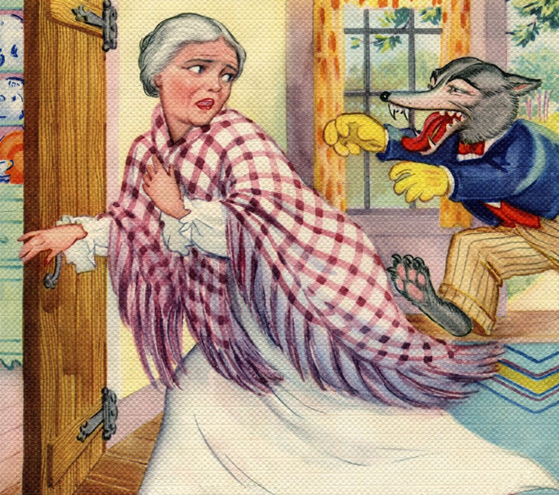
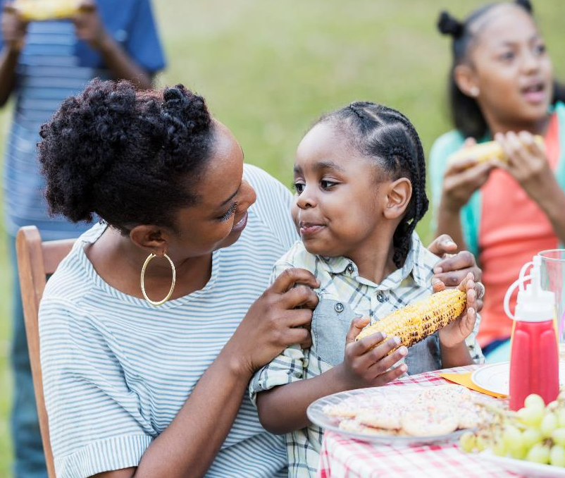
Activity
ohiofamiliesengage.osu.edu
Notes:
Let's do a quick activity to help you see why teaching writing and the structure of writing, is such an important part of the structured literacy approach.
I'm going to say a sentence,
As you hear the sentence, try to figure out what you think it means! Ready?
Let's eat Grandma...(wait)…..
What did it mean?....(wait) did you think of this? *(animate)*
Okay, a little scary, right?
Now I'm going to say the same thing, I'm going to say it again, listen.....and figure out what you think it means....
Let's eat, Grandma!
Did you think of something different that time? Even though I said the same words?
Maybe something like this?*(animate)*
Both sentences use the same words but mean different things.
You can probably tell that I mean something different in each sentence by listening to the tone of my voice and the tiny pauses between the words as I speak.
But what if I need to write these sentences? Then how would you know the difference? How will you know what I mean if the words are the same?

Slide 20


Talking vs. Writing
Jumbled sentences
Facial expressions
Tone & gestures
Writing structure
Helps understanding
"See" the structure
Notes:
Well, remember earlier, we saw how babies learn to talk, and writing is kind of like the written form of talking.
BUT! There is BIG difference in how we talk and how we write.
When we talk or tell a story, it's often in *jumbled sentences*—stopping and starting our train of thought, running our sentences together, AND we use *facial expressions*, tone of voice, and gestures to help us communicate what we mean.
When someone reads our writing, we don't have *facial expressions, tone and gestures to help tell our story, and so the words and the structure of our sentences are all we have to communicate what we mean.
In the sentences you just heard, I said the same words, but I would have to use a punctuation mark, a comma, after the word eat, in order for grandma to make it out alive!
And *punctuation, like commas, are just one way that we structure writing so that we are sure to get our meaning across.
The structured literacy approach teaches kids the *written structure, not just of words with the order of letters and sounds, but the structure of sentences, paragraphs, and essays.
Writing instruction also helps kids *understand what they read better.
Research has shown that teaching kids how to use words to write well helps improve their reading. It helps them to *"see the code"* or structure inside what they read and helps them understand what they read better.
Let’s take a closer look at how writing is structured…..

Slide 21
Activity: Can you see the structure?
Bob sits on the step.
B
_ _ _ _
.
thing
action
describing words/phrase
Bob
sits
on the step
Notes:
(Feel free to make this a hands-on activity with different levels of text per the facilitator materials)
The English language is structured in a certain way. We write words and sentences using certain rules or patterns.
Let's look at this sentence together.
*Click*
“Bob sits on the step.”
There is a structure to this sentence.
How is it built? (pause)
What parts do you see? (pause)
What rules or patterns are used?
(Wait time)
Sentences are structured with a capital *Click* letter at the beginning and a punctuation *Click* mark at the end.
The words are separated by spaces*Click* (Teachers sometimes tell students to put a finger space between each word.)
AND
Every sentence will have certain parts, like a thing *Click* or noun as a subject and an action *Click* or state of being as a verb and many sentences have describing words*Click* or phrases like "on the step".
The words in a sentence are written in a certain order to help the reader understand what the sentence means and to make the sentence easier to read.
All these structures and rules need to be taught to children as they are learning to be good writers.
So, if your child is writing a sentence at home, you can help them check their work by reminding them of the structure and writing rules.
Now, what are schools in Ohio doing to make sure that students are getting both good reading AND writing instruction in schools?

Slide 22

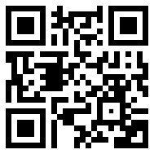
Structured Literacy: Good stuff
Science-based
Buy materials
List of good stuff
Teacher training
Notes:
Ohio is working really hard to make sure all kids get good reading and writing instruction in school.
To do that, Ohio actually has LAWS about using the Structured Literacy Appraoch.
These laws make sure that anything the school uses to teach reading and writing follows *science* and is a made for a structured literacy approach.
You see, schools and teachers will often *buy materials like entire reading programs*, books, workbooks, and worksheets from different companies to help teachers teach.
Now, some of these companies make their stuff using to the science of reading,
But other companies don't.
So, these laws in Ohio have really helped because...
Now, when Ohio schools go to buy stuff for the classrooms, they have a *list of good stuff* to pick from. And we as families, can even see this list!
In fact, we can ask our child's teacher what stuff they are using to teach reading and writing, and we
Should be able to find it on the Ohio list of Approved materials. You can see this list using the link in the title of this slide.
The law made it so that schools and teachers don't have to search for good science-based teaching materials- they have a trusted list of things to choose from.
Oh! And this is really important!
Ohio laws also are making sure that teachers who didn't get *structured literacy training, *they get it now—that way teachers have both the materials and the knowledge to teach reading and writing using the Structured Literacy Approach!

Slide 23
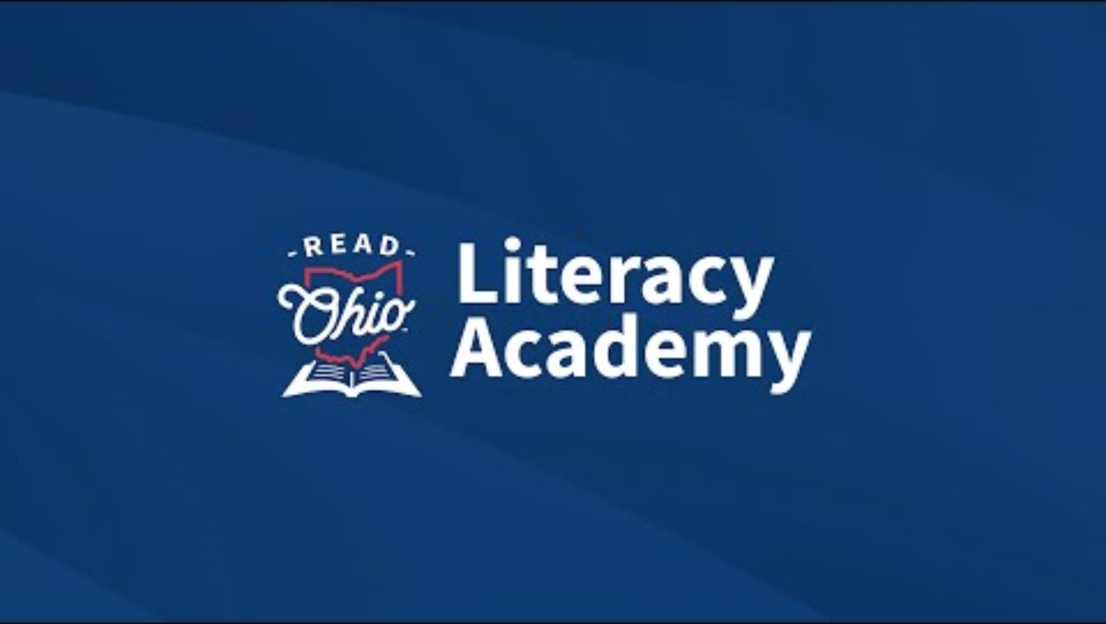
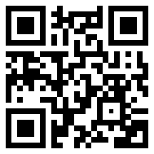
Dotting the “i” in Literacy
ohiofamiliesengage.osu.edu
Go.osu.edu/scienceofreadingvideo
Notes:
Ohio has put together a beautifully done video that shows how they have committed to using the Science of Reading in their schools. In it, you’ll hear from the Kareem Weaver—the film star, community activist, and literacy expert; you’ll hear from the governor, teachers, administrators, and local celebrity advocate Brett Tingley. Brett reminds families of their critical role in advocating for the Science of Reading in their child’s classroom. It is well worth the watch!

Slide 24

Lessons: Preschool
Book words
Rhyming
Syllables
Coloring & writing
Letter names & sounds
ohiofamiliesengage.osu.edu
Notes:
I'm going to show you some videos in a minute to give you an idea of what Structured Literacy looks like in action!
But let me give you a sense of what activities you might see in school at different ages.
Let's start with what this instruction looks like in PRESCHOOL:
In preschool, lessons focus mainly on spoken language and pre-literacy skills.
For example, teachers will read lots of books to kids, getting them familiar with *words that describe books* like: the cover of the book, the title, illustrations, who wrote the book—the author, and showing that we read from left to right by tracing the words as they read the stories aloud. They show kids how books work, how we use them.
Students will also learn lots of nursery rhymes.
Those rhyming stories help children to hear words that are similar like “wall” and “fall”,
Which gives them clues about how letters and sounds work together to build words.
The beat or rhythm in these nursery rhymes also helps children to hear that larger words are broken into *syllables* when we speak, like the word
to-ge-ther. Listen to this:
Hump-ty Dump-ty sat on a wall,
Hump-ty Dump-ty had a great fall.
All the king's horses and all the king's men
Couldn't put Hump-ty to-ge-ther a-gain."
Also, in preschool, kids begin to learn to hold and use a pencil, crayon, or marker and practice *coloring and drawing*.
They will also begin to learn the names and sounds of *letters* and they practice tracing or writing letters and even work on writing their name.

Slide 25

Lessons: Early elementary
Hearing sounds
Handwriting
Letter names & sounds
Read & spell
Sentence structure
ohiofamiliesengage.osu.edu
Notes:
ELEMENTARY school:
In elementary school, kindergarteners and 1st graders will work even more on learning to *hear and repeat sounds in words like syllables and rhyming,
*Letter writing, or handwriting becomes really important in these grades
Practicing good letter writing can help students to learn their letters and sounds better AND
When they can write a letter easily—without thinking—they can then focus on spelling and getting their ideas on the paper.
These students need to learn to what *letters go with what sounds*, such as, the letter <b> says /b/ and <r> says /r/.
They need this because they will start learning to blend sounds together to *read* small words and pull apart the sounds in words to figure out how to *spell* them.
They will start to learn new spelling and sound patterns like when we use the letters: ch, dge, and the silent or sneaky <e>.
AND they will learn the exceptions to those patterns.
Hard-to spell words (sometimes called sight, red, or heart words) will also be taught early in school.
Kids will also start to learn how to read and write simple sentences—learning *sentence structure* (like we showed before with “Bob sits on the step.”).

Slide 26

Lessons: Older students
Longer words
Vocabulary
Understanding
Writing skills
ohiofamiliesengage.osu.edu
Notes:
Older students:
As kids get older, they will learn to read and spell *longer words* using syllables and prefixes, roots, and suffixes.
Teachers will continue to teach new words that kids don't hear a lot in conversation to help them build a big *vocabulary*.
And they will teach students ways or skills to help them*understand* what they read- since they will be reading longer books and reading passages.
In older grades students will keep working on those *writing skills* so they can write sentences, paragraphs and essays with good structure.
Now, let's take a look at some videos that show some of the preschool and early elementary skills in action!

Slide 27
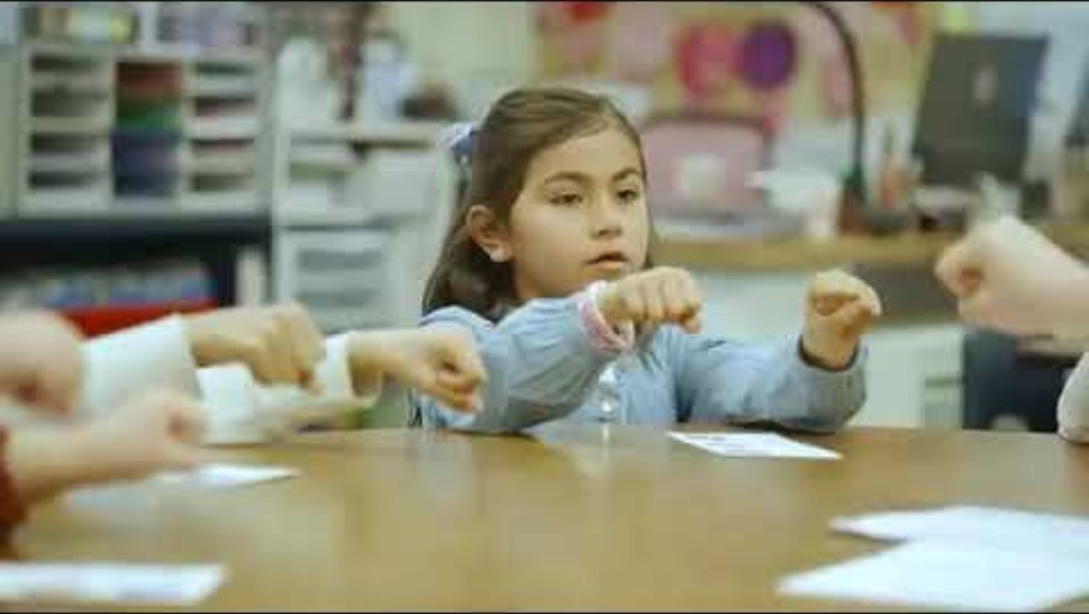
Example: Hearing syllables
ohiofamiliesengage.osu.edu
Notes:
Hearing Syllables
In this video you'll see how a teacher helps students to listen for the "big chunks of sound" in words OR syllables.
Notice that the kids in these videos are using all of their senses: listening, speaking, watching, and using their hands to really engage with the words!

Slide 28
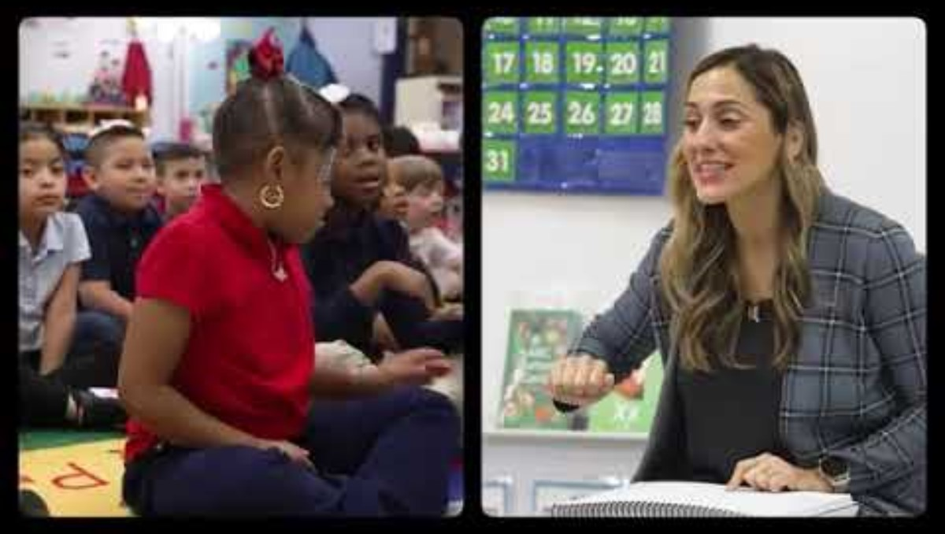
Example: Listening for sounds
ohiofamiliesengage.osu.edu
Notes:
This video is of a whole class and shows lots of ways to help kids hear the sounds in words. (beginning to 1:03)
This teachers helps kids to listen for:
The first sound in a word
The middle sound in a word
How to blend sounds together to make a word (for sounding out when reading)
How to break a word apart into sounds (like you would need to do for spelling)

Slide 29
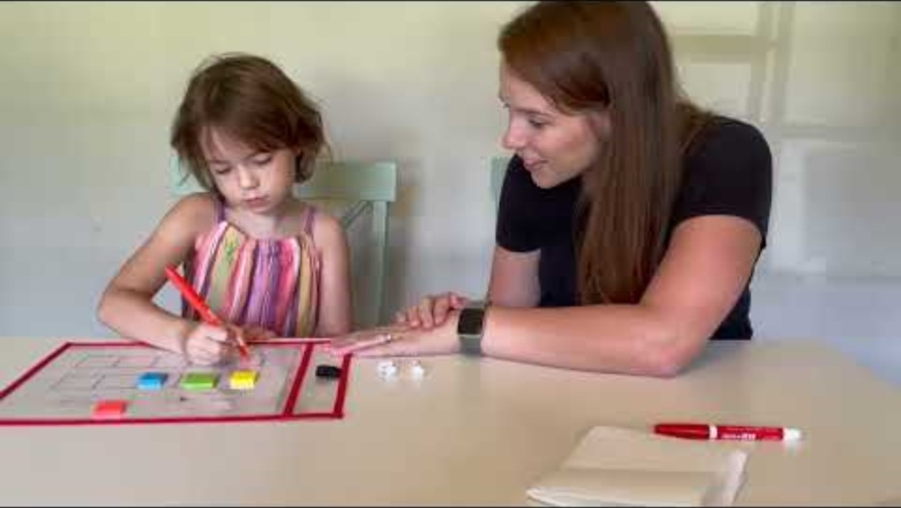
Example: Sounds to spelling
ohiofamiliesengage.osu.edu
https://go.osu.edu/phonemicawareness
Notes:
This video will show you a teacher working
one-on-one with a student as they
listen for the sounds in the word "got" and
write the letter for each sound to spell the word.
Families can do this activity at home with cheerios or any small objects.
Notice that children are taught to use their fingers to "tap out the sounds"

Slide 30
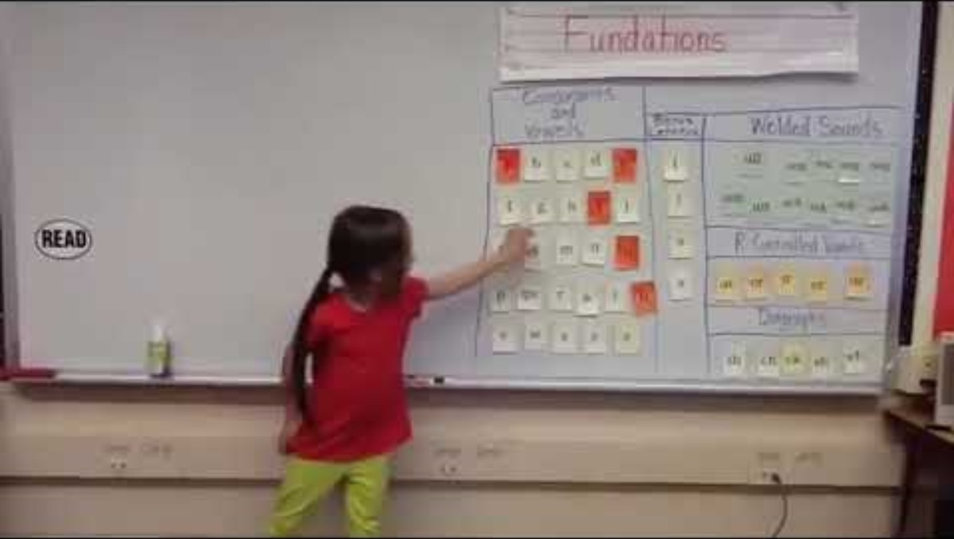
Example: Spelling and syllable type
ohiofamiliesengage.osu.edu
Notes:
This video shows a big classroom lesson with first grade students. In this, the kids are running the show! Together they:
Do a letter-sound warm-up
Practice building a word together
Then figure out the syllable type (which helps them figure out what the vowel sound will be)
You can play with building words just like this at home using:
post its or index cards with letters drawn on them
you can use them to do what you see in the video OR play matching or go fish type games!

Slide 31
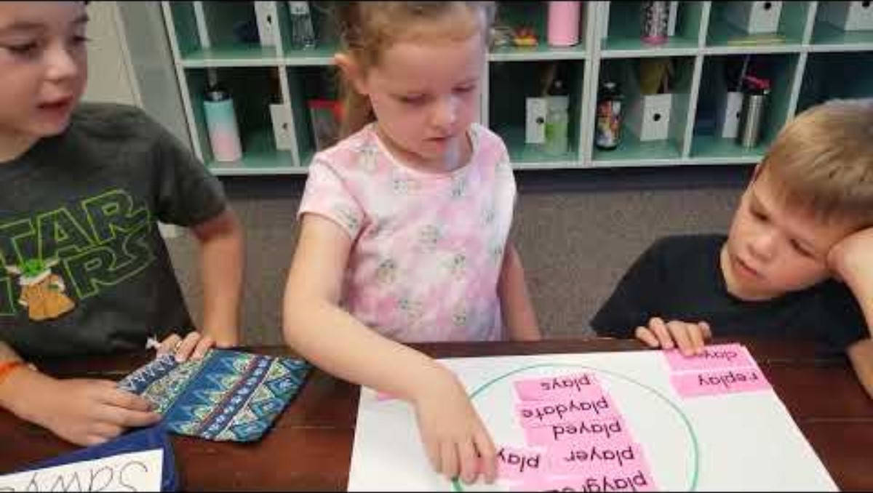
Example: Roots, prefixes, suffixes
ohiofamiliesengage.osu.edu
Notes:
This last video shows three kids sorting words that have some of the same letters.
Here, the teacher is helping the kids to learn to see the larger parts of words that hold meaning—in this case the base or root word.
They are trying to find words with the same root word or base <play>, p-l-a-y.
The little boy on the right will figure out that <play> can be a root word even if there are some letters in front of it...as in "re-play"
The teacher reminds them that what matters here is the meaning of the root word.....
AFTER the video is played:
Being able to "see" or hear the roots, prefixes, and suffixes inside words helps kids to figure out what a word means—increasing their reading, writing, and speaking vocabulary.

Slide 32
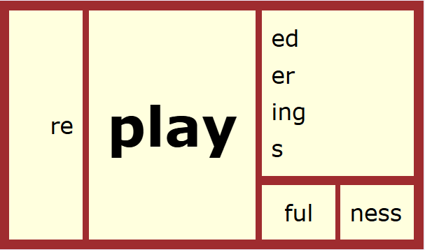
Example: Roots, prefixes, suffixes
How words work
Big words
Meaning
ohiofamiliesengage.osu.edu
Notes:
This is another way teachers show kids how words work* or the structure of words, using prefixes roots and suffixes!
This box is called a "word matrix."
Look how it shows how lots of words can be made with the base <play>
Kids can go from being able to read and write small words like <play> to reading and writing really big words* just by knowing word parts.
If you know the larger parts of words, a big word, with say 11 letters, like playfulness, now looks like just 3 parts instead of 11 separate letters—not so scary, right?
AND
As kids are taught the meaning of the parts*, they can figure out the meaning of words that they've never seen or heard before!
Like what if I said this pretend word to you: re + sing + able. Could you figure out what it means? re-sing-able.......
It would mean: able to be sung again
Kids suddenly can figure out how to read and write lots of big words and understand what they mean when then learn the structure of words in this way!
Instead of sounding out each letter, they learn to look for these bigger chunks that have meaning. This makes reading and understanding new words much faster and easier!
What we've shown you so far, are some examples of what structured literacy looks like in schools. Now let’s talk about what little things that we, as families can do at home to help our kids!

Slide 33

At Home
Talking & Reading
Play with letters
Writing stuff
Audiobooks
Decodables
Notes:
At home, our families can be a great help to our kids as they learn to read and write.
It is really fun and special to share moments of new learning with our kids! Here are some little ways that might be able to support their reading and writing. Some ideas might be:
As simple as *talking with your child, having good conversations. Remember, listening and speaking are the foundation skills for reading and writing. Encourage them to ask questions. Conversations will help them learn new words, new sentence structures, and knowledge about the world that will help them to understand things that they read.
If you can, read to your child, you could read them just stuff that's around, like the back of the cereal box, signs, the menu at a restaurant, or books; OR If reading is difficult for you, there are lots videos online of people reading children's books . You could ask your child's teacher if they have a favorite YouTube channel or storyteller they would recommend for your child's story time.
Another idea might be to make some kind of letter cards or Post-its like we mentioned earlier so you can just *play* around with letter sounds, building words, and you can even make up your own matching or any other kind of letter games!
Also, having *writing materials* like markers, crayons, pens or pencils, and any kind of paper just around the house encourages writing and spelling. Our kids can help us make a list, or we can write notes to each other, or they keep a journal of ideas, or a diary! AND Writing tools make great gifts for children too.
AND this one is great! *Audiobooks*! Audiobooks are just the sound recording of someone reading a book. The library has lots of these we can get for free. We can play them from our phone—in the car or around the house. Audiobooks make it so kids can hear lots of new words, build a strong vocabulary, and learn about the world!
Lastly, as they are learning to read, try and find what are called *"decodable books"* for early readers or readers that need more practice reading specific kinds of words.

Slide 34

Decodable Readers
Match skills
Follows a list
Lots of practice
Builds confidence
Ask the teacher
Notes:
What are decodable books?
Decodable books are great because they *match* the words in the books with what your child is learning in school.
The books often come as an entire set of books, and that set will *follow a list*, like the ones the teachers are using at school for spelling patterns.
So, early books in a book set will use simple spelling patterns or simple words like "dog“, and books later in the series might use words like "howl“, or even later books in the series might use longer two syllable words like "playful".
So, if your child is working on or needs extra practice reading say short "i" words, you can choose the book in the set that focuses on short "i" words. And that story will have all sorts of short "i" words like:
It might tell a story about a pig and the pig's name is Tim. And use words like hip, him, lip, dig, or rip,
So, your child will get *lots of practice sounding out* and reading short "i" words!....really building up their skills to read those words all by themselves!
The other thing that makes these books so great, is that they won't use words that kids haven't learned yet.
So, these books are great for *building their confidence*- making sure they have a positive reading experience!
It can be really frustrating for them if they are trying to read a book full of words that they don't know how to sound or read out yet.
Decodable books will, however, carefully introduce one or two of those hard-to-spell or read words at a time for your child -which is a good thing!
So, like I said, the order that these books introduce words will follow a list or structure similar to what the teachers are using at school.
So-Ask your child's teacher* exactly what spelling patterns your child can read and what skill they're working on now.
Your child's teacher can help you find just the right book for them.
AND teachers really love to have this "at-home" support from families!

Slide 35

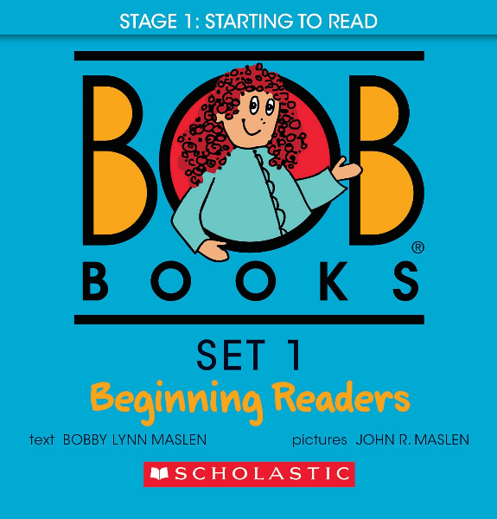
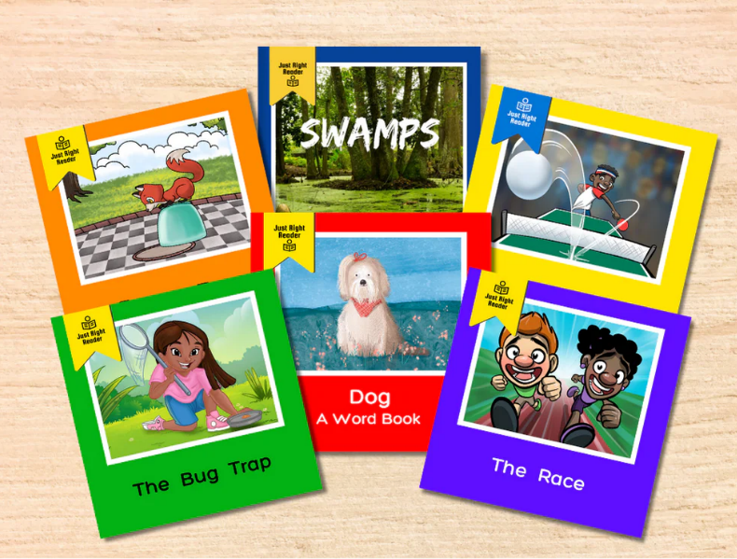
Activity: Share Decodables
Notes:
We’d love for you to enjoy a stretch break for about three minutes now, as we give you the chance to see what decodable books look like and how they follow a list of reading skills. So, we’ll show some books as well as the skills lists for those book sets and give you a chance to look them over, ask any questions you may have, and connect with others in the room.

Slide 36
Figuring Out New Words
Sound it out (tap it out)
C
a
t
First syllable; Second syllable
r o
b o t
Prefix
re
Base
play
Suffix
ing
Prefix, base, suffix
ohiofamiliesengage.osu.edu
Notes:
When your child is reading a decodable book, or any other book, at some point they'll come across a word they don't know.
At school, kids learn different ways to figure out how to read new words.
If they get stuck at home, you can remind them to use these skills.
For example, if your child comes across a short word they don’t know, like "cat," you can gently say,
*“Sound it out” or “Tap it out” to help them think of the letter sounds they know, like:
“c-a-t” (2X)….Saying the sounds in order a few times in a row can often help them to blend the sounds together and hear what the word is.
For bigger or longer words, it can be hard for kids, and they might try to guess because sounding out a lot of letters in a row can be too much to keep track of.
So, if they come to a larger word like "robot," you can remind them to just look at the first part of the word by saying:
“what's the *First syllable?- or just "first syllable?"” They can even cover the second part with their finger to get it out of the way while they focus on the first part.
Once they've got the first syllable, you can say, “Second syllable” and then have them put the parts together, like this:
*"ro-bot."
Another way to help with longer words is to remind them to look for a *prefix, base, and suffix.
This way, they’re not trying to read the whole word at once, just one part at a time.
For example, if they see a word like "re-play-ing," you can ask:
“Do you see a prefix?”...*re-
"A base or root?" …..*play,
"suffix?"….* ing "
"put it together"...replaying
These skills work for spelling too! For short words, saying "Sound it out" or "tap it out" works well. For longer words, they can spell by listening for the larger parts of the word.
You can ask, "Do you hear the first syllable?" or "Do you hear a prefix or base?"
And just have them spell one part at a time.
This way, your child can use all the big words that they know in their writing!
As a family, these little gentle reminders of the "structure of words" can help kids to practice using the skills they learn at school from the Structured Literacy Approach. This extra practice will help them to become really strong readers and spellers!

Slide 37

Questions to Ask
Approach
Programs
Direct instruction time
Small groups
Ask the teacher
Notes:
Now, in 2019, most teachers weren’t using the Science of Reading, and instead, they were still relying on other methods to teach reading and writing.
Even now, according to the latest reports, only about one-third of students are reading and writing at grade level.
The good news is, many states, including Ohio, have laws and programs to teach reading more effectively with the Structured Literacy approach!
There is still a long way to go, so it's really important that families speak up and take part in making sure that kids get good reading and writing instruction.
SO, to help you partner with the school and your child's teacher even more,
Here are some ideas for questions to ask to get the conversation started.
You might ask things like:
What *approach do you use to teach reading and writing (it should be a structured literacy approach)?
You could ask: What *curriculums or programs are you using (there might be more than one – are they on the approved list)?
AND How much time do you get to spend giving direct instruction using those materials?
Lastly, Is my child in or a part of any small groups for reading or writing? AND what types of things are they working on in those groups?
It's good to ask specific questions about where your child is in their learning and if they are on track to meet grade level goals.

Slide 38

Questions: Early readers
Handwriting
Letter-Sound
Sound-out & Spell
Hard-to-spell
Notes:
Specific questions for early readers and spellers might be:
How is their *handwriting or letter formation (is it automatic and smooth yet?),
How are they doing with hearing sounds and syllables in words....with rhyming?
What *letter-sounds do they know so far?
Also, are they able to *read small words by sounding them out?
And are they able to spell those same small words?
Also ask: What *hard-to-spell words do they know so far? (these also called red words, high frequency, or sight words)
For each of these questions. Ask if they are having trouble with any specific letters or types of words.
A good idea might be to ask the teacher for a copy of the lists they are using, so you can keep track of exactly where your child is doing well or needs more practice.
Finally, we can ask the teacher for ways we can help at home.
They'll really appreciate the team effort!

Slide 39

Questions: More advanced readers
Larger words
Syllables
Roots, prefixes, suffixes
Writing
Understanding
Notes:
Specific questions for families with older readers and writers might be:
How is my child doing with reading and spelling *larger words OR are they still struggling to read and spell some smaller words?
What *syllable types have they mastered—and are they having trouble with any?
Again, considering older students are being asked to read and write bigger words, maybe ask: What *roots prefixes and suffixes they've learned, AND How are they doing reading and spelling those larger word parts?
And the writing assignments get harder as they get older too, so ask:
What *writing skills are they working on?
Are they remembering to capitalize and punctuate their sentences?
Are they having trouble with sentence structures or trouble writing longer papers?
Lastly, older students are asked to read longer and harder books and reading passages. SO, it would be good to ask:
Are they *understanding what they read when they are given grade-level stuff?
Teachers in the older grades still have lists to follow for teaching using the Structured Literacy Approach so
Again, a good idea might be to ask the teacher for a copy of the lists they are using, so you can keep track of exactly where your child is doing well or where they might need more practice.
Teachers enjoy working with families, and when parents and teachers talk about how kids are learning, research shows that students do much better in school.

Slide 40


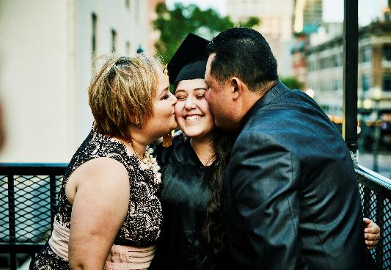


Families and Schools
Notes:
You are an important part of your child's reading and writing success. We want you to know:
what is being taught at school,
how your child is doing, and
how you can support your child at home.
There is great evidence that shows that the more families and teachers talk and work together, the better the kids do!
We invite and encourage you to talk with your child's teacher regularly.
You have the power to make a huge difference in your child's education.

Slide 41

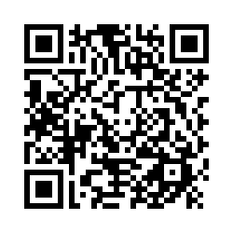
We’re so glad you came!
What did you think?
go.osu.edu/SFECfamilysurvey
Notes:
It was lovely to see everyone today. Thanks for coming out! We would love to hear what you thought of the workshop! The Statewide Family Engagement Center loves feedback! It is important to all of us that we offer resources and events that help families like yours. So please take a minute to fill out this short survey. Your comments are very important to us. And when you’re done filling out the survey, please feel free to stay after for a while to talk and connect more with other families and staff.
go.osu.edu/SFECfamilysurvey

