Slide 1
Welcome
We are committed to
BUILDING STRONG
family, school and community
PARTNERSHIPS
TO SUPPORT EACH STUDENT.
in partnership with
Notes:
0:00
Welcome and introductions
Start recording
Remind about notecatcher

Slide 2
Network of Partnership Schools
Colleague Connect
Barbara Boone, Ph.D.,
Director, Ohio Statewide Family Engagement Center
The Ohio State University
Notes:
1:00-1:01
Welcome!
Share a GIF, me, or emoji that represents how the start to the school year has been for you.

Slide 3
What's On Your Mind?
What color or number would you assign the start to your school year? Why?
3
2
4
5
1

Slide 4
Same/Different
Same
DIFFERENT
Evidence-based model
Johns Hopkins University
Handbook
6 Types
Overlapping Spheres
School Teams
Focus on schools serving less advantaged families
Delivery model
Flexibility: anytime October 1 – June 30
School leader & emphasis on team
One Year Action Plans are submitted on a rolling basis for new schools (after module 4) and for existing schools in the spring (via Spring surveys from OSU)

Slide 5
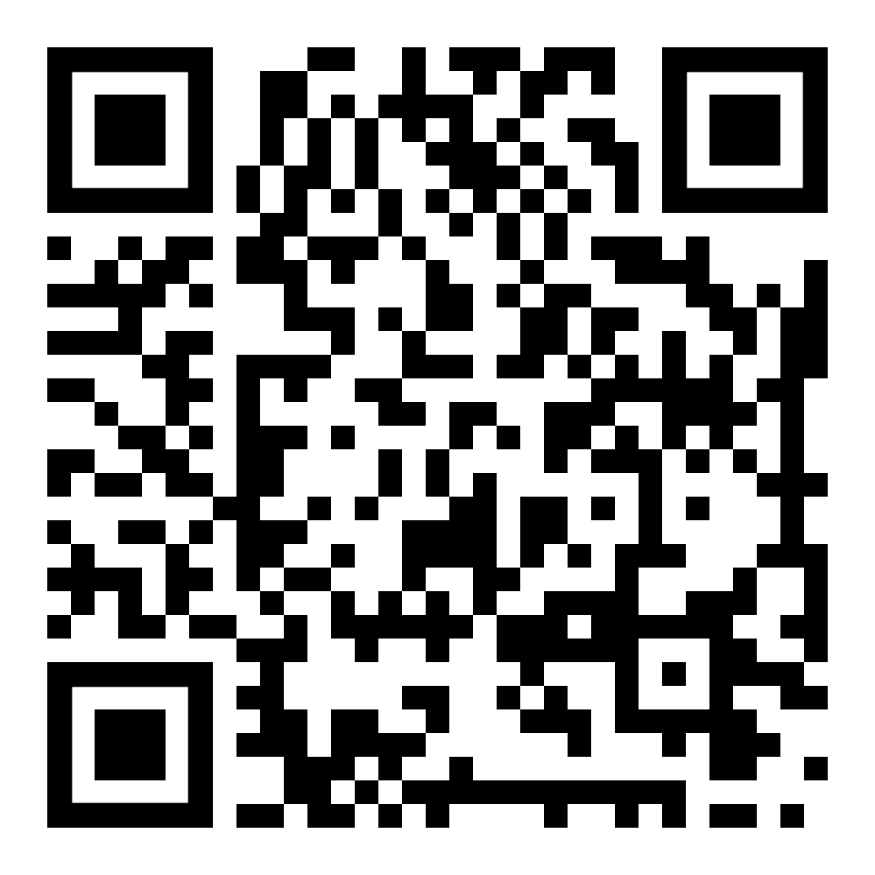
New! Website
Access to Modules
New School registration
Promotional flyer
Handbook Materials (from the CD)
Other Resources
ohiofamiliesengage.osu.edu/networks/
Notes:
11:47-11:52
Switch to sharing website page: https://ohiofamiliesengage.osu.edu/networks/
The CD is available at https://resources.corwin.com/partnershipshandbook
Also tell them they can search ONPS

Slide 6
Congratulations!
Featured Summit Speakers:
Licking Heights
Starting Point
Akron Public Schools
Mansfield City Schools
Shaker Heights Schools
Johns Hopkins University

Slide 7
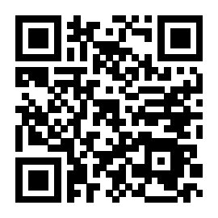
Family Leaders for Ohio Schools Academy
A free five-month program for up to 30 parents of school-age children
WHEN?
January – May 2025
Three in-person meetings in Columbus, Ohio
Two online meetings
Four learning modules with assignments
Local school project
Apply by October 25, 2024
BROUGHT TO YOU BY:
Visit:
go.osu.edu/familyleadersacademy
Notes:
Hot off the presses. Family Leaders for Ohio Schools Academy application is now open! Post in chat! https://go.osu.edu/familyleadersacademy
We would like to give our council members priority to apply for this opportunity as many of you were vital in providing feedback in its development.
We encourage all of you that work with families in your organizations to also share opportunity and application.
Kristin will send a follow up email after this meeting with a flyer and promo slide that you can share with others.

Slide 8
Join Us for NEW Webinars!
First Webinar: October 15, 2024
http://go.osu.edu/howtoengagemultilingualfamilies
Notes:
http://go.osu.edu/howtoengagemultilingualfamilies

