Slide 1
WORKSHOP FOR DISTRICT LEADERS FOR SCHOOL, FAMILY, AND COMMUITY PARTNERSHIPS
April 19 and April 21, 2021
Ohio State Family Engagement Center (OhSFEC)
Live-Online ZOOM Workshop
Facilitators
Dr. Joyce L. Epstein, Director, NNPS
Dr. Barbara J. Boone, Director, OhSFEC
© Johns Hopkins University, 2021

Slide 2
District Leaders Workshop
TODAY, we will focus on YOUR LEADERSHIP on
School, Family, and Community Partnerships.
At the end of this training, you will be able to:
Describe the roles and responsibilities of
leaders for partnerships at the district level.
Select strategies for effective leadership and facilitation on partnerships for YOUR location.
Draft YOUR Leadership Plan for Partnerships
for the 21-22 school year.
Provide your plan to your SST Coach.
Identify NNPS resources to help you with your work.

Slide 3
NEXT WEEK, we will prepare your
schools’ to strengthen their programs with
the NNPS One-Day Team Training Workshop.
YOU are your district’s expert on partnerships.
By attending next week with your project
schools, you will know how to guide them
(and other schools) to use research-based
structures and processes to ensure effective
and equitable programs of family and
community engagement.

Slide 4
The research base—
Why is it important to have LEADERS
for Partnership Program Development?
Research shows that:
When district leaders provide training
and facilitation to schools’ Action Teams for Partnerships, their schools:
Have higher quality partnership programs.
Address more challenges to involve all
families, including those who are
typically “hard to reach.”
Source: Epstein & Sheldon, 2016; Epstein, Galindo, & Sheldon, 2011. See summary in notebook pocket.
Notes:
Critical role of district leadership
Purpose of the training

Slide 5

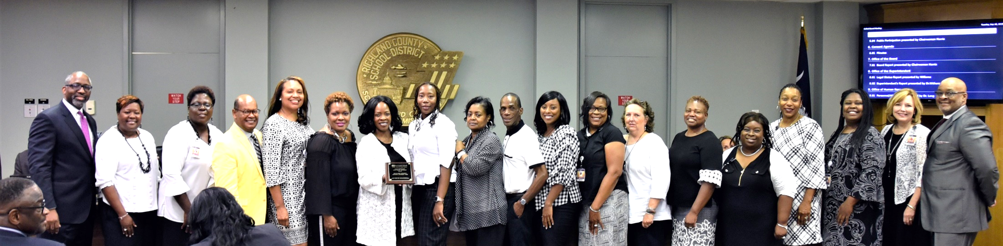
Leaders for Partnerships
Part 1.
Roles and Responsibilities
Richland School District One, 2019
Richland, SC

Slide 6
What’s in a name?
A DISTRICT FACILITATOR
FOR PARTNERSHIPS
and
KEY CONTACT to NNPS
is a specialist who will lead the agenda for partnership program development in their location,
and
directly facilitate schools to help them strengthen their
school-based programs and practices of family and
community engagement.
NOTE: Regional SST Coaches will
facilitate DISTRICT leaders’ work and progress.
Notes:
Shakespeare: That which we call a rose by any other name would smell as sweet.

Slide 7
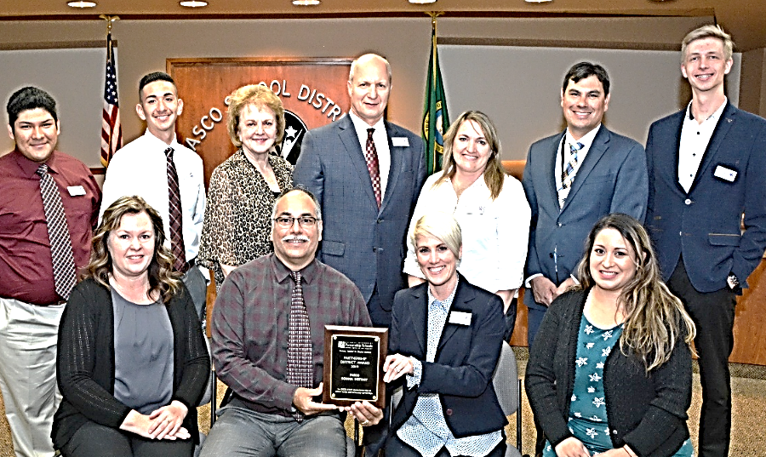
District Leaders for Partnerships
Have TWO Major Responsibilities
Conduct Leadership-Level Activities
on Family and Community Engagement
PARTNERSHIP
PROGRAM
GOALS
FACILITATE schools’ Action Teams
for Partnerships (ATPs)
Pasco School District, 2019
Pasco, Washington

Slide 8
REGIONAL SST Coaches for Family and Community Engagement
How does “NESTED” Leadership
Promote Successful Partnership Programs?
WHOSE RESPONSIBILITY IS IT?
District Leaders for Partnerships
School-based programs of partnership
Improve and increase
goal-linked engagement of all parents
and selected community partners
More successful students.

Slide 9
District Leadership-Level Activities
Your expertise at the district level.
Review and discuss the district’s official policy on family
involvement
Conduct staff development on partnerships
Conduct workshops for parents
Make other presentations on partnerships
Update partnership information on your website
Coordinate an Advisory Council on family and
community engagement
Collect and share best practices for schools
Conduct OTHER leadership activities on partnerships (Share YOUR examples)

Slide 10
District Leader’s
Activities to Facilitate School ATPs
❑ Conduct the NNPS One-Day Workshop for Action Teams
for Partnerships (ATPs).
Make monthly or weekly contact with school ATPs.
Check in with ATP Chairs/Co-Chairs about planned
activities.
Hold quarterly cluster meetings for ATP Chairs.
Schedule an annual meeting with each principal.
❑ Convene end-of-year celebrations for ATPs to share best
practices, discuss challenges, and write next plans.
Guide ATPs to evaluate programs and progress.
❑ Facilitate schools in OTHER ways to help them improve
their partnership programs. (YOUR examples)

Slide 11
Zoom Room
Activity 1 A and 1 B
With Your ZOOM partners:
Check list: Quickly check the boxes in
Activity 1 A and 1 B to show:
Which activity do you do NOW? Mark with a ✓
Which activity would you like to do? Mark with a ?
What other activities do you conduct NOW as a
district leader for partnerships?
2. If you have time before returning to the
main room, discuss activities on 1A and 1B
that you want to improve as the OhSFEC
project proceeds.
Your group will have 15 minutes for this activity.

Slide 12
NNPS Expectations for
Leaders for Partnerships
One FTE Facilitator can guide up to 30
school-based Action Teams for Partnerships (ATPs).
Part-time Facilitators work with a proportional
number of school ATPs.
Write and implement an annual Leadership Plan
for Partnerships.
Have a budget for staff (salaries and benefits)
and program activities.
EVALUATE the quality and progress of partnership programs each year. NNPS helps you conduct annual evaluations—a unique member-benefit.

Slide 13
Administrative Support
Leaders for Partnership do more and better
with support from:
Superintendent
Other Administrators
School Board
Official Policy
Building Principals
Others?

Slide 14

Collegial Support
Leaders for Partnership do more and better
with INTERDEPARTMENTAL support from:
Title I – Federal Programs
Curriculum & Instruction
ESOL/Bilingual
Special Education
Social Work / School Psychology
Student Services
Research/Evaluation
Business Roundtable
Other Departments
or Programs?

Slide 15
MAJOR SOURCES OF FUNDS for Partnership Programs
Title I and other “Titles” [II, III, IV, V, IX]
Curriculum and Instruction
Bilingual Education
Special Education
General Funds
State Programs and Grants
Superintendents’ and Principals’
Discretionary Funds
Foundation Grants
More Ideas—see NNPS Handbook, Chapter 7
In ESSA: Title I-Basic Programs; Title II-PD-Training Teachers/Principals; Title III-ELL
Title IV-21st Century Schools; Title V-Innovation/Local Flexibility; Title IX-Homeless +

Slide 16
Path to An Excellent District Partnership Program
Financial Support
Administrative
Support
NNPS
An Excellent
District Program
What support do you have in YOUR district or need to build?
Collegial Support

Slide 17

10 Minute Break

Slide 18
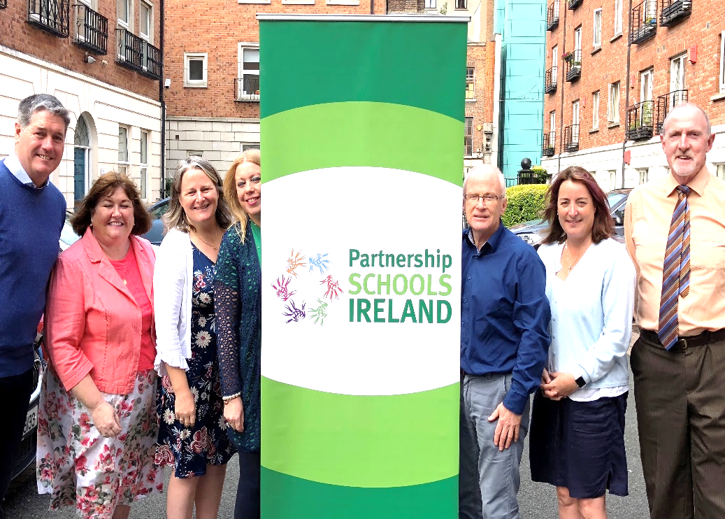
PART 2.
LEADERSHIP and FACILITATION
STRATEGIES for School, Family, and Community Partnerships
National Parent Council Primary
Partnership Schools Ireland, 2020
Dublin, Ireland

Slide 19
Leadership & Facilitation Strategies
Create awareness
  Actively promote your partnership program with key
  stakeholders. Share your own, NNPS, and OhSFEC
  websites to show that you are using research-based
  approaches.
Align program & policy
  Show how official policies, priorities, “pillars” and
  Strategic Plans are supported by your leadership and
  programs of partnerships.
  Help schools link partnership practices to school goals
  for student achievement and behavior, and to the school
  climate for good partnerships.
Guide learning & program development
  Conduct the NNPS One-Day Team Training Workshops
  for schools’ ATPs. Conduct “refreshers,” and other
  professional development activities on partnerships.

Slide 20
Leadership & Facilitation Strategies continued
Share knowledge
  Communicate on a regular schedule with SCHOOL ATP
  chairpersons and team members to increase knowledge
  about effective partnership programs.
  Collect best practices and network with others—locally,
  nationally, and internationally.
Celebrate milestones
  Recognize progress and excellence.
Document progress & evaluate outcomes
  Evaluate teamwork, program quality, and progress.
  Keep records of plans, activities, and evaluations.
  Work with NNPS to conduct annual evaluations.

Slide 21
LEADERSHIP AND FACILITATION STRATEGIES
Create Awareness
  Actively promote your partnership program to key stakeholders.
NEWS You Can Use – E-forms
Bridgeport School District
Bridgeport, Connecticut
Promising Partnership Practices, 2016
See more examples of district leadership and facilitation in NNPS’s books of
Promising Partnership Practices, www.partnershipschools.org, in Success Stories.

Slide 22

Align Program and Policy
We Are a STEM Family
Pasco School District
Pasco, Washington
Promising Partnership Practices, 2016

Slide 23
Guide Learning and
Program Development
  Conduct One-Day Team Training Workshops for
  schools’ ATPs and on-going professional development with school teams.
ESSENTIAL One-Day Team-Training Workshop
for School-based Partnership Teams
Conducted by District Leaders
Your Handbook for Action 4th edition, 2019

Slide 24

Share Knowledge
  Communicate with school teams on a regular schedule. Conduct well-planned meetings to discuss successful activities, challenges to solve, and new knowledge. Network with others locally and nationally.
Cluster Busters: Keep Teams Engaged
Saginaw Public School District, MI
Promising Partnership Practices. 2017

Slide 25

LEADERSHIP AND FACILITATION STRATEGY Celebrate Milestones
  Recognize progress and excellence.
PPP
2021
YOUR BOOK of
Promising Partnership Practices
Many districts and organizations in NNPS create a collection.
Glow and Grow: An End-of-Year Celebration
Middletown Public Schools, CT
Promising Partnership Practices, 2009

Slide 26
LEADERSHIP AND FACILITATION STRATEGY Document Progress and Evaluate Outcomes
Evaluate teamwork, family and community involvement activities, quality of district and school programs. Assess progress on YOUR office’s leadership for partnerships.
Evaluate:
Guide schools to use: Annual Evaluation of Activities
(chapter 9 in Handbook)
NNPS will conduct: Annual UPDATE surveys
to renew membership

Slide 27
An Excellent Program of Partnership
will work at the leadership level
and with all school ATPs to . . .
Lead Your Location
Create Awareness
Align Program & Policy
Celebrate Milestones
YOUR
PROGRAM
GOALS
Share Knowledge
Guide Learning
Document & Evaluate
Facilitate School ATPs
Questions about these
Leadership Strategies?

Slide 28
Explore
Leadership Plans

Slide 29
ZOOM ROOM Activity 2
Explore Leadership and Facilitation Strategies
1. Select a RECORDER to write your group’s ideas
2. Consider YOUR district and schools in the
OhSFEC project.
On the Lead and Succeed Inventory (Activity 2),
see the MOST ESSENTIAL LIST of activities for the
21-22 school year. You cannot do them all.
Which activities will help you strengthen leadership
and guide YOUR schools to implement effective and
equitable partnership programs.
With your ZOOM partners, agree on activities
you want to conduct in the 21-22 school year.
* Look over the list of leadership and facilitation
strategies.
* Check ✓ at least ONE activity for each strategy.
* Select NO MORE THAN 14 activities TOTAL.
You will have 25 minutes
to come to a consensus on a proposed plan.

Slide 30
“Pluck” ONE Important Activity to Explain
Which activity did you and your ZOOM partners think is most important to conduct in the 21-22 school year and why?
1: Create awareness
2: Align program and policy
Guide learning and
program development
4: Share knowledge
5: Celebrate milestones
6: Document progress &
evaluate outcomes
3:

Slide 31
DRAFT YOUR 2021-22
LEADERSHIP PLAN FOR
PARTNERSHIPS
Activity 3 for this Workshop
Page 1: Leadership Activities
Page 2: Facilitate Your Schools’
Action Teams for Partnerships
* Check activities 1A and 1B.
* Check your ZOOM Room Activity 2 for your
selection of essential activities.
* See the full Lead and Succeed Inventory
* See the resource: What DO Facilitators DO?

Slide 32
Page 1

Slide 33
Page 2
Use the CONTINUATION PAGES to list more activities!

Slide 34
YOUR HOMEWORK (REQUIRED)
Complete YOUR Leadership Plan for Partnerships for 2021-22.
E-Mail a copy of YOUR
Leadership Plan for Partnerships for 21-22
to your SST Coach.
See IMPORTANT REMINDERS from OhSFEC, coming up.

Slide 35

5 Minute Quick Stretch

Slide 36

Whole Group
Activity 4
Think Quick!
COMMON CHALLENGES
FACED BY FACILITATORS
WHAT WOULD YOU DO??
Here are 8 common challenges that district facilitators have faced.
Think Quick!
How might you solve this challenge?
Select challenge and THINK QUICK.
Volunteer in chat box to share an idea.

Slide 37
FOLLOW UP
How can NNPS help YOU Lead and Succeed?
Share the NNPS website as a useful resource:
www.partnershipschools.org
Participate in quarterly calls from an NNPS Facilitator.
Read NNPS monthly E-Briefs and occasional E-Alerts.
Check that NNPS e-mail is approved by IT for delivery.
Call or e-mail an NNPS facilitator, coordinator, or
researcher at any time.
(On-call Technical Assistance is a member benefit.)

Slide 38
What Does NNPS Ask of
District Leaders and Their Schools?
Use the NNPS approaches.
Implement research-based structures and processes.
Tailor practices to fit YOUR local needs and goals.
Participate actively. Write annual plans for partnerships, implement activities, evaluate activities, return UPDATE, submit Promising Partnership Practices, and aim for NNPS
Partnership Awards.
EVALUATE progress on the NNPS annual,
end-of-year UPDATE survey. Renew membership
($250) each year to continue benefits and services.

Slide 39
Let’s Check the Goals of This
Leadership Institute: YES or NO?
Are you able to. . .
Explain the NNPS model?
Describe the roles and responsibilities of a District Facilitator for Partnerships?
Select strategies for effective leadership and facilitation on partnerships for your location?
(Next Step) Draft YOUR Leadership Plan for 21-22?
Identify NNPS resources to help you with your work?
NEXT WEEK, you will learn to conduct the NNPS
One-Day Team Training Workshop. You will be able to
conduct the NNPS workshop if your project schools need a “refresher,” or with additional schools in YOUR district’s network linked to NNPS.

Slide 40





NNPS PUBLICATIONS
From Corwin Press
From Corwin Press
2009
From Taylor and Francis
2012
4rd Edition and CD 2019
From Taylor and Francis
2nd Edition, 2015
TEXT, SECOND EDITION
Westview Press-2011

Slide 41


MORE NNPS PUBLICATIONS
FROM NNPS
2020
FROM NNPS
(18 Booklets)
FROM NNPS
SAMPLERS
Summary of Research & Sample Engagement Activities
READING, MATH
SCIENCE, WRITING
ARTS, HEALTH,
ATTENDANCE, BEHAVIOR, HOMEWORK, TRANSITIONS, FATHERS
COLLEGE and CAREERS,
PRESCHOOLS,
MIDDLE SCHOOLS,
HIGH SCHOOLS
GRANDPARENTS,
SUMMER LEARNING,
TESTS & ASSESSMENTS
Interactive Homework
Elem Literacy K-3
Math K-5
Middle Grades
Language Arts 6-8
Science 6-8
Math 6-8
See TIPS RESOURCES
on the
NNPS website
2018
NNPS Member-Only Code: 21NNPSmem

Slide 42
?
?
Q & A

Slide 43




Connect with NNPS!
www.partnershipschools.org
https://www.facebook.com/partnershipschools
E-mail: nnps@jhu.edu
https://twitter.com/NNPS_JHU

Slide 44
Connect with Us!
Ohiofamiliesengage.osu.edu
Twitter: @OhioEngage
Email: OhioSFEC@osu.edu

