Slide 1
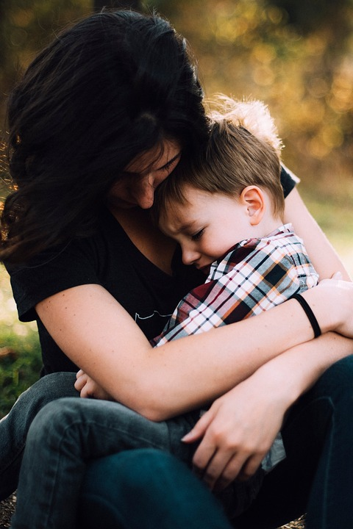
Family Engagement Within Trauma-Informed Schools
Partnering with families of Elementary School children who have experienced trauma
May 2019
Notes:
Presentation Guidance for Facilitators
Audience: This presentation was designed to be given to elementary school staff (leaders, teachers, other staff) seeking to have methods of support to offer families when their children experience trauma. It is a training that complements, but does not replace, a trauma-informed classrooms/school training.
This presentation was designed to be about 1 hour long.
Handouts should be given to attendees:
“Family Engagement within Trauma-Informed Schools” Handout
“Be Ready with Resources” Handout,
“Family Engagement within Trauma-Informed Schools: Self-assessment Activity” Worksheet
“NCTSN Self-Care for Educators” Handout
“Taking Care of Yourself” Checklist
Facilitator Notes for Slide 1:
Welcome everyone, do introductions if needed.
Let participants know that this is sensitive material to be covered. They can share as much or as little as they would like.

Slide 2
Why
66%
“When young children are exposed to a traumatic event, they depend on adults, especially their parents, to protect them and to make sense of the world for them. However, loss of trust in adults and new fears are common after traumatic events. Parents need to be able to listen to their children and hear their concerns. They also need to help them feel safe. If parents are traumatized, it is important for them to find support for themselves and to reach out to others for support for their children.” - Joy D. Osofsky, Ph. D.
of children have experienced a traumatic event by the time they turn 16
Notes:
Facilitator Notes:
Ask participants about why they think it’s important to engage families when children are exposed to trauma
Link for Quote: https://rems.ed.gov/docs/SAMHSA_HelpingYoungChildrenFamiliesCope.pdf

Slide 3
Today’s outline
What is Trauma?
What is Trauma-Informed Care?
Why is Family Engagement in times of trauma Important?
How can we support families when their children have experienced trauma?
What information can we share with families about trauma and how to support their child?
Resources for Families
Questions
Notes:
Facilitator Notes:
Have participants review the agenda or read it out loud.

Slide 4
What is Trauma?
An event, series of events, or set of circumstances that is experienced by an individual as physically or emotionally harmful or life threatening and that has lasting adverse effects on the individual's functioning and mental, physical, social, emotional, or spiritual well-being
- SAMHSA, 2018
A trauma is a scary, dangerous, or violent event that can happen to any or all members of a family - National Child Traumatic Stress Network, 2011
Notes:
Facilitator Notes:
Have all participants read one of the definitions out loud.
Make the point that a trauma could have occurred in the past or recently.
Optional Information to Share:
Four main types of trauma are Acute Trauma (single event), Chronic Trauma (war, poverty, repeated abuse, homelessness), Traumatic Grief, and Complex Trauma (layered or multiple).
Children can experience trauma directly or indirectly.

Slide 5
Trauma examples
Accidents/Injuries | Serious Illness | House Fires | Crimes
Community Violence | School Violence | Sudden loss of a loved one | Combat injuries or death of a family member
Domestic violence | Abuse/ Neglect | Homelessness | Bullying
Natural Disasters | Acts of Terrorism | Living in or escaping a war zone | Stress
Notes:
Facilitator Notes:
Trauma comes in many shapes, sizes, and forms. Read off a few examples.
Ask participants: Does anyone have additional examples?

Slide 6
What is Secondary Traumatic stress?
Secondary traumatic stress is the emotional duress that results when an individual hears about the firsthand trauma experiences of another.
- National Child Traumatic Stress Network
What is Secondary Traumatic stress?
Notes:
It’s important to acknowledge that working with children and families who have experienced trauma is hard. It is important to take care of yourself first before trying to assist others.
NCTSN’s Secondary Traumatic Stress Speaker Series provided these four thoughts for caregivers to remember:
Giving to others gives us a sense of satisfaction, but we must be sure to give to ourselves as well
When we take care of ourselves we are better caregivers to others
It is our responsibility to our students to take time to rejuvenate ourselves
Setting healthy, realistic limits for ourselves and others ensures a more relaxed and mutually supportive environment
Facilitator notes: Pass out / Direct participants to the “Self-Care for Educators” handout and “Taking Care of Yourself” checklist
An additional handout titled “10. Secondary Traumatic Stress Handout” is included in the toolkit and is intended for building administrators / leaders

Slide 7
What does trauma look like
Preschool and Elementary Students (may):
Show fear of separation from caregiver
Cry or scream a lot
Eat poorly (lose / fail to gain weight as expected)
Feel guilt or shame
Lack Focus
Have issues with sleep (too much/too little, nightmares)
Show a significant behavior change
Flinch or startle easily
Notes:
Facilitator Notes:
These are mostly externally visible symptoms.
Ask: What are some effects of trauma that you might not be able to see?
Ask: What are other symptoms you’ve seen or experienced?
Additional Information to share:
Symptoms can be physiological, behavioral, cognitive, and/or emotional.

Slide 8
Six Principles of Trauma Informed Care
1 | Safety | Make sure students and families feel physically and psychologically safe.
2 | Trustworthiness and Transparency | Be as honest as possible. Cultivate a trusting relationship by listening closely, showing that you care, and following up on promised support.
3 | Peer Support and Mutual Self-Help | Encourage students and families to seek out family, friends, and community groups with similar experiences. Help them find these resources if needed.
Notes:
Facilitator Notes:
The next few slides are about what we need to think about when we are working with families whose children have experienced trauma. Here are the first three of six principles of trauma informed care.
These are principles of working with anyone who has experienced trauma at any point.
[Read off the principles]
These are not a checklist – each time you work with families, these principles should be considered.
SOURCES
CDC - https://www.cdc.gov/cpr/infographics/6_principles_trauma_info.htm
SAMHSA -https://store.samhsa.gov/system/files/sma14-4884.pdf
** Sources cited by SAMHSA
Elliot, D.E., Bjelajac, P., Fallot, R.D., Markoff, L.S., and Reed, B.G. (2005). Trauma-informed or trauma-denied: Principles and implementation of trauma-informed services for women. Journal of Community Psychology, 33(4), 461-477.
Harris, M. and Fallot, R. (2001). Using trauma theory to design service systems. New Directions for Mental Health Services, 89. Jossey Bass.

Slide 9
Six Principles of Trauma Informed Care, cont’d
4 | Collaboration and Mutuality | Everyone has a role to play. Let families and students know they are not facing this situation alone. Healing happens in relationships. We shouldn’t try to do it on our own and neither should caregivers.
5 | Empowerment, Voice, and Choice | Bring families into the decision-making process as much as possible. Recognize and build upon individuals’/families’ strengths. Help develop new skills as necessary. Believe in the resilience of those involved and their ability to heal and promote recovery.
6 | Context | Seek to understand and encourage the family’s healing process. Actively move past cultural stereotypes and biases. Offer gender responsive services. Leverage healing value of traditional cultural connections. Recognize and address historical trauma.
Notes:
Facilitator Notes:
Here are the rest of the principles of trauma informed care.
[Read through each principle and description, and ask if anyone has questions as you go.]

Slide 10
Check your understanding
How many principles of Trauma Informed Care can you remember?
How would you explain the principles in your own words?
1 | ?
2 | ?
3 | ?
4 | ?
5 | ?
6 | ?
Notes:
Facilitator Notes:
Ask participants if they can name them all. If not, go back to the prior slides to get them all or refer to their handouts.

Slide 11
What information do we need?
Why is this important?
How can we best engage with families?
Notes:
Facilitator Notes:
Next, we are going to discuss why this is important, what information we need to equip ourselves with to work well with families, and what we can do as schools.

Slide 12
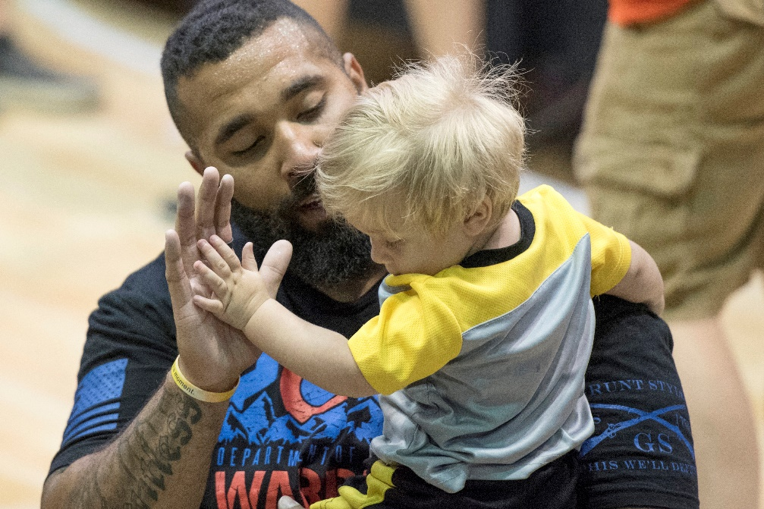
The Why
Communicating with and including families significantly improves outcomes for students who have experienced trauma
- (Brown et al., 2006; Tan, Wang, & Ruggerio, 2017; Goodkind, LaNoue, & Milford, 2010)
Poor planning or execution of engagement around trauma can have a negative impact on students and families
Notes:
Facilitator Notes:
This slide is about research on why you should build your skills and understanding about working with Families
Why do we as schools need to think about family engagement when a child has experienced trauma?
Research on this subject has found that “Communicating with and including families significantly improves outcomes for students who have experienced trauma”
When we don’t plan how we will work with families after their child has experienced trauma, we might end up focusing solely on negatives, which can be unhelpful and retraumatizing.

Slide 13
The Why
Accidents/ Injuries | Serious Illness | House Fires | Crimes
Community Violence | School Violence | Sudden loss of a loved one | Combat injuries or death of a family member
Domestic violence | Abuse/ Neglect | Bullying | Homelessness
Natural Disasters | Acts of Terrorism | Living in or escaping a war zone | Stress
Families are likely managing:
Their own stress
Difficulty sleeping for themselves, their child
Interpersonal challenges with family, friends
Notes:
Facilitator Notes:
Remember the examples from before? Think about how a family is experiencing these traumas with their child.
IMPORTANT POINT HERE: As schools, we need to shift our thinking about a child’s behavior.
Instead of asking why the child is behaving inappropriately, we need to ask “What happened to this child? What can we do to support them?”
Instead of placing blame on a family, try starting from the assumption that all families care about their children.

Slide 14
The How: Supporting Families in Crisis
1
2
3
4
5
Be Calm
Be Prepared to Listen
Be Positive
Be Honest
Be Resourceful
Take a breath and make sure you are calm before contacting families
Recognize families’ strengths and call them out! Only focusing on the negatives can be counter-productive
Share information openly and willingly with families
Be prepared to connect families to resources for themselves and their child
Families are experts on themselves. Listen to what they have to say first!
Notes:
Facilitator Notes:
How can we as school staff help families that are experiencing traumatic events in their life?
Here are five ways that school staff can support families.
Remember that this is an event that is real event ,you do not want to minimize their feelings.
Above all you will want to remain calm.
Next we are going to do an activity.

Slide 15
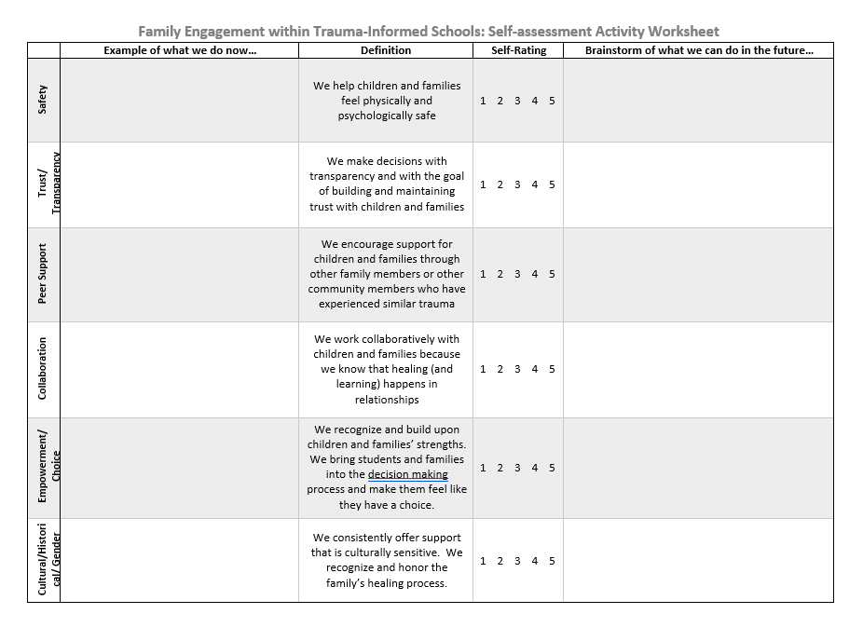
1-Think 2-Pair 3-SHARE
Think – Complete the worksheet activity on your own (5 minutes)
Pair – Find a neighbor and talk about what you wrote down (2 minutes)
Share – Come back together as a group and discuss (3 minutes)
Notes:
Facilitator Notes:
Allow for up to 10 minutes for this activity
Make sure everyone gets a copy of the:
“Family Engagement within Trauma-Informed Schools: Self-assessment Activity” Worksheet
“Family Engagement within Trauma-Informed Schools” Handout
Follow directions on the screen. Adapt as needed for your presentation timeframe.
This activity could be completed individually or in groups/school teams.
Go to next slide to review their activity results as a large group.

Slide 16
Activity Share out
Safety
Trustworthiness and Transparency
Peer Support and Mutual Self-Help
Collaboration and Mutuality
Empowerment, Voice, and Choice
Cultural, Historical, and Gender Issues
What principles do you feel most successful at as an individual/school?
What principles are an area of growth for you or your school?
Notes:
Facilitator Notes:
Have this slide up as you review the activity they completed.
What principles do you feel most successful in as an individual or school?
What principles are an area of growth for you or your school?

Slide 17
Schools can Support Families by sharing and modeling these strategies
Supportive Families
Be a Good Listener
Encourage Questions
Alleviate Blame
Model Self-Care
Set Routines
Encourage Healthy Habits
Notes:
Facilitator Notes:
Say “At the beginning of the presentation, we talked about symptoms of trauma in elementary children, such as separation anxiety, or flinching.
Here are some strategies that you can share with families to support their child who is experiencing these or other symptoms of trauma.”
Then, Share these descriptions of each strategy in the slide:
“Families can model self-care – children look to the adults in their lives to set an example. Take care of yourself to show them how to take care of themselves.
Families can encourage healthy habits -provide healthy meals and opportunities for healthy sleep and exercise. Being physically healthy can help a child get through a psychological challenge.
Families can set Routines – trauma can make everything seem uncertain. Maintaining a routine can help your child know what to expect next.
Families can Encourage Questions – children are going to have questions after a traumatic event. Let them know it’s okay to ask.
Families can Alleviate Blame – kids are likely to blame themselves for whatever happened to or around them. Make sure they know that whatever happened was not their fault.
Be a Good Listener– practice good listening skills, let the child express themselves at their own speed and affirm that it’s good to talk about it.”

Slide 18
Resources and Services
Resources
Feelings Chart for Talking with Young Children
Exercises for Grounding, Emotional Regulation, & Relaxation for Children and their Parents
Services
Syntero (syntero.org)
Family and Children First Council (helpmykid.org)
Mental Health America of Franklin County (mhafc.org)
Databases
redtreehouse.org/resources
nctsn.org/resources
Notes:
Facilitator Notes:
Take some time to talk about the resources listed. Maybe pull some up on a screen, or have some printed out to show.
Ask participants: What resources do you think will be most useful in your conversations with families?
Say: In this short training, we’ve only scratched the surface of how to support families whose children have experienced trauma. Here are a few additional resources for your consideration.
**Hand out or explain local/school resources here as well**
Refer to “Be Ready with Resources” Handout

Slide 19
The best thing that can happen to a dysregulated child is a regulated adult.
The best thing that can happen to a dysregulated adult is a regulated adult.
You can’t pour from
an empty
cup
Notes:
Facilitator Notes:
Have everyone read this statement aloud. “Empty Cup” quote is attributed to various authors. Including Health Education Professional Eleanor Brownn who specializes in self-care
Additional Information: Emotional Dysregulation: “The inability to manage the intensity and duration of negative emotions such as fear, sadness, or anger. - Fabiana Franco, PhD
Dysregulation quote was found within presentations by Syntero (counseling organization) and Ohio’s Family and Children First Councils.
One of the most helpful things you can do for your students and families is to take care of yourself first. Working with families who have experienced trauma can be difficult and tiring. Student and family reactions aren’t always going to make sense to you, especially when they are dysregulated. If you take care of yourself first, you will be better prepared to support others.
Remind participants again about the “Self-Care for Educators” handout and “Taking Care of Yourself” Checklist

Slide 20
Recap
What is Trauma?
What is Trauma-Informed Care?
Why is Family Engagement in times of trauma Important?
How can we support families when their children have experienced trauma?
What information can we share with families about trauma and how to support their child?
Resources for Families
Questions
YOU ARE HERE
X
Notes:
Facilitator Notes:
Ask if anyone has questions, their own resources to share, and you could take time to discuss next steps as a school.
Will you have a place in the school for staff to go to find these and other resources for families?
Will you have a check-in about this training to see how practices are changing as a result of this training?
How will new staff learn about these resources?

Slide 21
This content was developed by Ohio’s Statewide Family Engagement Center in collaboration with Ohio’s Family and Community Engagement Network.
For more information, contact OhioSFEC@osu.edu
Notes:
Thank you for taking the time to learn more about family engagement within trauma-informed schools.

