Slide 1


Educational Resources for Military Connected Youth
Ohio National Guard
Family Readiness & Warrior Support

Slide 2
Family Readiness & Warrior Support
RESOURCES
Resource | Contact | Resource | Contact
OHIOCARES (Behavioral Health Assistance) | 800-761-0868 | Military OneSource | 800-342-9647
Survivor Outreach Services | 614-336-7375 or 614-336-4284 | State & Federal Veteran Benefits | 614-336-7349 or 614-336-4192
Drug & Alcohol Intervention | 614-336-7319 | Youth Programs | 877-460-2177 or 614-336-7456
American Red Cross | 614-251-1798 | ONG Sexual Assault Response Coordinator | 877-751-5628
National Suicide Prevention Hotline | 800-273-TALK (8255) | Civilian Employment Support | 614-336-4554
Education Guidance Counselor | 614-336-7255 | Employer Support of the Guard & Reserve | 614-336-7444

Slide 3
Troop and Family Assistance Centers
Regional Troop & Family Assistance Specialists and Airmen & Family Readiness Program Managers are highly trained professionals who provide information, resources, referrals and assistance to all Service Members and Families before, during and after deployments, or whenever there is a need.
To reach the Troop and Family Assistance Center Specialist in your region call: 1-800-589-9914 24 Hour Joint Operations Center 1-888-637-9053
TFAC LOCATIONS
Region 1: North Canton
Region 2: Chillicothe/McConnelsville
Region 3: Cincinnati/Woodlawn
Region 4: Dayton/Kettering
Region 5: Toledo/Bowling Green/Mansfield
Region 6: Columbus
Airmen & Family Readiness Program Locations:
Mansfield – 179th AW – (800) 642-8365 x7
Toledo – 180th FW – (800) 495-4250 x8684550
Springfield – 178th FW – (800) 851-4503 x2583
Columbus – 121st ARW – (800) 377-5570 x5

Slide 4
EDUCATION OUTREACH: Mission and Purpose
There are almost two million children who have a parent or guardian serving in the United States Armed Forces.
Military connected youth can be found in EVERY school district in the country.
The purpose of Education Outreach is to inform schools, districts and support agencies of the educational resources and programs available to a group of students that many had no idea even existed.
This knowledge empowers educators to look for red flags during times of separation, as well as ensuring educators have an understanding of the programs and resources available to support their students.

Slide 5

Identifying Military Connected Youth
There are roughly 30,000 Military Connected Youth in Ohio. Military youth are in every county and most likely in every school district.
The Every Student Succeeds Act (ESSA) has added a Military Family identifier, which will make it easier to identify new incoming students.
As far as existing students are concerned, schools should be creative:
newsletters | web sites
announcements | emergency medical forms
conferences | class meetings
bulletin boards | VETERANS DAY

Slide 6
Higher Education Benefits for Military Families
Post 9/11 GI Bill | Can be deferred to their children, but they have to start the process before they separate from the service. They have to begin the process while still in their boots.
Ohio War Orphans Scholarship | Offers tuition assistance to children of fallen or severely disabled veterans who served during a period of declared conflict or war. Student must be enrolled fulltime in study and pursuing an associate or undergraduate degree at an eligible Ohio college or university. Applications are made to the Ohio Department of Higher Education. For more information go to www.ohiohighered.org/ohio-war-orphans
Fry Scholarship | Provides Post 9/11 benefits to children and spouses of fallen members who died in the line of duty while in action after 9/10/2001. Beneficiaries may receive up to 36 months of benefits at 100%. Children are eligible as of their 18th birthday or have already graduated from high school. A child may be over 23 and married, eligibility ends on their 33rd birthday. For more information go to www.benefits.va.gov/gibill/fry_scholarship.asp

Slide 7

Purple
Star
Award
The Purple Star Award, presented by the Ohio Department of Education, was created to make schools aware that there is a unique culture in their buildings that has unusual needs and challenges.
The Purple Star award goes to schools who are military friendly. Schools that go above and beyond the normal to support the military families in their building.
In order to qualify; schools must have a point of contact, apply through the Learning Management System for Ohio Education (accessed through SAFE account), fulfill all the required activities (plus one optional activity), and complete professional development.

Slide 8
Purple Star Award (cont.)
Olentangy Liberty Middle School was one of the first eight schools in the state to receive the award. Jason Durrell is the point of contact for the school and has done a great deal for military connected youth and families within his building and throughout the Olentangy School District:
Founded the Olentangy Military Family Program.
Identified over 100 military families (including veterans) at his school.
Arranged for all three high schools to hold Military Appreciation Nights at football games.
Established a link on the district’s home website for military families.
Offers a class through Ashland University on Military Family Life that teachers in the district can take and receive CEU’s.
Brought all the counselors in the district together on a Professional Development Day and had a presentation on resources and program available for Military Connected Youth.
He is a member of the MIC 3 state commission and is currently serving in the Ohio National Guard.

Slide 9

The Compact is law in Ohio, and all 50 states and territories.
It deals with transitional issues military families face in education, especially going from state to state. On average, an active military family will move 6-9 times during a child’s educational career.
The Compact addresses everything from the kindergarten starting age to graduation, and many things in between. It covers enrollment, placement and attendance, eligibility, and graduation.
The purpose of this is to not punish kids for something the government is making their parents do, and to avoid extending a child’s education any longer than need be.
https://www.mic3.net

Slide 10
Military OneSource
Military OneSource is a Department of Defense program that provides FREE services to all members of the military regardless of branch or component.
School professionals may create an account on the Military OneSource website for access to the Morale Welfare Recreation (MWR) libraries. Some of the libraries that are available to students and school professionals are:
Teacher Reference Center
Academic Search Libraries
Peterson’s Education Resource Center
Peterson’s Online Academic Skills
Tumble Books
***In addition to educational resources, Military OneSource offers free services that include but are not limited to:
Non-Medical Counseling (12 FREE)
Health & Wellness Coaching
Education Consultations
Special Needs Consultations

Slide 11

Our Military Kids pays for children ages 5 through the 12th grade of deployed National Guard and Reserve personnel to participate in youth sports, fine arts, and tutoring programs.
This is a way of recognizing the sacrifices the entire family is making while the service member is deployed overseas.
An Our Military Kids application can be downloaded from their website and sent in with the required documentation.
The grant will cover up to six months of instruction for the activity selected, with a maximum grant award of $500 per child.

Slide 12



Educational Resources
 | A 24 hour live chat homework hotline, available for students in grades 4-12. Includes all branches of service and is FREE for all military connected youth.
 | An online standardized test resource for ACT, SAT & ASVAB. March 2 Success is FREE for all students. The system provides a full array of subject specific assessments and remedial course tailored to the students’ educational needs, as well as practice drills and tests.
 | A standardized test resource for ACT, SAT & ASVAB. ALL military students & families can receive FREE $350 Semester-length, Interactive, Multimedia, Online Courses.

Slide 13

The MCEC is a nonprofit organization dedicated to quality educational experiences in times of transition and family separation. Some of the programs the offer are:
  Student 2 Student brings military and civilian students together to ease the transition for new students.
  Parent to Parent brings groups and organizations in the community to address issues associated with military family lifestyle.
  Professional Development to address the unique changes facing military connected youth.
  Military Student Transition Consultant is an education professional within the school district to advocate for, and build resilience, in military connected students.
  SchoolQuest offers a scholarship finder for Military Connected Youth.

Slide 14
~Military Kids Connect is an online community where kids, tweens and teens can de-stress and connect with other military kids their age.
~The website helps military youth develop coping skills and build psychological health and resilience.
The website includes resources for parents, caregivers and teachers:
  Ideas for helping children cope
  Military related lesson plans
  Military culture information and videos to help educators work with military children
  Resource guides with extensive lists of military support services

Slide 15

Ohio Military Kids (OMK) is a partnership between the Ohio National Guard and The Ohio State University’s 4-H youth development program.
The goal of OMK is to create community support networks for military youth when they experience a loved one’s deployment.
OMK educates the public on the impact a deployment has on a service member’s children, families, and communities through awareness building and educational trainings with schools and community organizations.
OMK delivers recreational, social, and educational programs for military youth in civilian communities geographically dispersed throughout the state.
OMK strives to provide military families and youth with well-rounded programming that strengthens ties, creates lifelong friendships, and builds leadership, resilience, and camaraderie.

Slide 16
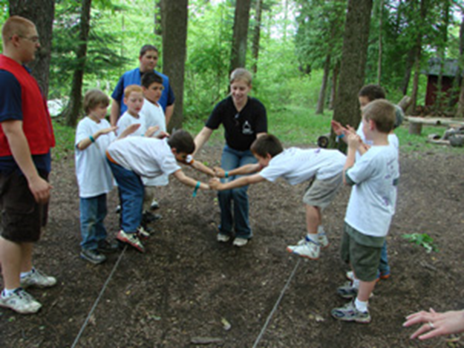

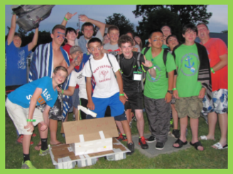
OMK Programs
HERO CAMPS | TROOP & FAMILY CAMPS | CAMP KELLEYS ISLAND
One day camps for the whole family that provide exciting learning experiences while integrating key resiliency skills. | Weekend camps for the whole family to strengthen ties and build camaraderie with other military families. | Ohio Military Kids (OMK) offers two residential camps, held concurrently at Kelleys Island in Lake Erie! Military Youth participate in service learning projects, build relationships with military peers, learn resiliency, develop habits for healthy living and instill pride in being a military kid.

Slide 17
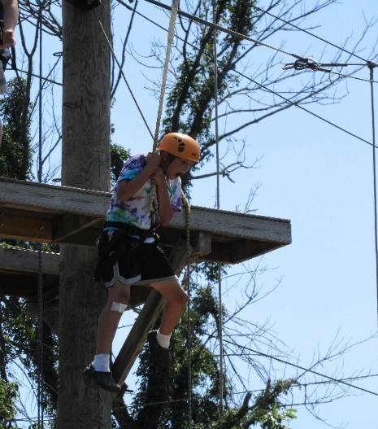

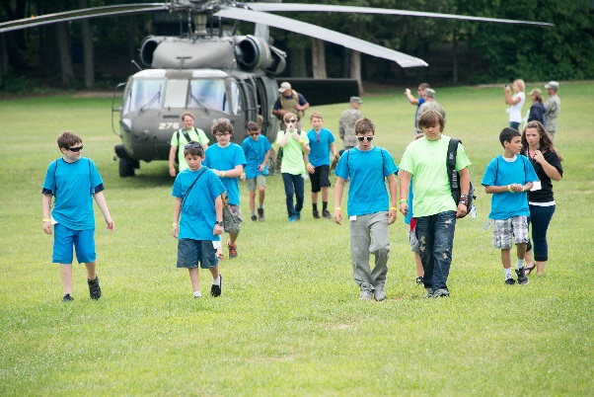

Attending OMK Events and Volunteering
OMK events are open to all branches of the Armed Forces, and all components (Active Duty, Guard and Reserve).
If the service member is a veteran, they (and their children) can still participate in OMK events for one year after their separation from the military.
Volunteers at OMK events fill a variety of roles: administrative, social media, marketing, hands on support at youth events, and logistical support.

Slide 18
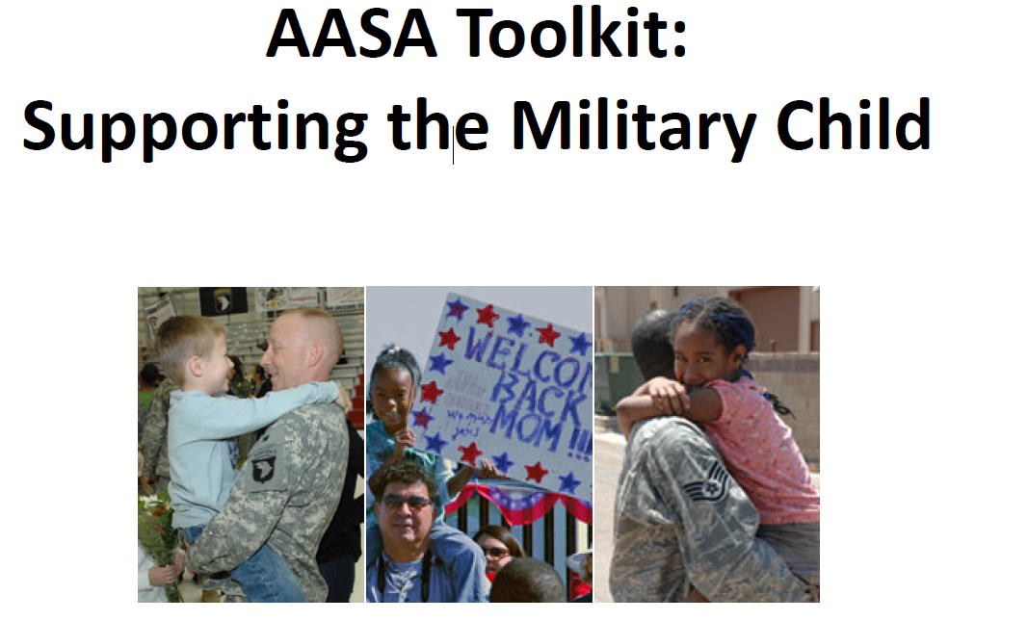

Literature
Put out by the American Association of School Administrators, this toolkit provides guidance for school leaders on meeting the unique educational needs of children whose parents are deployed or in transition. | This publication provides practical, hands-on information to help educators deal with the unique “tough to talk about” topics that students experience in the school setting.

Slide 19

Web Links
ong.ohio.gov/frg/FRG_youthprograms.html
ohio4h.org/statewide-programs/ohio-military-kids
Find us on Facebook by searching Ohio National Guard Strong Families or Ohio Operation: Military Kids

Slide 20
Contact Us!!!
Ohio National Guard Family Readiness and Warrior Support ATTN: NGOH-PEW-FR (YOUTH PROGRAMS) 2825 West Dublin Granville Road Columbus, OH 43235
Mark Scherer Child & Youth Program Coordinator, Contractor Ohio National Guard Family Readiness & Warrior Support Office: 614-336-4214 Mobile: 614-593-1658 Email: mark.a.scherer7.ctr@mail.mil | Chip Merkle Youth Program Specialist/Education Outreach Ohio National Guard Family Readiness & Warrior Support Office: 614-336-7456 Mobile: 614-296-7694 Email: william.j.merkle5.ctr@mail.mil

