Slide 1
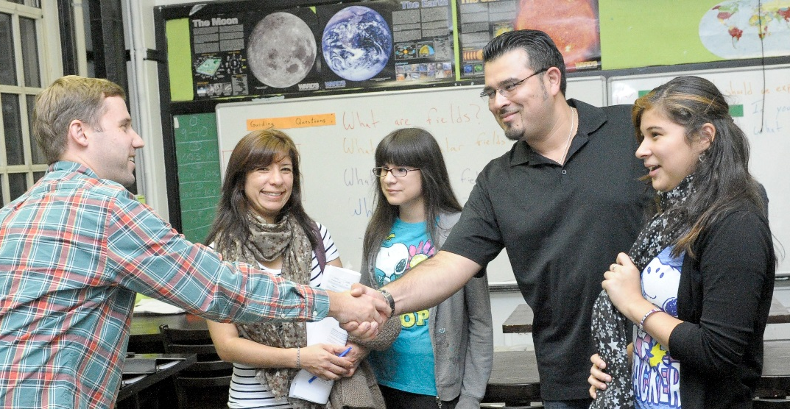


Parent-Teacher Partnerships for Student Success
Module 8: Next Steps
Notes:
Welcome parents, teachers and administrators.
We are at a crossroads - we have come together as parents and teachers in a series of meetings to understand and develop partnerships. These meetings have helped us understand each other, learn from each other, and work together to support students.
In this session, we are going to reflect, review, and recommend! What have we learned? What partnership practices do we do well as a district / building?
Where have we improved? What do we still need to do to enhance parent-teacher partnerships? Generally, WHAT'S NEXT?!

Slide 2
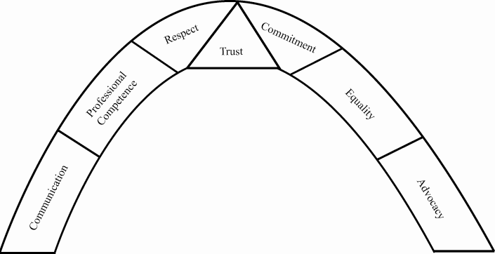
Turnbull et al.
Families, Professionals, and Exceptionality, 2e
Copyright ©2006 by Pearson Education, Inc.
Upper Saddle River, New Jersey 07458
All rights reserved.
Partnerships and Trust
Notes:
(Turnbull, et al., 7th ed., p. 183)
We spent most of our meetings learning about these partnership principles. These are the foundation on which partnerships build.
We learned that for trust to be built, the other 6 principles must be present.

Slide 3

Reaching Results for Students
Studies show that each type of involvement promotes different kinds of results.
Parenting | Students improve when families are provided information on child development and school expectations at each grade level (e.g., to support student health, behavior, attendance).
Communicating | Students Increase awareness of their own progress in subjects and skills when teachers, students, and parents communicate about classwork.
Volunteering | Students gain academic skills that are tutored or taught by volunteers.
Learning At Home | Students complete more homework in specific subjects when teachers guide parents in how to interact on assignments.
Decision Making | Students benefit from policies and projects conducted and supported by parent organizations and partnership teams.
Collaborating with the Community | Students gain skills and talents in curricular, extra-curricular, and afterschool projects with community partners.
Notes:
We also learned in our sessions that these are the keys to involving families according to Epstein et al. (2009)
Each key provides strategies / activities to keep families and communities involved within the district - with the focus on partnerships for better student outcomes!
When you put the principles and involvement keys together - we get this big picture of all the modules covered in the Parent - Teacher Partnership sessions!
The highlighted "structure" of the building represent the Principles of Partnership as described by Ann Turnbull et al. through the University of Kansas and in our resource text Families, Professionals, and Exceptionality, Sixth Edition, by A. Turnbull et al, 2011 by Pearson Education, Inc.
The Titles within the school building are the Key Strategies of Involvement developed by Joyce Epstein et al. at Johns Hopkins University and in our resource text School, Family, and Community Partnerships, Third Edition, by J. L. Epstein et al., 2009 by Corwin Press.
REFLECTION and DISCUSSION:
1. INDIVIDUAL REFLECTION - DISCUSS (5-10 minutes)
a) Looking at one area, what have you learned about yourself as a parent / teacher in partnerships?
b) In that area, what have you done differently as a result of this project?
c) What do you still need to continue developing partnerships to better support students?
2. GROUP REFLECTION and ACTIVITIES: (10-15 minutes)
a) Have EACH principle and key strategy on a large paper - make a T on the paper - label one side "do" and one side "needs to improve" in this area - have participants walk around and write their responses on the posters / sticky notes.
(If you have session summaries from previous sessions, you can prefill some of these and just add to if needed)
(Possible topics if you want to make it more specific)
* special education processes (evaluation, IEP)
* individual student intervention
* reporting student progress
* sharing district information
* parents as part of district improvement
* other?

Slide 4

Promoting Partnerships
  Looking at our posters / recommendations,
  what is next for promoting partnerships
  in our building / district?
Notes:
ACTIVITY: What do we want to recommend to promote parent-teacher partnerships?
* PRINCIPLES AND PRACTICES: (10-15 mins)
1. What is working that should continue?
2. Do we want to focus on all areas, or 1-2 at a time?
3. HOW do we see the strategy being implemented? WHO? WHAT? WHERE? WHEN? RESOURCES NEEDED?
* PARENT-TEACHER LEARNING SESSIONS: (10-15 mins)
What are our next steps for continuing parent-teacher learning sessions?
What would our sessions look like next school year?
- who should be invited?
- how do we invite?
- expand to other buildings? grade levels?
- dates, time, location?
- food / childcare?
- topics?
- start a new group with same content?
- who will facilitate?
- resources needed?
- administrative support?

Slide 5
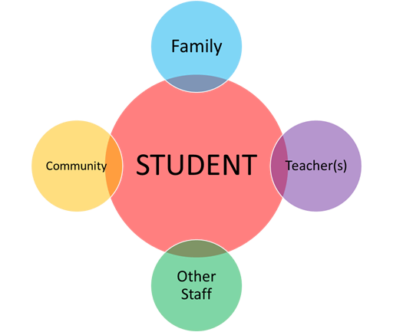
Link to Student Outcomes
Notes:
“The purpose of these sessions was to not only promote parent-teacher partnerships, but to partnership for student progress and better outcomes!
KEY DISCUSSIONS:
1) What student outcomes have you observed during this project? (5 minutes)
2) What other (outer circles) outcomes have you observed during this project? (5-10 mins)
3) How can these outcomes continue in the building / district?

Slide 6

LINK to CURRENT PRACTICES
Parents
Teachers
Student
General School
Activities
Special Education
Activities
Notes:
KEY DISCUSSIONS: Facilitate group discussion and sharing of ideas in each area based on experiences and recommendations
***REMEMBER: ASK THE PARTICIPANTS TO TRY NOT TO USE SPECIFIC NAMES – AND KEEP CONVERSATIONS CONFIDENTIAL
1) General School Activities (examples: student-focused meetings, parent-teacher conferences, PTA, school events, state testing, etc. .)
a) Have general school activities changed as a result of these sessions? How?
b) If not, what have been the barriers? What are the recommended next steps?
2) Special Education Activities (Parent concerns / referrals, evaluations, IEP meetings)
a) Have special education activities changed as a result of these sessions? How?
b) If not, what have been the barriers? What are the recommended next steps?

Slide 7
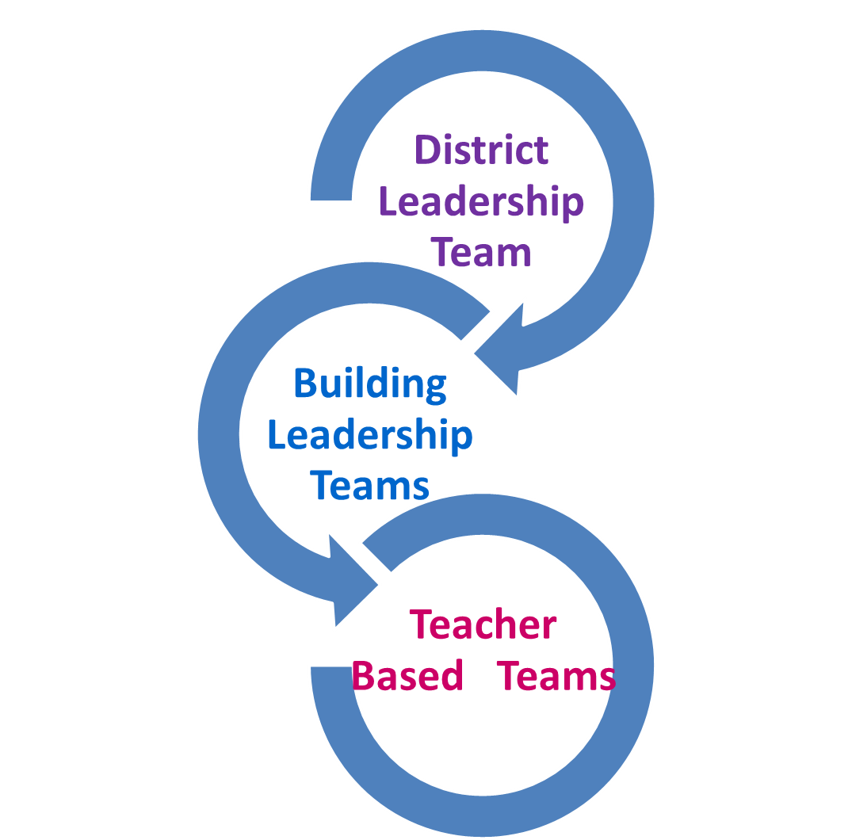
Inform the School System and Learn from Parents and Teachers
Parent - Teacher Partnership
Outcomes
Parents and teachers partnering and valuing each other’s expertise
Students improve outcomes
Academically
Behaviorally
Notes:
We have spent our time on these modules reflecting how we can build parent-teacher partnerships to improve student outcomes through the district improvement process.
ADMINISTRATOR REMARKS (5-10 mins)
a) Ask the administrator to provide what they have learned from this project?
b) What changes have been made at the district, building, or teacher level to promote parent-teacher partnerships in improving student outcomes?
c) What are their next steps for continuing this process of promoting and building partnerships?
Some processes to address may include:
Response to Intervention
Positive Behavior Supports
Special Education Evaluation
IEP
Functional Behavior Assessments
Disciplinary Actions
Ohio Teacher Evaluation
Standardized Testing
Reporting Student Progress
WHAT ELSE?
2. CO-FACILITATOR REMARKS
What have you learned as a co-facilitator during this process?
How has this process helped you in your parent-teacher partnerships?

Slide 8
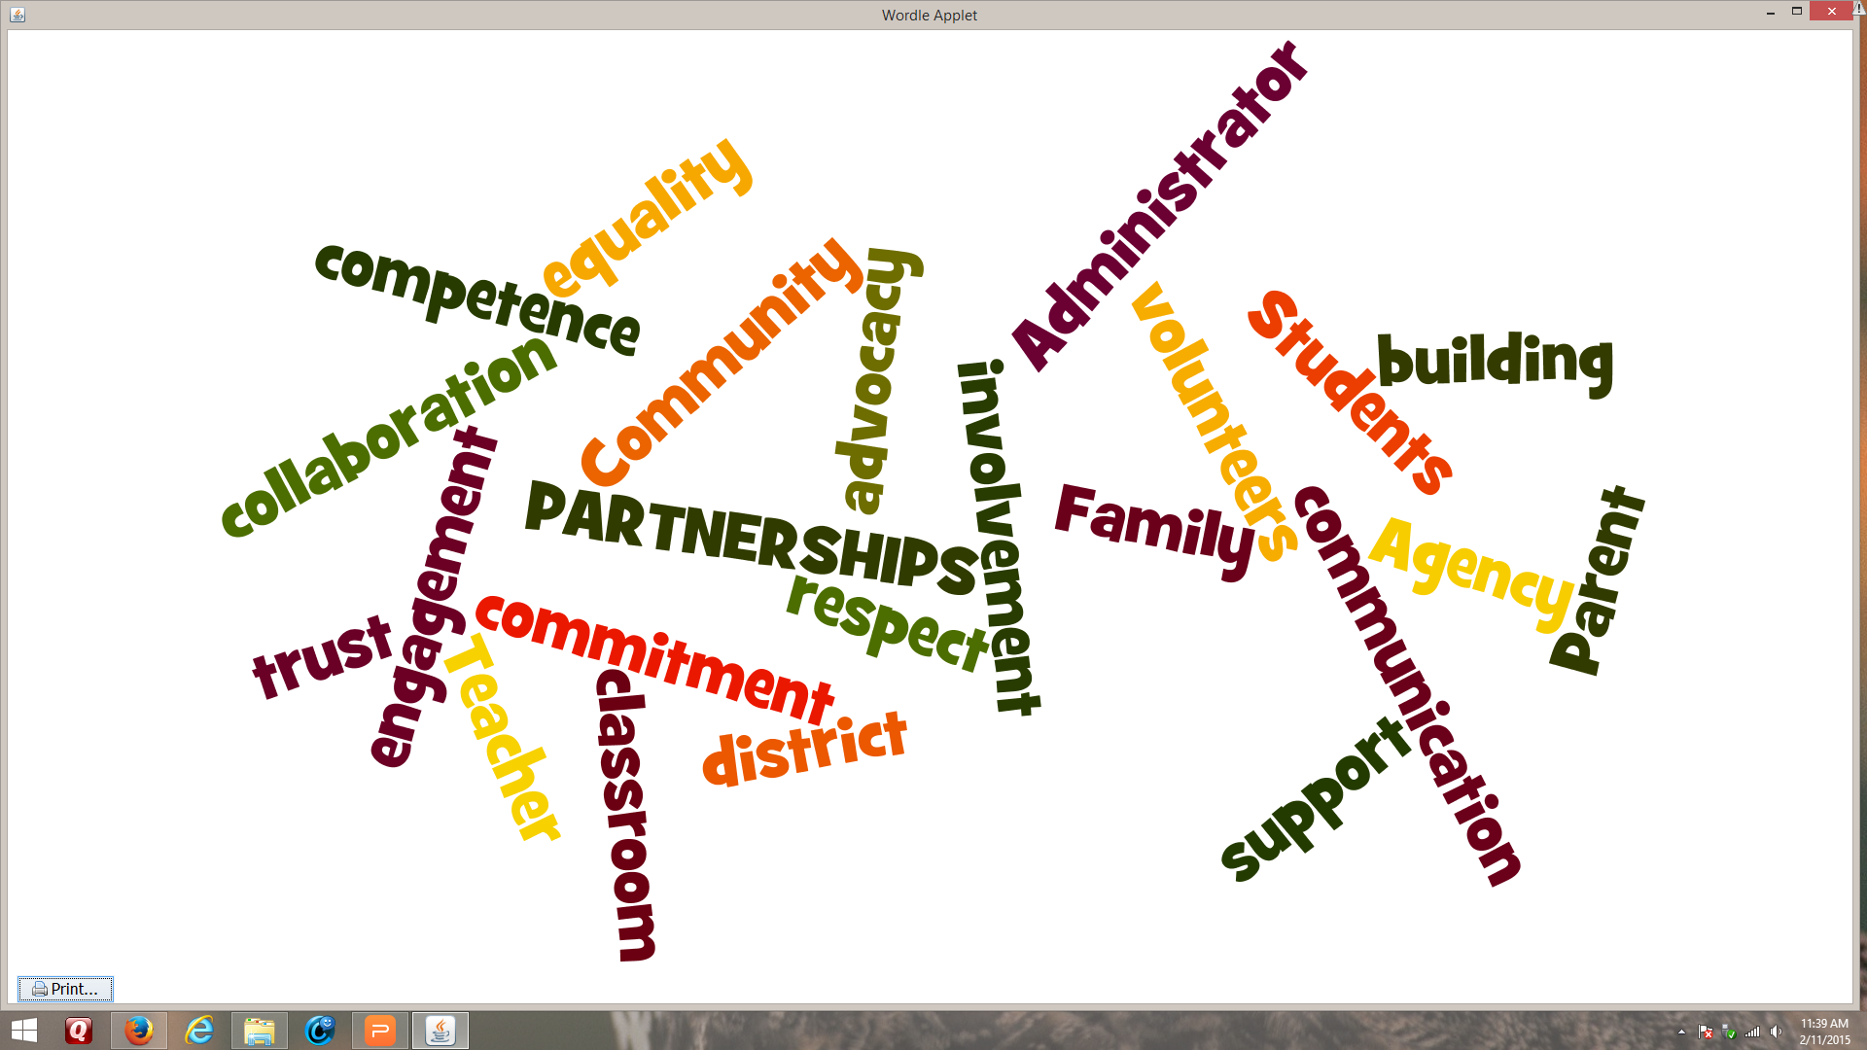
Congratulations!
You've come a long way!
Notes:
1. Co-facilitators - think about a positive comment you can make about each participant - how you have valued their participation? What did they bring to the group?
2. Handout certificates!
(OPTIONAL MUSIC: "Celebration" by Kool & The Gang)
9/20/2017
8

Slide 9
Unity by Ray A. Lingenfelter
I dreamed I stood in a studio
And watched two sculptors there,
The clay they used was a young child’s mind
And they fashioned it with care.
One was a teacher;
the tools she used were books and music and art;
One was a parent with a guiding hand
and a gentle loving heart.
And when at last their work was done
They were proud of what they had wrought
For the things they had worked into the child
Could never be sold or bought.
And each agreed she would have failed
if she had worked alone
For behind the parent stood the school,
and behind the teacher stood the home.
Notes:
Final thoughts.....(Read poem)
* Hand this out as a bookmark (see handout)

Slide 10

Contents were developed under a grant from the US Department of Education, #323A120002-13 and adapted in 2017 by The Ohio State University. However, the contents do not necessarily represent the policy of the US Department of Education, and you should not assume endorsement by the Federal Government. Project Officer, Jennifer Coffey. PTP Documents Archive: https://u.osu.edu/familyschoolpartnerships/ptp/
Notes:
10

