Slide 1
Parent-Teacher Partnerships for Student Success
Module 6: Commitment and Volunteering

Slide 2
Respect
Communication
Equality
Communicating
Decision-Making
Competence
Parenting
Learning at Home
Notes:
Before we begin our new session, let’s review what we have learned and discussed so far.
KEY DISCUSSIONS:
What did we learn about these topics?
Has this knowledge helped you, or your student(s), since our last session? If so, how?
Co-facilitators – review what was shared with the district point of contact and how responded.
Remember, the purpose of these sessions is to not only promote parent-teacher partnerships, but to partnership for student progress and better outcomes! So, as we go through the information and discussions, think about how we can impact student achievement with this information!
OPTIONAL:
Ice Breaker Activity

Slide 3
COMMITMENT
and
VOLUNTEERING
Notes:
As we continue to build parent-teacher partnerships in our district, today’s module will focus on COMMITMENT as a partnership principle and VOLUNTEERING as a key involvement strategy.
We will reflect on our own individual COMMITMENT in parent-teacher partnerships and VOLUNTEERING opportunities that we both take and provide to support our students, families, and staff. We will discuss what we have experienced as a teacher and/or parent in the district, and brainstorm individual and building/district needs in these areas. At the end of this session, we will gather suggestions from all of you around in order to make recommendations to the leadership team for improvement in these areas.
OPTIONAL
Ice Breaker Activity

Slide 4
Group Rules
Notes:
Review

Slide 5
COMMITMENT
= loyal and sensitive in working with the
student and others
Be Sensitive to Emotional Needs
Be Available and Accessible
Go "Above and Beyond"
Notes:
KEY DISCUSSIONS:
How do you demonstrate sensitivity to the emotional needs of the team members, including the student?
How do you take care of your own needs in order to support the student(s)?
Where do your beliefs fall regarding family-teacher "friendliness" and does that negatively interfere with any of your parent-teacher relationships or relationships with colleagues?
Discuss how you have had to establish boundaries with a teacher / family yet still had a committed relationship?
How do you handle a situation in which the only time the team can meet is during a time in which you have a personal family commitment?
How do you feel about team members leaving a meeting about an individual student early?
How do you approach team members who are not committed to the student's progress?
How do the topics that we have already addressed (respect, communication, equality, decision-making, competence, parenting, learning at home) support the demonstration of commitment?
CONTENT NOTES:
Commitment is NOT feeling an obligation, but a feeling of completing a pledge / promise.
Turnbull, et. al., defines commitment in partnerships as:
1) BE SENSITIVE TO EMOTIONAL NEEDS: of parent, team members, and student to focus on educational progress
* recognize what might help or hinder
* provide resources
- Be aware of YOUR needs in the partnership - don't be afraid to ask for support
* provide empathetic listening
2) BE AVAILABLE AND ACCESSIBLE
* schedules
* attend, and remain at, meetings
3) GO ABOVE AND BEYOND
* enter into a reliable alliance with family/staff
- T: recognize student and family as real people, not a "case"
- P: recognize a teacher has to balance multiple students / families
* know ethical boundaries
OPTIONAL:
* ACTIVITIES:
Review and Discuss COMMITMENT Activities document
“YES, BUT; YES, AND” (see handout)
Commitment Grows When…..
* Make a team commitment poster (or wordle!) using ideas from the group
(These ideas below are from the Community Tool Box website: Leadership and Management, Chapter 14,Section 5. Building and Sustaining Commitment
http://ctb.ku.edu/en/table-of-contents/leadership/leadership-functions/build-sustain-commitment/main)
Work together
Feel successful at what they do
Make decisions together
Work through conflicts
Support one another's leadership
Have fun and play together
Overcome obstacles
Hold each other to high principles
Appreciate and respect one another
Challenge one another to take the next step
Build relationships
Experience a victory together
Learn from mistakes and setbacks
See their leaders model commitment
* VIDEO: (2:31)
1.) From Commitment to Recognition, NJ Teacher Patrick O'Neill Gets the Surprise of his Career https://www.youtube.com/watch?v=C9IohcX5r0k
a) What did you think of his reaction?
b) What did this tell you about his "commitment"?

Slide 6
VOLUNTEERING
Improve recruitment, training, work, and schedules to involve families as volunteers and audiences at school or in other locations to support students , staff, and school programs.
School, Family, and Community Partnerships, by J. L. Epstein et al., 2009 by Corwin Press.
6
6
Notes:
Epstein, et. al., lists VOLUNTEERING as one of the 6 top ways to involve families with schools.
KEY DISCUSSIONS:
1.) Review VOLUNTEERING ACTIVITIES document:
What volunteer activities does the district offer parents / community members to support student learning?
How do parents / community members know that volunteers are needed? Is this recruiting method effective? What other ways do you recommend?
What activities (or what building / grade level) does the district / building have difficulty in recruiting volunteers?
What do you think are other barriers to volunteering in the building / district?
How would you address these barriers?
2.) How can the other areas that we have discussed (respect / communication / competence / commitment / equality / parenting / learning at home) affect volunteering in the district?
CONTENT NOTES:
- The emphasis should be on supporting students and school district improvement - not just "getting things done"
“Volunteer” is anyone who supports school goals and children’s learning and development in an way, at any place, and at any time
Volunteers should be trained, recognized, and recruited widely (as many parents as possible, not always relying on the same ones)
Volunteering does not always have to mean physical presence in building / district
OPTIONAL:
ACTIVITIES:
1.) Review and discuss Summary Type 3 – Volunteering (Epstein, et. al., p. 155)
2.) Complete one of the following rating scales around Volunteering
a) An Inventory of Present Practices of School, Family, and Community Partnerships (Epstein, et. al., p. 176)
b) Measure of School, Family, and Community Partnerships (Epstein, et. al, p. 327)
3.) What’s In A Name?
** Have each person write their name vertically, then write a word for each letter of their name that describes them – based on that, what areas would be a good fit for them as volunteers?
(example: Teacher support
Alone
OrgaNized
disabilitY
Academics
- I might be good at assisting a teacher with academic support for students, organizing volunteers / activities for teachers or school groups, present information to staff / parents on disabilities.)
VIDEO: (2:44)
1) NBC Today Show: Education Nation - Putting Parents to Work in the Classroom http://www.youtube.com/watch?v=ubo6L0qQv6Q&list=PLvzOwE5lWqhRPzheyprYHcA8SZl9Qvnpz

Slide 7
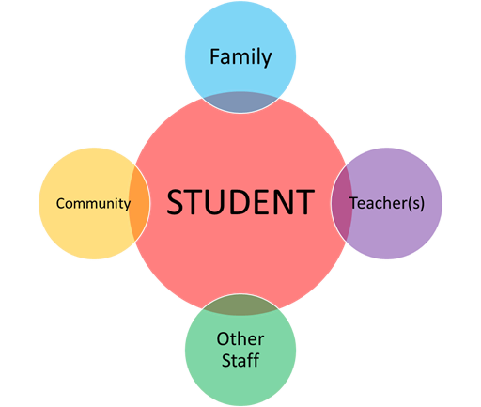
Link to Student Outcomes
Notes:
Reminder: “The purpose of these sessions is to not only promote parent-teacher partnerships, but to partner for student progress and better outcomes!
KEY DISCUSSIONS:
Give an example of student success because of a team member demonstrating commitment.
Give an example of student success because of volunteering.
How can volunteering improve results for parents? For teachers and staff? For the community?

Slide 8
LINK to CURRENT PRACTICES
Parents
Teachers
Student
General School
Activities
Special Education
Activities
Notes:
KEY DISCUSSIONS:
Facilitate group discussion and sharing of ideas in each area based on experiences and recommendations
***REMEMBER: ASK THE PARTICIPANTS TO TRY NOT TO USE SPECIFIC NAMES – AND KEEP CONVERSATIONS CONFIDENTIAL
* Keeping COMMITMENT and VOLUNTEERING in mind,
What have been your experiences with specific situations of general school activities?
(examples: student-focused meetings, parent-teacher conferences, PTA, school events, state testing, etc. .) a) What are the strengths of the (grade level / building / district) in these areas?
b) What would we recommend for improving parent – teacher partnerships in these areas?
What have been your experiences with specific situations of special education activities?
(Parent concerns / referrals, evaluations, IEP meetings)
a) What are the strengths of the (grade level / building / district) in these areas?
b) What would we recommend for improving parent – teacher partnerships in these areas?
What is an immediate change that you can make around COMMITMENT and VOLUNTEERING that would positively impact success for your student(s)?

Slide 9
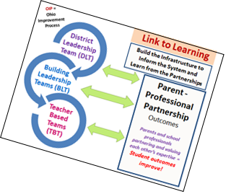
Link to Improvement
Share Bright Ideas / Session Highlights
Complete Session Highlights form
Notes:
1. Have the group review their "bright ideas" - capture on large poster paper – then Session Highlights form
2. Decide what will be presented to district point of contact

Slide 11
Contents were developed under a grant from the US Department of Education, #323A120002-13 and adapted in 2017 by The Ohio State University. However, the contents do not necessarily represent the policy of the US Department of Education, and you should not assume endorsement by the Federal Government. Project Officer, Jennifer Coffey. PTP Documents Archive: https://u.osu.edu/familyschoolpartnerships/ptp/
Notes:
11

