Slide 1
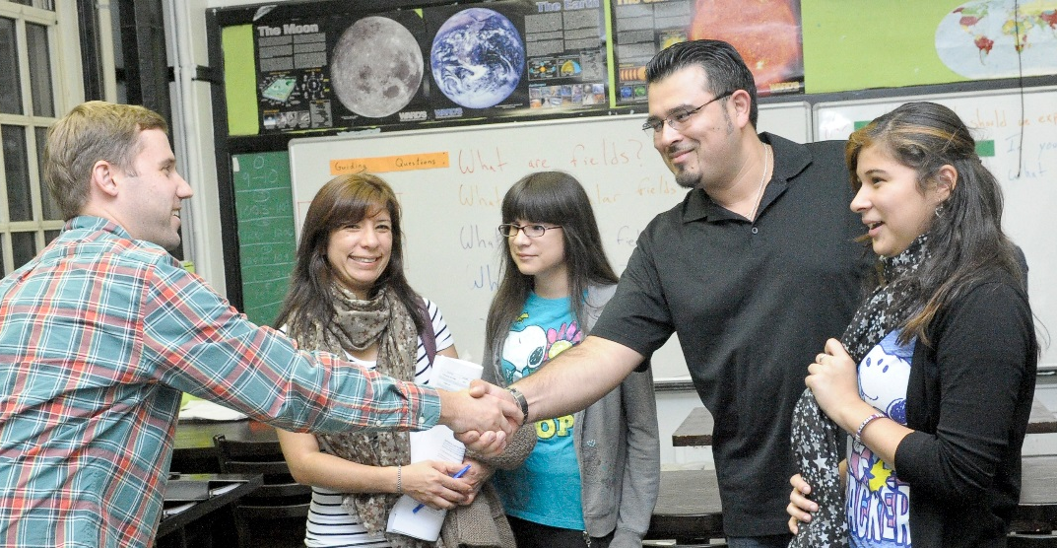


Parent-Teacher Partnerships for Student Success
Module 1: Parent-Teacher Partnerships Overview
Notes:
CONTENT NOTES:
This is a PowerPoint you may use as a kick-off meeting with the administrators, parents and teachers in your school. We recommend that you use this presentation along with one or more activities that will help parents and teachers get to know each other and feel comfortable with each other.
Ensure that there is one teacher and one parent presenting this material together; role modeling a respectful and equal relationship for everyone else in the room. This is a very important component of the PTP.
* Welcome parents and teachers
* Thank them for taking time from their busy schedules to come be a part of the district’s Parent-Teacher Partnerships.
* If you choose, you can provide some background about how the district became involved in the Parent-Teacher Partnerships. The organizations listed below have all partnered to make this possible.
Partners:
Ohio Department of Education Office for Exceptional Children (OEC)
Ohio Coalition for the Education of Children with Disabilities (OCECD)
Bowling Green State University (BGSU)
The Ohio State University (OSU)
State Support Teams
Ohio Public School Districts and Community Schools Staff and Families

Slide 2

Parent-Teacher Partnerships are Important
Notes:
CONTENT NOTES:
* Research shows that strong Parent-Teacher Partnerships help students succeed but, WE also believe that Parent-Teacher Partnerships:
a. Are critical to student success
b. Should be a part of the district's "culture" and improvement plan
c. Are important because Parents and Teachers want to work together for student success!
KEY DISCUSSIONS:
What are your beliefs about parent-teacher partnerships?
What do you believe supports these partnerships?
What do you believe hinders these partnerships?
2

Slide 3



History of Ohio’s
Parent-Teacher Partnerships Model
Ohio’s
SPDG
2012-2017
Notes:
3
Originated from research at Bowling Green State University (Murray & Mereoiu, 2012)
Adapted for Ohio’s schools between 2012-2017, under guidance from The Ohio State University and Ohio’s State Support Teams and Schools that implemented the PTP as part of the State Personnel Development Grant.
Intended to lead to changes in parent and teacher knowledge, attitudes and dispositions necessary to establish and maintain effective parent-teacher relationships for the purpose of improving student outcomes.
Built around two sets of practices taught to an equal number of parent and teacher participants: (1) relational practices such as active listening, cultural sensitivity, respect, and (2) participatory practices that facilitate informed decision making, active participation in setting and implementing goals.

Slide 4
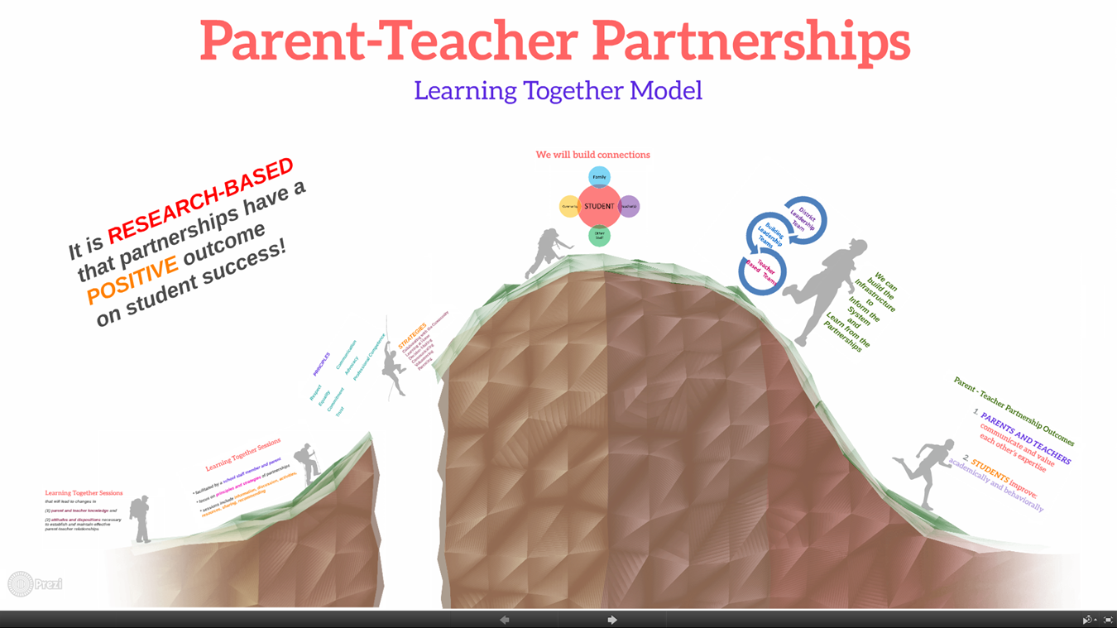
http://prezi.com/bwanepsl8_2o/?utm_campaign=share&utm_medium=copy&rc=ex0share
Notes:
* We have developed a model that emphasizes parents and teachers learning and sharing together over 8 sessions. Let’s review this model…..(PREZI)
CONTENT NOTES:
Slide 1: the big picture
Slide 2: we know that research shows that parent-teacher partnerships have positive benefits for students, parents, teachers and other school staff, and the community
Slide 3: we have developed sessions that we hope will change knowledge, attitudes, and dispositions toward these partnerships, and that will assist in developing, improving, and growing these relationships district-wide
Slide 4: we will use the work from Dr. Ann Turnbull et al. through the University of Kansas (resource text Families, Professionals, and Exceptionality, Sixth Edition, by A. Turnbull et al, 2011 by Pearson Education, Inc.) and by Dr. Joyce Epstein et al. at Johns Hopkins University (resource text School, Family, and Community Partnerships, Third Edition, by J. L. Epstein et al., 2009 by Corwin Press.)
We will also recommend and/or develop activities from other text and web resources, as well as our own experiences!
Slide 5: During our sessions, we will focus our time together on the content of partnership principles and key involvement strategies from our resource texts, looking at how we are currently doing in these areas, and what we would recommend for improvement in these areas.
Slide 6: Most importantly, we will build these partnerships with student progress and success as our focus!
Slide 7: At the end of each session, we will make recommendations that can be discussed with teachers, building leaders, and district leaders to assist in student progress.
Slide 8 (read slide)
Slide 9 (big picture, again)
KEY DISCUSSIONS:
What questions do you have so far about this model?
OPTIONAL:
OLAC Modules emphasizing first cohort http://www.ohioleadership.org/mod_mov_filter.php?mod_id=12
Read through some of highlights from first cohort (supplemental resource)

Slide 5
LINK TO STUDENT OUTCOMES
STUDENT
Family
Teacher(s)
Other Staff
Community
Notes:
We will build family-school-community connections in each session that focus on student progress, but also builds the connections amongst those supporting the student! We know from research that relationships play a critical factor in student success!
KEY DISCUSSIONS:
What do you think this picture represents?
Do you feel this is happening in your student’s life?
How will this model support your student(s)?

Slide 6
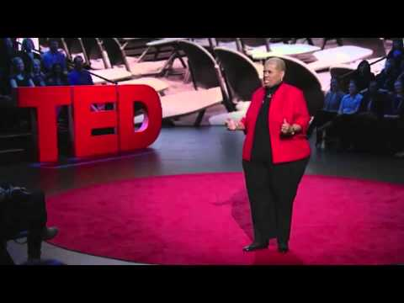
Every Kid Needs a Champion
Notes:
Activity and Discussion
Video (7:49)
* Rita Pierson: Every kid needs a champion https://www.youtube.com/watch?v=SFnMTHhKdkw
Rita talks about the importance of relationships for student learning. Do you feel the same? Why or why not?
What relationships have you, or your student(s), had that helped you succeed?

Slide 7

LINK to CURRENT PRACTICES
Parents
Teachers
Student
General School
Activities
Special Education
Activities
Notes:
We will relate the topics by sharing examples of day-to-day situations we have experienced as a parent / teacher in partnerships - such as meetings, events, IEP meetings, etc. . .- and how those have impacted us and our student(s).

Slide 8
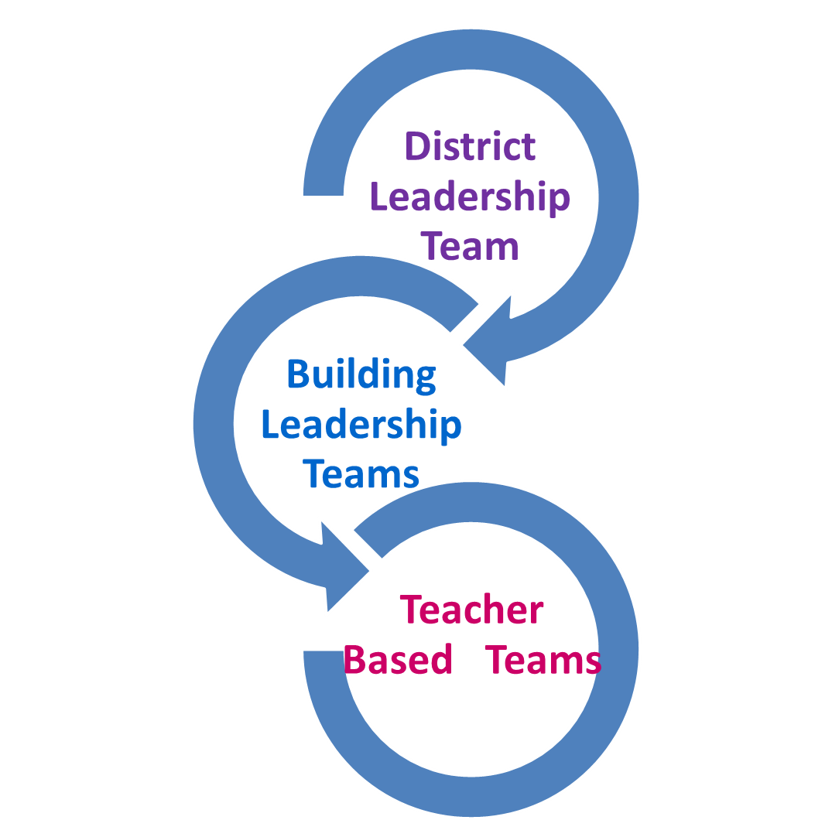
Inform the School System and Learn from Parents and Teachers
Parent - Teacher Partnership
Outcomes
Parents and teachers partnering and valuing each other’s expertise
Students improve outcomes
Academically
Behaviorally
Notes:
We will also make recommendations to our teams operating under the Ohio Improvement Process, a structured process that involves four stages across which processes, structures, tools, and people are connected all with the intent of helping districts improve student outcomes. Parent-teacher-partnerships have been shown to be an integral part of student success - and should be a part of the overall planning at the district, building, and teacher level.
KEY DISCUSSIONS:
How do you currently get information to teachers? Building leadership staff? District leadership staff?
How do these teams get information to you?
Is the information focused on student outcomes?

Slide 9

Notes:
Any comments, questions or concerns so far?

Slide 10

ICE BREAKER ACTIVITY
Notes:
GROUP ACTIVITY (Ice Breaker Activity – Your Choice!)
Let’s take some time to get to know each other! After all, we will be partnering together!!

Slide 11

Next Steps
Notes:
KEY DISCUSSIONS:
Spend time at the end of the session talking informally and getting to know the parents and teachers who attended.
2. Ideas for recruiting staff and parents:
Administrator invite staff and parent
Teacher invite a staff member and parent
Parent invite a staff member and parent
Announcement in school newsletter or website
Provide overview at PTA / Boosters meeting
Find ways to offer meal, childcare, transportation, homework help
Be specific about the time commitment
Set up a partnership table at open houses / school fairs
Give a specific name and number to contact for more information
3. Share the dates, times and locations of future meetings with the parents and teachers.
11

Slide 12

Contents were developed under a grant from the US Department of Education, #323A120002-13 and adapted in 2017 by The Ohio State University. However, the contents do not necessarily represent the policy of the US Department of Education, and you should not assume endorsement by the Federal Government. Project Officer, Jennifer Coffey. PTP Documents Archive: https://u.osu.edu/familyschoolpartnerships/ptp/
Notes:
12

