Slide 1
PARENT-TEACHER PARTNERSHIPS
Respect
Commitment
Parenting
Communicating
Volunteering
Learning at Home
Decision Making
Collaborating with the Community
Equality
Trust
Advocacy
Professional Competence
Communication
Notes:
* (Welcome Slide) OR you may add your own to make it more district / meeting specific!
This is the big picture of all the modules we will be covering in the Parent - Teacher Partnership sessions. It represents a school district / building.
The "structure" of the building, the highlighted words, represent the Principles of Partnership as described by Ann Turnbull et al. through the University of Kansas and in our resource text Families, Professionals, and Exceptionality, Seventh Edition, by A. Turnbull et al, 2015 by Pearson Education, Inc.
The Titles within the school building are the Key Strategies of Involvement developed by Joyce Epstein et al. at Johns Hopkins University and in our resource text School, Family, and Community Partnerships, Third Edition, by J. L. Epstein et al., 2009 by Corwin Press.
We will also recommend and/or develop activities from other text and web resources.

Slide 2
Notes:
Review
OPTIONAL
Ice Breaker Activity

Slide 3
Respect
Communication
Equality
Competence
Commitment
Advocacy
Decision-Making
Parenting
Learning At Home
Volunteering
Collaborating with the Community
Communicating
Notes:
So far, we have looked at all of these Partnership Principles and Involvement Strategies.
KEY DISCUSSIONS:
Co-facilitators report information from district point of contact regarding previous session(s).
What comments or questions do you have about these?
Have any helped you the most to support your student(s)? Support your partnerships? How?
We will be talking about TRUST in this session – which one of these do you think is a MUST for you to have trust in partnerships? Why?
Can TRUST happen in partnerships without one, any, or all of these? Why or why not?

Slide 4
Trust is…
“…having confidence in someone else’s reliability,
judgment, word, and action to care for and not
harm the entrusted person.”
(Turnbull, et. al., 6th ed., 2011, p. 153)
4
Notes:
KEY DISCUSSIONS:
What is TRUST to you?
What makes you someone that others can TRUST?
CONTENT NOTES:
* "Trust exists when
- people believe that the trusted person will act in the best interests of the person extending the trust AND
- will make good faith efforts to keep their word"
Turnbull, et. al, 7th ed., 2015, p. 180
OPTIONAL:
VIDEO (3:12)
(1) Why Trust Is Worth It http://www.youtube.com/watch?v=cWypWe9UAhQ
a) Have group discuss general feelings after viewing video.
b) In the end of the video, the narrator says, "Who do you trust and how can you grow it?" How would you answer that?

Slide 5
TRUST PRACTICES
Be Reliable
Use Sound Judgment
Maintain Confidentiality
Trust Yourself
5
Notes:
KEY DISCUSSIONS:
Which one of these is most important to you to trust someone?
How do you demonstrate that you are reliable?
How do you know that others are reliable?
How do you show team members that you use sound judgment?
What do you do when someone is NOT maintaining confidentiality – either in or outside of the school building?
Where do you fall in trusting yourself ?
CONTENT NOTES:
Turnbull, et al., found that four practices create trust in parent-teacher partnerships:
1. BE RELIABLE = do what you say you will do
- others depend on you acting predictably
- organize your tasks and time
- be honest about the demands of your time
- if you can't help, offer a solution
2. USE SOUND JUDGMENT = use good judgment in curriculum, instruction, assessment, discipline, social relationships, and safety
- be competent
- provide scientifically-based instruction
- use positive behavior supports
3. MAINTAIN CONFIDENTIALITY
- special education evaluation
- information from conversations with family, staff, outside agencies
- information shared in team meetings is relevant, recent, reliable, and necessary for making decisions about the student's education
- Federal Educational Rights and Privacy Act (FERPA)
- local and state policies- "mandated reporter" requirements
RESOURCES:
IDEA and FERPA Confidentiality Provisions, U.S. Department of Education, http://www2.ed.gov/policy/gen/guid/ptac/pdf/idea-ferpa.pdf
FERPA guide for families, https://www2.ed.gov/policy/gen/guid/fpco/brochures/parents.pdf
FERPA guide for colleges and universities, https://www2.ed.gov/policy/gen/guid/fpco/brochures/postsec.pdf
4. TRUST YOURSELF = confidence in your own reliability, judgment, word, and action
- you know that you have capacity to care for and not harm what others entrust to you
- you will act in best interest of others and follow through on your word
- trusting yourself is tied to your self-efficacy= the beliefs in one's capacities to organize and carry out a course of action (Maddux, 2009); a fluid characteristic
OPTIONAL:
* ACTIVITY
1) Trust in Schools Discussions (article and summary handouts)
* VIDEO: (1:49)
1) I Trust You http://www.youtube.com/watch?v=jhInj0ZHNC8
a) What was missing here to really have "trust"?

Slide 6
Continuum of Trust
Distrust
Conditional
Trust
Unconditional
Trust
“lack of confidence in the reliability, judgment, word, and actions of another”
“courtship” phase: professionals and families generally assume each other is trustworthy
“optimal” phase: partners feel safe about being open and vulnerable
Notes:
CONTENT NOTES:
* Read each area aloud
KEY DISCUSSIONS:
Where do you feel that you are in your parent-teacher partnerships right now? Explain why.
If wanting change on the continuum, what needs to happen? What other content areas that we have learned would help the most, and how?
OPTIONAL:
** MEET THE PARENTS
1) SHOW VIDEO (2:26)
Meet the Parents (4/10) Movie CLIP - The Circle of Trust (2000) HD http://www.youtube.com/watch?v=5dSvsp3dxvc
2) ACTIVITY: Using the diagram below, put your answers to the following questions on the line:
1. Think about someone you trust: Who is that person? Where do they fall on the line? Why do you trust this person? What qualities does this person possess?
2. Think about a situation where you lost trust: Where does that fall on the line? What happened? What qualities does this person possess? Could this person be trusted again? What would they have to do to regain your trust?
3) DISCUSS

Slide 7
Equality
TRUST
as the
Keystone for Partnerships
Advocacy
Turnbull et al. Families, Professionals, and Exceptionality, 2e Copyright ©2006 by Pearson Education, Inc. Upper Saddle River, New Jersey 07458 All rights reserved.
Notes:
TRUST is connected to and holding together the other 6 principles. "Unless connected by trust, partnership is in jeopardy" (Turnbull, et al., 7th ed., p. 183)
ACTIVITY / DISCUSSION
1. Draw arch on poster with all areas, except Trust - that will be on another paper cut out as a triangle
2. List activities / strategies that your group has demonstrated working together in these areas
3. On the TRUST triangle, write some of the ways trust has been developed in your group / partnerships – now place trust on arch where it fits best: if it is beginning to develop - put just some of the triangle on the arch; if it is very built- put it in completely)

Slide 8
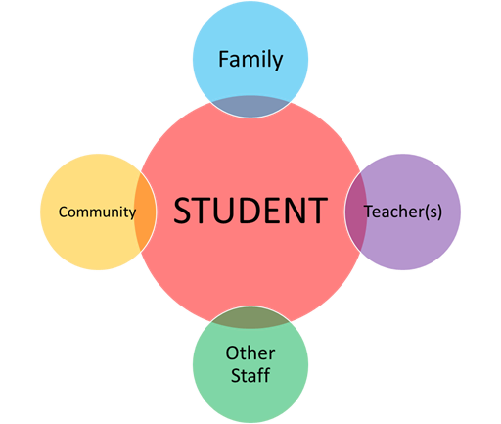
LINK to STUDENT OUTCOMES
Notes:
Reminder: “The purpose of these sessions is to not only promote parent-teacher partnerships, but to partner for student progress and better outcomes!
KEY DISCUSSIONS:
1) How have you developed TRUST with other team members to support your student(s)?
2) In all of these connections, where do you feel the district still needs to develop trust? Why?

Slide 9
LINK to CURRENT PRACTICES
Parents
Teachers
Student
General School
Activities
Special Education
Activities
Notes:
KEY DISCUSSIONS:
Facilitate group discussion and sharing of ideas in each area based on experiences and recommendations
***REMEMBER: ASK THE PARTICIPANTS TO TRY NOT TO USE SPECIFIC NAMES – AND KEEP CONVERSATIONS CONFIDENTIAL
* Keeping TRUST in mind,
What have been your experiences with specific situations of general school activities?
(examples: student-focused meetings, parent-teacher conferences, PTA, school events, state testing, etc. .) a) What are the strengths of the (grade level / building / district) in these areas?
b) What would we recommend for improving parent – teacher partnerships in these areas?
2) What have been your experiences with specific situations of special education activities? (Parent concerns / referrals, evaluations, IEP meetings)
a) What are the strengths of the (grade level / building / district) in these areas?
b) What would we recommend for improving parent – teacher partnerships in these areas?
3) What is an immediate change that you can make around TRUST that would positively impact success for your student(s)? For your partnerships?

Slide 10
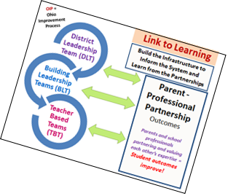
Link to Improvement:
Share Bright Ideas / Session Highlights
Complete Session Highlights form
Notes:
1. Have the group review their "bright ideas" - capture on large poster paper – then Session Highlights form
2. Decide what will be presented to district point of contact

Slide 12
The contents of this presentation were developed under a grant from the US Department of Education, #323A120002-13. However, those contents do not necessarily represent the policy of the US Department of Education, and you should not assume endorsement by the Federal Government. Project Officer, Jennifer Coffey.
Notes:
12

