Slide 1
PARENT-TEACHER PARTNERSHIPS
Respect
Commitment
Parenting
Communicating
Volunteering
Learning at Home
Decision Making
Collaborating with the Community
Equality
Trust
Advocacy
Professional Competence
Communication
Notes:
This can be your welcome slide – or add your own to personalize for district / building and session.
“This is the big picture of all the modules we will be covering in the Parent - Teacher Partnership sessions. It represents a school district / building.
The "structure" of the building, those highlighted, represent the Principles of Partnership as described by Ann Turnbull et al. through the University of Kansas and in our resource text Families, Professionals, and Exceptionality, Seventh Edition, by A. Turnbull et al, 2015 by Pearson Education, Inc.
The Titles within the school building are the Effective Strategies of Involvement developed by Joyce Epstein et al. at Johns Hopkins University and in our resource text School, Family, and Community Partnerships, Third Edition, by J. L. Epstein et al., 2009 by Corwin Press.
We will also recommend and/or develop activities from other text and web resources.”

Slide 2
Respect
Communication
Communicating
Notes:
Before we begin our session on Equality and Decision-Making, let’s review Respect and Communication.
KEY DISCUSSIONS:
What did we learn about Respect? Communication?
Has this knowledge helped you, or your student(s), since our last session? If so, how?
Co-facilitators – review what was shared with the district point of contact and how responded.
Review group rules.

Slide 3
PARENT - TEACHER PARTNERSHIPS
EQUALITY
and
DECISION-MAKING
Notes:
Welcome to the Parent-Teacher Partnership Module: Equality and Decision-Making. In this module, we will focus on Equality as a principle for creating a foundation of partnerships, and Decision-Making as an effective key strategy for involving parents and families. We will look at both of these within rules for our group sessions, for student outcomes, and for changes in our current practices.
Remember, the purpose of these sessions is to not only promote parent-teacher partnerships, but to partnership for student progress and better outcomes! So, as we go through the information and discussions, think about how we can impact student achievement with this information!
KEY DISCUSSION:
How would you define equality?
What would this look like in parent-teacher partnerships?
How might equality impact decision-making on a team?
OPTIONAL:
Ice Breaker Activity

Slide 4
EQUALITY
SHARE POWER
PROVIDE OPTIONS
FOSTER
EMPOWERMENT
4
Notes:
To finish a puzzle, each piece of the puzzle is needed and equally important. On any team involving students, each member is equally important to the ideas, decisions, and implementation to support the students.
KEY DISCUSSIONS:
Teachers – what do you do to empower families to be an equal member of their student’s team?
Parents – what do you do to share power with the educational staff supporting your student’s needs?
Who on the team makes sure that options are considered before decisions are made?
Describe a situation in which a team member was putting themselves in power and not allowing all members to contribute.
a) How did you feel?
b) What were your actions?
c) How did it influence outcomes of the situation?
5. How would respect and communication impact equality?
CONTENT NOTES:
Turnbull, et. al, gives three skills that contribute to equality on a team, or equal power to influence a student’s education:
Foster Empowerment (self / parent / family / student / staff)
= view all team members as capable of solving challenges, influencing outcomes, and participating in joint decision-making activity
2. Share Power = sharing leadership, time, talents, resources; accepting of each other’s knowledge; working together toward mutual goals
3. Provide Options = choices help make decisions
- be flexible and creative
- investigate all options
- look at research-based strategies
- use data to support
- compare what works for other team members, in what environments, for what task demands
OPTIONAL:
* Review and discuss Equality Activities document

Slide 5
DECISION-MAKING
School, Family, and Community Partnerships, by J. L. Epstein et al., 2009 by Corwin Press.
Include families as participants in school decisions and advocacy through school organizations, committees, councils, student teams, etc. . .
Framework of Six Types of Involvement
5
5
Notes:
Epstein, et. al., lists DECISION-MAKING as one of the 6 top ways to involve families with schools.
KEY DISCUSSIONS:
How are parents involved in decisions regarding their student(s)? Is this focused on student progress?
Are parents recruited for involvement in school decisions? How? Do classroom / district policies reflect parent input?
How are parents made aware of school organizations, committees, councils, etc. . .? Is this effective? How do you know?
Is the diversity of the district represented in the parents involved in decision-making activities?
Is training provided to parents who may need assistance in participation so that they are not just “represented” but actually “actively participating”?
Review DECISION-MAKING ACTIVITIES document:
What are our experiences with some of these activities?
What would we recommend to the building / district leadership?
How do the topics we’ve already discussed (respect, communication) affect decision-making in partnerships?
CONTENT NOTES:
enables families to participate in decisions about school programs that affect their own and other children
enables shared leadership on district, building, teacher projects / committees / councils
develops parent leaders
focuses on a process of partnership, not a power struggle
OPTIONAL:
* ACTIVITIES
1) Review and discuss Summary Type 5 – Decision-Making (Epstein, et. al., p. 157)
2) Complete one of the following rating scales around Decision-Making:
a) An Inventory of Present Practices of School, Family, and Community Partnerships (Epstein, et. al., p. 177)
b) Measure of School, Family, and Community Partnerships (Epstein, et. al, p. 328)
3) ARE TWO HEADS BETTER THAN ONE? (Epstein, pp. 171-172 or see document)
* VIDEO (2:06)
Parent Involvement- Be an Active Part of Decision Making https://www.youtube.com/watch?v=DKRyiYGAt80

Slide 6
Link to these Sessions
Notes:
KEY DISCUSSIONS:
Let’s review our rules for our group sessions that we developed last meeting. Is there anything we need to change or add based on what we know about equality and decision-making?
(Allow group to brainstorm and vote. Keep poster at each meeting.)

Slide 7
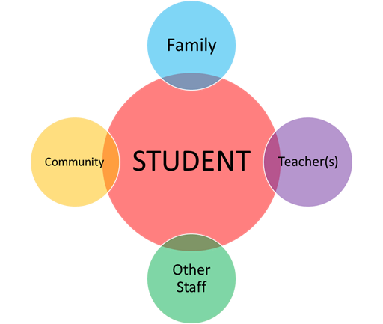
LINK to STUDENT OUTCOMES
Notes:
Reminder: “The purpose of these sessions is to not only promote parent-teacher partnerships, but to partner for student progress and better outcomes!
KEY DISCUSSIONS:
1. How do equality and decision-making link together for your student’s success?
Give an example of student success because of equality and decision-making.
Of those supporting your student’s success, where do you need to encourage more equality?

Slide 8
LINK to CURRENT PRACTICES
Parents
Teachers
Student
General School
Activities
Special Education
Activities
Notes:
KEY DISCUSSIONS:
Facilitate group discussion and sharing of ideas in each area based on experiences and recommendations
***REMEMBER: ASK THE PARTICIPANTS TO TRY NOT TO USE SPECIFIC NAMES – AND KEEP CONVERSATIONS CONFIDENTIAL
* Keeping EQUALITY and DECISION-MAKING in mind,
What have been your experiences with specific situations of general school activities?
(examples: student-focused meetings, parent-teacher conferences, PTA, school events, state testing, etc. .) a) What are the strengths of the (grade level / building / district) in these areas?
b) What would we recommend for improving parent – teacher partnerships in these areas?
What have been your experiences with specific situations of special education activities?
(Parent concerns / referrals, evaluations, IEP meetings)
a) What are the strengths of the (grade level / building / district) in these areas?
b) What would we recommend for improving parent – teacher partnerships in these areas?
What is an immediate change that you can make around EQUALITY and DECISION-MAKING that would positively impact success for your student(s)?

Slide 9
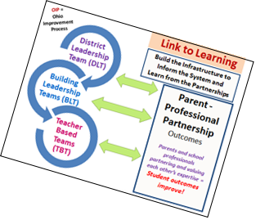
Link to Improvement:
Share Bright Ideas / Session Highlights
Complete Session Highlights form
Notes:
1. Have the group review their "bright ideas" - capture on large poster paper – then Session Highlights form
2. Decide what will be presented to district point of contact

Slide 11
The contents of this presentation were developed under a grant from the US Department of Education, #323A120002-13. However, those contents do not necessarily represent the policy of the US Department of Education, and you should not assume endorsement by the Federal Government. Project Officer, Jennifer Coffey.
Notes:
11

