Slide 1
Family Engagement Leaders of Ohio
April 16, 2024
Welcome!

Slide 2
Greetings
Please add your name, Role, and Organization to the Chat Box.
Notes:
1:00-1:04
Wesley: Greetings and Welcome to the Family Engagement Leaders of Ohio Professional Learning Community. This is a place informed by district family engagement professionals where we learn from and support each other, share resources, and partake in professional learning.
My name is Wesley Owens. I am a Senior Research Associate here at the Ohio Statewide Family Engagement Center at the Ohio State University. I’m happy to be your host and am very glad you are joining us today.
If you haven’t done so already, please say hello in the chat by sharing your name, role, and organization.
With me today is the esteemed Tom Capretta. Tom will be our moderator today- If you need any support, technical assistance, or other help you can message Tom.
Tom: Hello

Slide 3
WELCOME!
Family Engagement Leaders of Ohio (FELOs) is a virtual professional learning community for family engagement professionals in Ohio’s districts and community schools. FELOs brings professionals together to share experiences and to learn how we can build partnerships with all families in our PreK-12 education community.
Notes:
1:05- 1:06
Wesley: Every time we meet we have new leaders joining us, so we always want to take a quick moment to share who we are.
Family Engagement Leaders of Ohio (FELOs) is a virtual professional learning community for family engagement professionals in Ohio’s districts and community schools. FELOs brings professionals together to share experiences and to learn how we can build partnerships with all families in our preK – 12 education community.

Slide 4
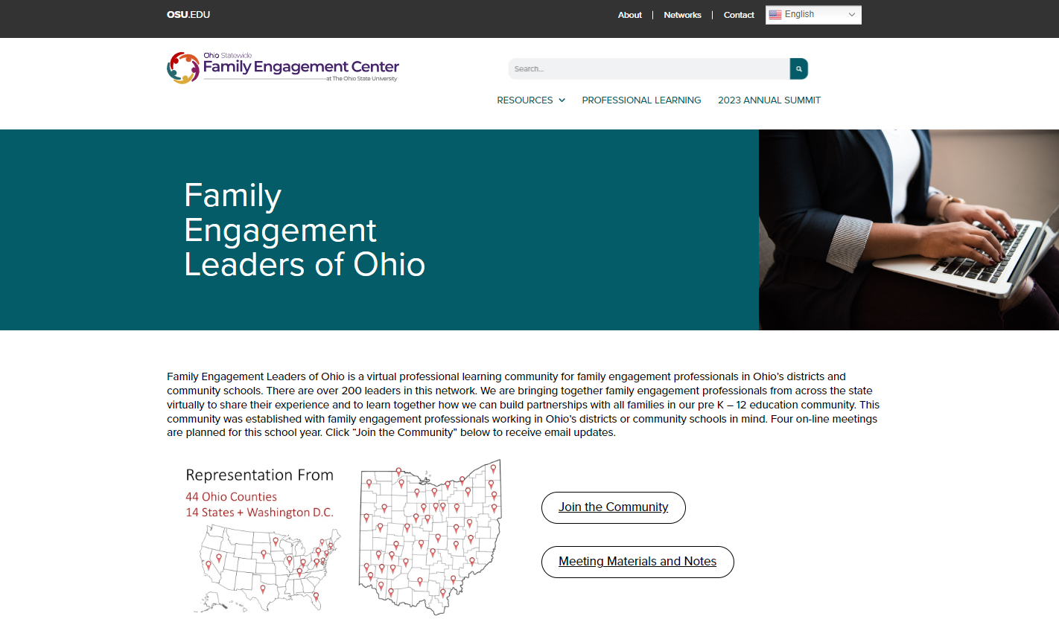
FELOs Website
Notes:
1:06- 1:10
Wesley
We would like to take a moment to show you our FELOS website. Here, you can access resources we use in our meetings, including today’s meeting.
[Demo website]

Slide 5
Objectives
1. Build a community of inquiry for family engagement
2. Identify strengths and areas of improvement of family engagement goals, including my own.
Notes:
1:10- 1:11
Wesley: Let’s read our objectives for today:
1. Build a community of inquiry for family engagement
2. Identify strengths and areas of improvement of family engagement goals, including my own.

Slide 6
Agenda
Welcome
Setting the stage for this year’s Family Engagement Leaders of Ohio Professional Learning Community
Connecting with Colleagues
District Presentations and Discussion
Debrief, exit survey, and adjourn
Notes:
1:11-1:13
Wesley:
Here is our agenda for today…
Welcome
Setting the stage for this year’s Family Engagement Leaders of Ohio Professional Learning Community
Reconnecting with Colleagues
District Presentation: Ana Martinez, Princeton City Schools
Discussion and Application
Debrief, exit survey, and adjourn
We have a jam packed agenda today, so we are going to keep things moving by connecting with each other.

Slide 7
Colleague Connection
Share with your group what you are looking forward to this summer
AND
What goal have you accomplished this year, or expect to? AND/OR
What is one thing you learned this year you will carry into next year?
Notes:
1:14-1:30
1:14-1:16
Wesley:
Last time we met we asked you to share a highlight or goal you hope to accomplish before the end of the school year? Let’s take time now to share:
What goal have you accomplished this year, or expect to? AND/OR
What is one thing you learned this year you will carry into next year?
You’ll begin, though, by sharing what you are looking forward to this summer.
The person located closest from CETE (Columbus) will go first, the next closest second, and so on. Each person has 2 minutes to share.
1:16- Open Break out rooms (1:16-1:25)
Rooms of 4
1:25-1:30
Facilitator: Is there anyone who would like to share full group?

Slide 8
Presentation
Ana Martinez
Bilingual Parent Liaison
Dawn Millhouse
Parent Mentor
Notes:
1:30-1:32
Wesley
Today we have two speakers sharing their work. First, we have Ana Martinez from Princeton City Schools, where she is a Bilingual Parent Liaison. Ana will share with us today the work she has been involved in, which includes programs such as Second Cup of Coffee, Hispanic Heritage Festival, and a Parent Academy. Welcome, Ana.
Our second speaker is Dawn Millhouse from Centerville City Schools. Dawn is a Parent Mentor and will be sharing about her school’s plan to engage families and make connections over the summer. Welcome, Dawn.
After each presents, we will have a time to engage through a discussion protocol called Praise, Question, Suggestion. In this protocol we will have a round of time to give the presenter a praise, a round to ask a question, and a round to offer a suggestion. We’re providing a note-catcher so you can record notes and thoughts while our speakers our sharing. Please download or make a copy.

Slide 9
Presentation
Ana Martinez
Bilingual Parent Liaison
Princeton City Schools- Cincinnati
Second Cup of Coffee ●Hispanic Heritage Festival ● Parent Academy
Notes:
1:32-1:40
Ana Martinez Presents
1:40-1:55
Praise, Question, Suggestions

Slide 10
Praise, Question, Suggestion
PRAISE
Notes:
1:40-1:45

Slide 11
Praise, Question, Suggestion
QUESTION
Notes:
1:45-150

Slide 12
Praise, Question, Suggestion
SUGGESTION
Notes:
1:50-1:55

Slide 13
Presentation
Dawn Millhouse
Parent Mentor
Centerville Schools
Summer Engagement
Notes:
155-2:05
Dawn Millhouse Presents
2:05-2:20
Praise Question Suggestion

Slide 14
Praise, Question, Suggestion
PRAISE
Notes:
2:05-2:10

Slide 15
Praise, Question, Suggestion
QUESTION
Notes:
2:10-2:15

Slide 16
Praise, Question, Suggestion
SUGGESTION
Notes:
2:15-2:20

Slide 17
Debrief
Praise, Question, Suggestion Protocol
What worked well?
How might we apply what we learned to other work?
Notes:
2:20-2:25 (If time)
Wesley:
Let’s debrief the protocol.
What worked well?
How might we apply what we learned to other work?

Slide 18
Celebrations
Share a highlight or success from the year!
Notes:
2:20-2:25
We want to give a bit of time to the group now to share a highlight or a success from this year. You may unmute to briefly share.

Slide 19
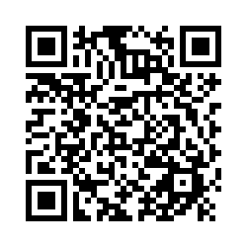
In Closure
Please take the exit survey by following this link:
https://osu.az1.qualtrics.com/jfe/form/SV_a9H48tdRutvo76S
See you next school year!
Notes:
2:25
Tom: Please take a few minutes to complete this exit survey during this time. We want to give you the time now to do that.
Drop in chat: https://osu.az1.qualtrics.com/jfe/form/SV_a9H48tdRutvo76S
We also want to invite you back to our next meeting on February 6th. Mark that on your calendars now. We look forward to seeing you then.

Slide 20
OhioSFEC@osu.edu
@OhioEngage
Ohiofamiliesengage.osu.edu
Notes:
Close
We really thank you for joining us today. If you have any questions you’d like to ask of us, please don’t hesitate to send us an email. You can also follow us on X/twitter to learn more about our current work. Finally, our website is a treasure trove of family engagement resources for schools and families, including projects in family engagement for early literacy, family engagement at the middle school years, engaging grandparent caregivers, and more. Sign up for our monthly News & Guidance to stay up to date with research based family engagement practices and to hear news from our center.
(post links in chat:
https://ohiofamiliesengage.osu.edu/
https://ohiofamiliesengage.osu.edu/newsletters-2/
https://ohiofamiliesengage.osu.edu/researchbriefs/

